Slide 1
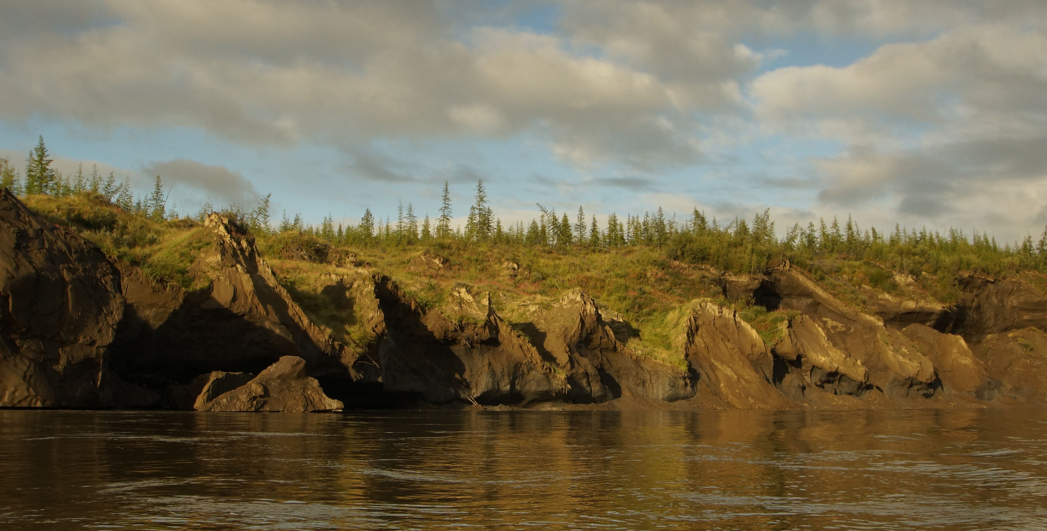
Permafrost Action Team
Activity Report
Dr. Ted Schuur
Dr. Christina Schädel
Northern Arizona University
May 25, 2016

Slide 2


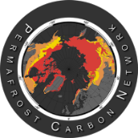
SEARCH
(Study of Environmental Arctic Change)
Sea Ice Action Team
Land Ice Action Team
Permafrost Action Team
Document and Understand How Degradation of Near-Surface Permafrost Will Affect Arctic and Global Systems USING SYNTHESIS SCIENCE
Infra
structure
Fish,
Wildlife
Notes:
Asked to explain the structure of the Permafrost Action Team in relation to SEARCH and the Permafrost Carbon Network

Slide 3
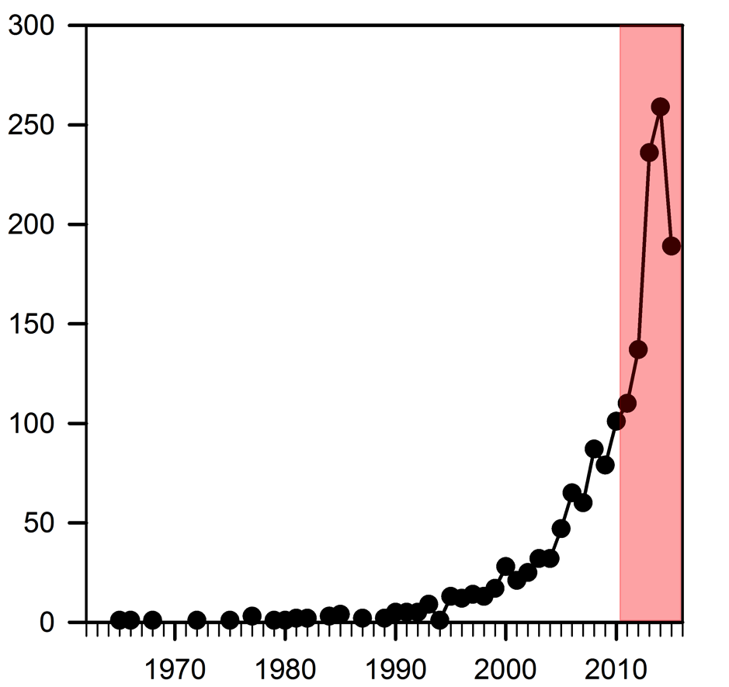
Permafrost Carbon Published Literature
Search Terms in Science Citation Index at Web of Science (ISI)
Permafrost and Carbon in Full Text
2000–present: 91%
2005–present: 80%
2010–present: 55%
Number of Publications
Network Goal: Use synthesis science to integrate knowledge ‘under the curve’ and distill findings for decision makers
and public
Year
Myers and Schädel 2015

Slide 4
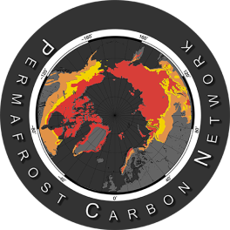
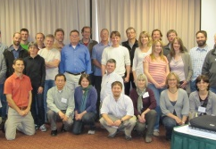
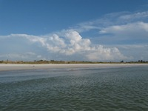
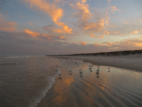
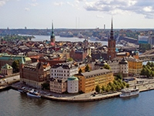
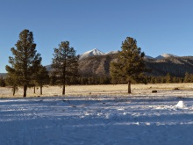
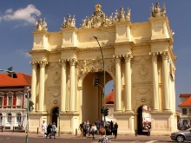
Bonanza Creek LTER Annual Meeting, Fairbanks, AK
NACP, Albuquerque, NM
EGU, Vienna, Austria
DOE Terrestrial Ecosystem Sciences, Washington, DC
Climate Science & Policy, Washington, DC
Center for Permafrost SG, Copenhagen, Denmark
Cryosphere in a Changing Climate, Tromsø, Norway
NACP, Washington, DC
Climate in Cryosphere, Boulder ,CO
ASSW 2015, Toyama, Japan
GCP SSC meeting, Oslo, Norway
Our Common Future, Paris, France
IARPC, online
GEOQuébec, Québec City, Canada
AGU, San Francisco, CA
Arctic Encounter, Seattle, WA
DGP, Hamburg, Germany
CliC forum, Copenhagen, Denmark
Soil Carbon Vulnerability, Boulder, CO
ASSW, Fairbanks, AK
ARCUS, Washington, DC
Powell Center, USGS, Ft Collins
NRC Polar Research Board, Washington, DC
IARPC 1, Washington, DC
CliC SSG, Geneva, Switzerland
Carbon Cycle Science SG, Washington, DC
CAPP Meeting, Stockholm, Sweden
SEARCH, Boulder, CO
IARPC 2, Washington, DC
PAGE 21
NGEE Arctic, San Francisco, CA
EGU, Vienna, Austria
Carbon Cycle Science SG, Washington, DC
TICOP, Salekhard, Russia
ESA, Portland, OR
US-UK Arctic Workshop, Cambridge, UK
AGU, San Francisco, CA
2011
2012
2013
2014
2015
2016 -
1st Annual Meeting, AGU
2nd Annual Meeting, AGU
3rd Annual Meeting, AGU
4th Annual Meeting, AGU
5th Annual Meeting, AGU
Kick-off
meeting, Seattle
Lead meeting, Florida
Lead meeting, Florida
Lead meeting,
Stockholm
Lead meeting, Flagstaff
Lead meeting, Potsdam

Slide 5
Biomass offsets little or none of permafrost carbon release from soils, streams, and wildfire: an expert assessment. Abbott et al. 2016 ERL
Climate-sensitive northern lakes and ponds are critical components of methane release. Wik et al., 2016 Nature Geoscience
Changing permafrost in a warming world and feedbacks to the Earth system. Grosse G et al. 2016, ERL
Potential carbon emissions dominated by carbon dioxide from thawed permafrost soils. Schädel et al. Nature Climate Change, in press
Thermokarst terrain: circumpolar distribution and soil carbon vulnerability. Olefeldt et al., Nature Communications, in revision
A model-based analysis of the vulnerability of carbon in the permafrost region between 1960 and 2009, McGuire et al., Global Biogeochemical Cycles, in revision
Deep Yedoma permafrost: A synthesis of depositional characteristics and carbon vulnerability, Strauss et al., to be submitted to Scientific Advances
Science Advances 2016
2015
2016
A pan-Arctic synthesis of CH₄ and CO₂ production from anoxic soil incubations. Treat et al. GCB 2015
Climate Change and the Permafrost Carbon Feedback. Schuur et al. Nature 2015
Assessment of model estimates of land-atmosphere CO₂ exchange across Northern Eurasia. Rawlins et al. 2015 Biogeosciences
Permafrost thaw and resulting soil moisture changes regulate projected high-latitude CO₂ and CH₄ emissions. Lawrence et al. 2015, ERL
Permafrost soils and carbon cycling, Ping et al. 2015 Soil
A simplified, data-constrained approach to estimate the permafrost carbon–climate feedback. Koven et al. 2015, Proc. Royal Soc.
Effects of permafrost thaw on Arctic aquatic ecosystems. Vonk et al. 2015, Biogeosciences
more at: www.permafrostcarbon.org/publications

Slide 6
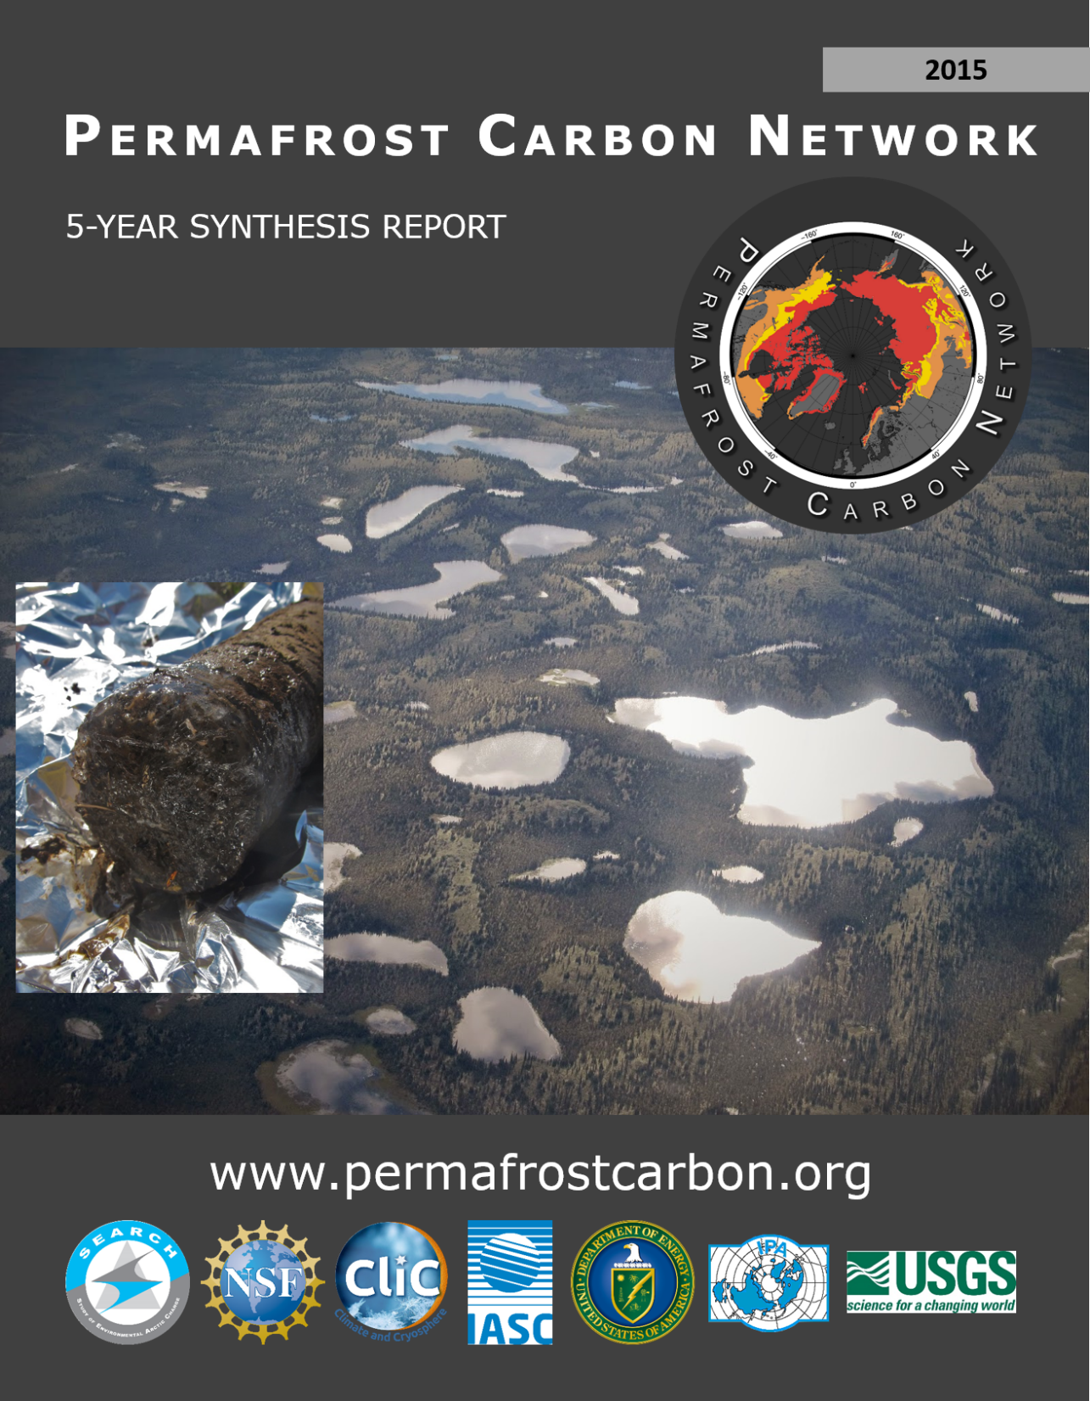
Schädel & Schuur 2015

Slide 7


Permafrost Carbon Network AGU Events 2015
Session: Vulnerability of Permafrost Carbon to Climate Change
Session Chairs: Christina Schädel, Ted Schuur, Cristian Estep Aragones
3 oral sessions, 1 poster session
Special Session Thursday: Panel Session
Chip Miller, Vladimir Romanovsky, Ted Schuur, Merritt Turetsky, Stan Wullschleger
Hosted Happy Hour: @ Palio, 640 Sacramento Street
Permafrost Carbon Network + Bolin Centre for Climate Research
Appetizers and drinks (first 50 on the house)

Slide 8
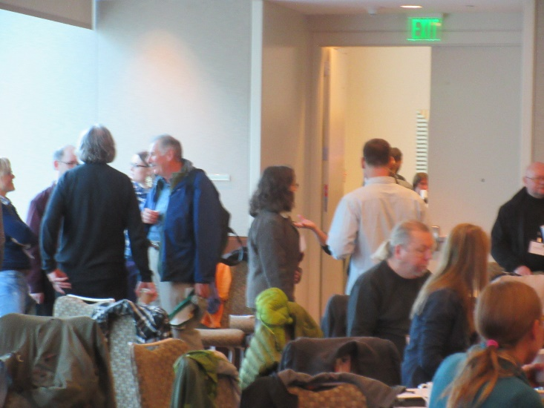

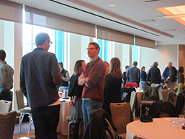
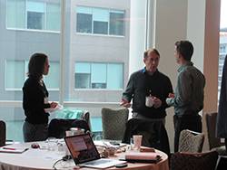
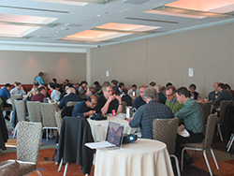
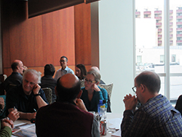
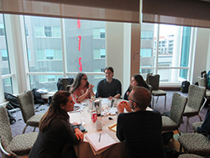
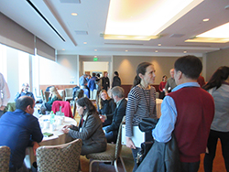
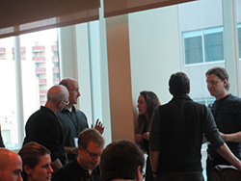
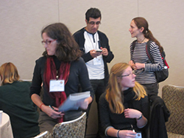



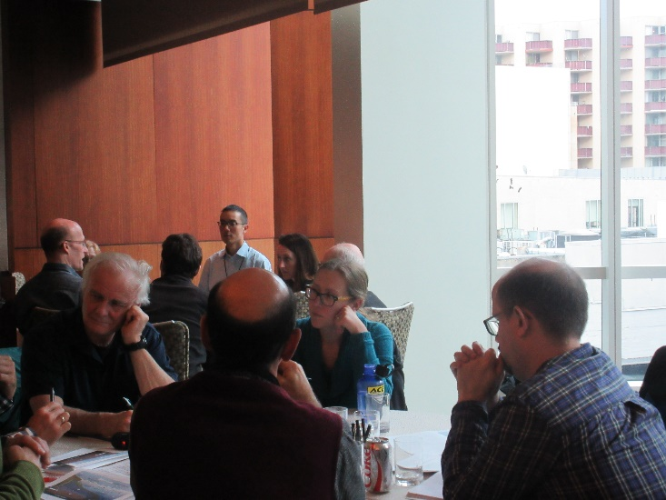
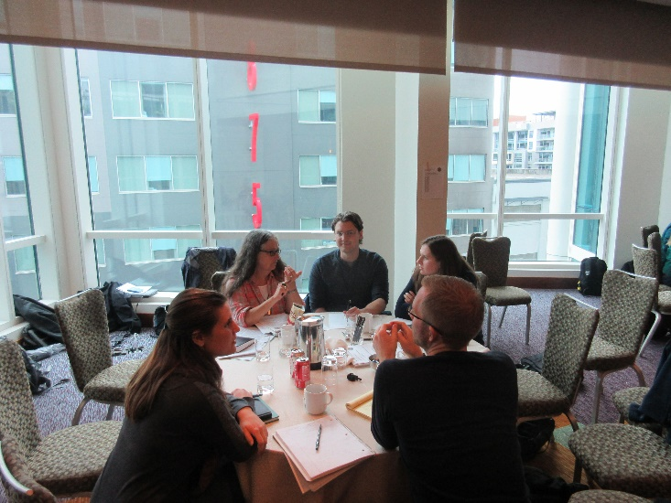



120 Participants

Slide 9
New syntheses in progress:
Reconciling permafrost region methane budgets: a) onshore; b) coastal; c) atmospheric
Lead: Dave McGuire, Jennifer Frederick, Robie McDonald
Quantifying relationships between vegetation structure and permafrost thermal dynamics
Lead: Mike Loranty, Heather Kropp, Sue Natali
Where and when will the Arctic become wetter or drier?
Lead: Christian Andresen, Cathy Wilson
Carbon emissions from the Arctic during the non-growing season
Lead: Sue Natali
Strategizing a comprehensive laboratory protocol to determine the decomposability of soil organic matter in permafrost
Lead: Christina Schädel
Dissolved organic matter composition in waters draining permafrost landscapes
Lead: Jon O’Donnell

Slide 10
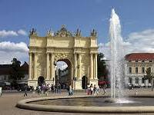
Lead Meeting Potsdam
Participant List
Name | Affiliation
Abbott, Ben | Université de Rennes, France
Andresen, Christian | Los Alamos National Lab, USA
Epstein, Howard | University of Virginia, USA
Frederick, Jennifer | Sandia National Lab, USA
Grosse, Guido | Alfred Wegener Institute, Germany
Hayes, Dan | University of Maine, USA
Hugelius, Gustaf | Stockholm University, Sweden
Kuhry, Peter | Stockholm University, Sweden
Loranty, Mike | Colgate University, USA
McGuire, Dave | University of Alaska Fairbanks, USA
Miller, Chip | Jet Propulsion Laboratory, USA
Muster, Sina | Alfred Wegener Institute, Germany
O’Donnell, Jon | National Park Service, USA
Romanovsky, Vladimir | University of Alaska Fairbanks, USA
Sannel, Britta | Stockholm University, Sweden
Schädel, Christina | Northern Arizona University, USA
Schuur, Ted | Northern Arizona University, USA
Sjöberg, Ylva | Stockholm University, Sweden
Strauss, Jens | Alfred Wegener Institute, Germany
Treat, Claire | USGS, USA
Wilson, Cathy | Los Alamos Laboratory, USA
Yang, Yuanhe | Chinese Academy of Sciences, China
Working group lead/co-lead meeting of the Permafrost Carbon Network, June 18-19, 2016

Slide 11
Permafrost Action Team
Network Development
Active Science and Action Steering Committee:
  *Cathy Wilson (DOE Los Alamos National Lab, NGEE Arctic)
  *Erik Kasischke (NASA, ABoVE)
  *Dave McGuire (UAF/USGS, PCN)
  *Vladimir Romanovsky (UAF, GTN-P)
  *Kevin Bjella (CRREL)
  *Toni Lewkowicz (U Ottawa, IPA)
  *Merritt Turetsky (U Guelph, PCN)
  *Dave Schirokauer (Denali NPS)
  *Michelle Walvoord (USGS Denver)
  *Scott Rupp (UAF, SNAP, Alaska Climate Center)
  Quarterly conference calls in progress (started March 2016)

Slide 12
Permafrost Action Team
Science synthesis pitches
How does permafrost thaw, and in particular, thermokarst disturbance affect habitats for fish and wildlife species? (couple models of land cover change with occupancy models of fish and wildlife species)
Improve our understanding of a potential hydrologic transition in response to permafrost thaw (Transition of surface water dominated to groundwater dominated hydrology resulting from permafrost thaw, using stream flow records)
What technology, methods, or discovery is needed to advance standoff detection of the ground ice condition? (Improve advanced standoff ground ice detection capabilities)
How is carbon involved in the redox chemistry of key contaminants and how is coupled element cycles likely to respond to permafrost thaw in various environments? (Review of coupled cycling of carbon and contaminants in permafrost soils)
How can we estimate the cumulative effect of northern infrastructure development and climate change?

Slide 13

Permafrost Action Team
Network Development
Synthesis Postdoctoral Researcher
Funded by USGS Climate Science Center for 2 years (Steve Gray).
Based at UA Fairbanks / IARC.
Focused on Permafrost Impacts on:
Theme 2 Infrastructure, or
Theme 3 Fish/Wildlife/Ecosystem Services.
Works with McGuire, Schuur, Eicken, others TBD
Application review starts June 30 and position will
remain open until filled.

Slide 14


Network: Synthesis Science
Upcoming Hosted Workshops:
Synthesis Lead Workshop. Held in conjunction with XI. International Conference of Permafrost (ICOP), Potsdam, Germany (June 18-19, 2016). This smaller workshop brings lead/ co-lead scientists of synthesis products together for cross-cutting opportunities.
Methane Synthesis Workshop. (November 2016, Seattle, WA) [Potential opportunities here to cross cut with sea-ice via subsea methane / interest from FAMOS group]. This workshop will focus in more detail on four methane synthesis products outlined at Open Science PCN meeting.
Permafrost Action Team kick-off meeting: Fall 2016 or Early 2017
Upcoming Organized Sessions:
XI. International Conference on Permafrost 2016, Potsdam, Germany
Climate Change and the Permafrost Carbon Feedback: Past, Present and Future (78 abstracts)
American Geophysical Union 2016, San Francisco, CA
Vulnerability of Permafrost Carbon to Climate Change
Science Networking:
Arctic Science Summit Week. Fairbanks, AK 2016. Permafrost Action Team White Paper.
IASOA Flux Synthesis. Workshop planned November 2016.
Climate in Cryosphere (CliC) (WMO): Permafrost Modeling Forum / Permafrost Carbon Model Intercomparison Project

Slide 15
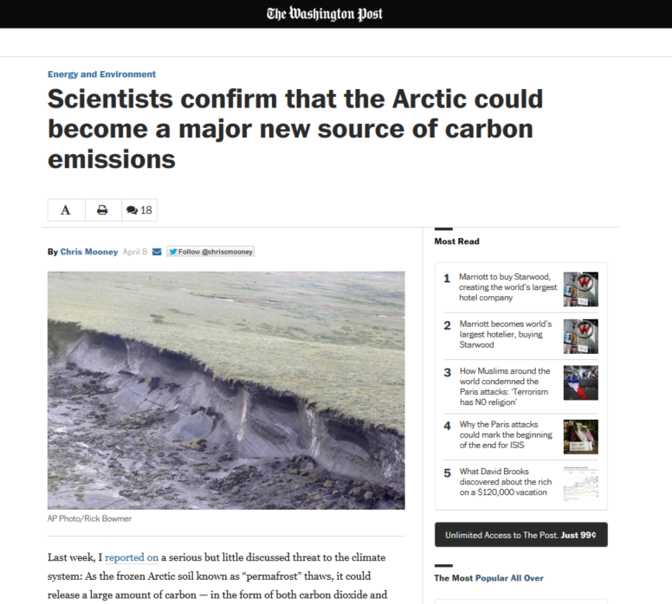
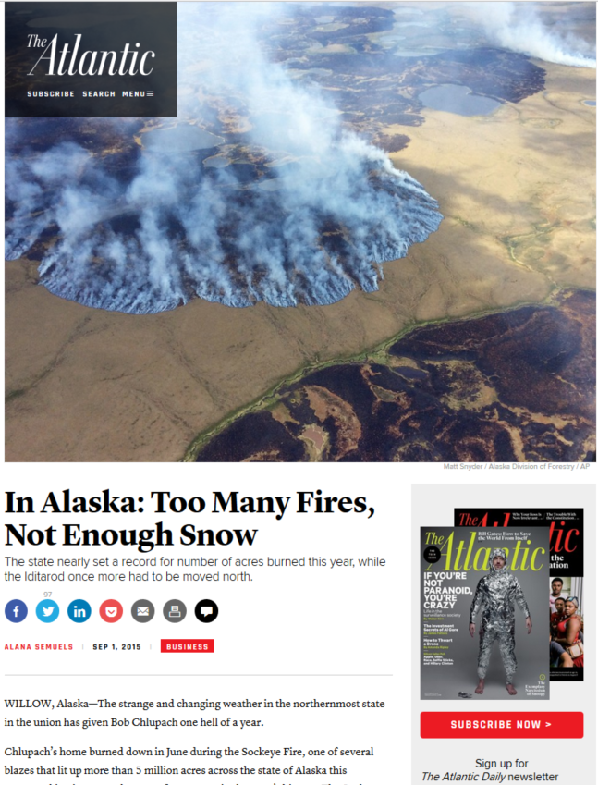
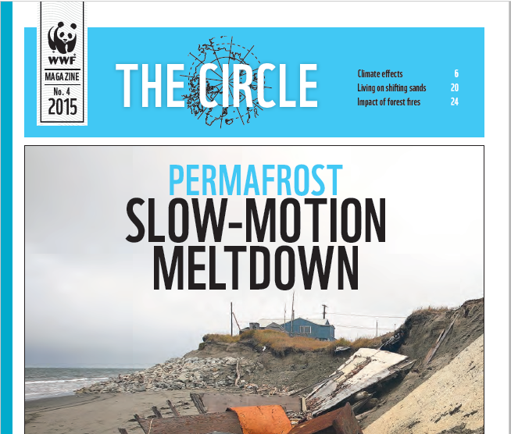
Public Outreach Activities
Press Releases:
Climate Change and the Permafrost Carbon Feedback: 71 news articles published (4pm 4/10/2015)
A Simplified, Data-Constrained Approach to Estimate the Permafrost Carbon-Climate Feedback: 6 news articles published
Potential Carbon Emissions from Permafrost Dominated by Carbon Dioxide Climate Feedback: NAU Press release June 2016
Interviews:
Alaska Fire Season 2015:
Atlantic Magazine. In Alaska, Too Many Fires, Not Enough Snow. Sept 2015
National Public Radio. Beneath Alaskan Wildfires, A Hidden Threat: Long-Frozen Carbon’s Thaw. July 2015
Washington Post. Alaska’s Terrifying Wildfire Season and What it Says About Climate Change. July 2015
BBC. Permafrost Warming in Parts of Alaska ‘Is Accelerating’. Oct 2015
Washington Post. Even For Fast Melting Arctic, 2016 Is In Uncharted Territory. May 2016
Authored Public Articles:
World Wildlife Foundation. The Circle. Permafrost Carbon and Climate Change. Oct 2015.
The CarbonBrief: What the latest science says about thawing permafrost. April 2015
Scientific American: Permafrost Carbon and Climate Change, October 2016

Slide 16
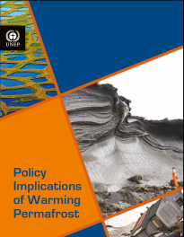
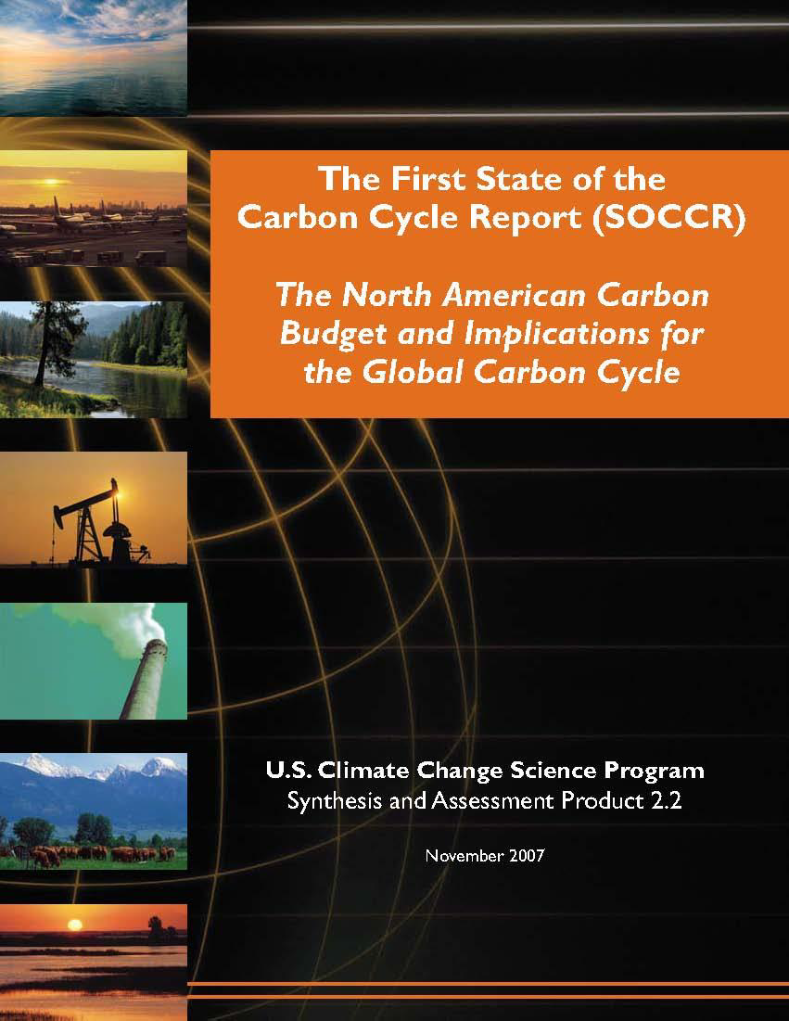
Decision Maker Support
National & International Synthesis Science Reports:
Snow, Ice, Water, and Permafrost in the Arctic (SWIPA)
Arctic Monitoring and Assessment Program, Arctic Council
Second State of the Carbon Cycle Report (SOCCR2)
Carbon Cycle Science Interagency Working Group/USGCRP
Briefing Reports & Presentations:
International Permafrost Association. 2015.
SEARCH and the Permafrost Carbon Network
National Academies Polar Research Board. 2015.
Rapid Change at the Poles.
Interagency Arctic Research Policy Committee. 2015.
Permafrost Carbon Research Coordination Network Progress on Milestone 3.2.3.
Arctic Encounters. 2016. Permafrost in a Changing Arctic
ARCUS Arctic Research Seminar Series. 2016.
Regional and Global Implications of Changing Permafrost
Other Decision Maker Support:
Materials provided to USGCRP and State Department in Advance of President Obama’s presentation at the GLACIER conference. August 2015. https://www.whitehouse.gov/2015-alaska-trip?sid=123
Arctic Science Ministerial – Agency Call: A Science Synthesis Network for Understanding and Communicating Local and Global Impacts of Permafrost Change. February 2016

Slide 17
Permafrost Action Team: Budget Update
1. Budget to Actual Report (Total SEARCH Action Team Expenses to Date)
Expense Report for: __Year 1.5__________ Expenditures as of: report generated 2/29/16
Item | Original Budget | Expended | Remaining | Explanation (e.g., what major tasks were supported, if there is a variance from original plan)
Personnel/Staffing | 111,745 | 97,375 | 14,369 ($0 end of Y1.5)
Meeting/Workshop Support | 91,411 | 88,491 | 2,919 | (this is all non-personnel costs including IDC
2. Non-Budgeted Financials
Non-NSF financial contributions:
CHF4,300 from WCRP Climate in Cryosphere Program for 2016 workshop support (to be held in conjunction with XI International Conference on Permafrost).
In-kind travel support by USGS, DOE, and various European Union Agencies.
USGS Climate Science Center is providing 2-year funding for a synthesis science postdoctoral researcher to work as part of the Permafrost Action Team (UAF Based)
Non-budgeted expenses:
Christina Schädel; Promotion to Research Assistant Professor, Northern Arizona U

