Slide 1
Understanding and Predicting Arctic Land-ice Loss and its impacts
Fiamma Straneo (WHOI), Ted Scambos (NSIDC)
Greenland Ice Sheet
(6.5 m SLR)
Arctic Ice Caps/Glaciers
(0.35 m SLR)
Current discharge
1200 Gt/yr
(+30% 1960-1990)
Current discharge
226 Gt/yr
(+50% 1960-1990)
Bamber et al 2012; Enderlin et al 2014; Dyurgerov et al 2010; Gardner et al 2013

Slide 2
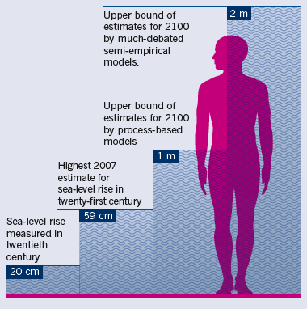
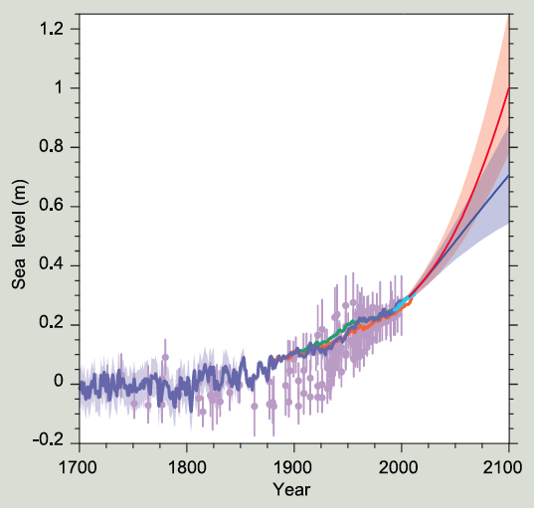
Consequences: #1 Sea Level Rise Greenland ~1/4 SLR
Shepherd et al. 2012; IPCC 2013; Scientific American, 2013

Slide 3
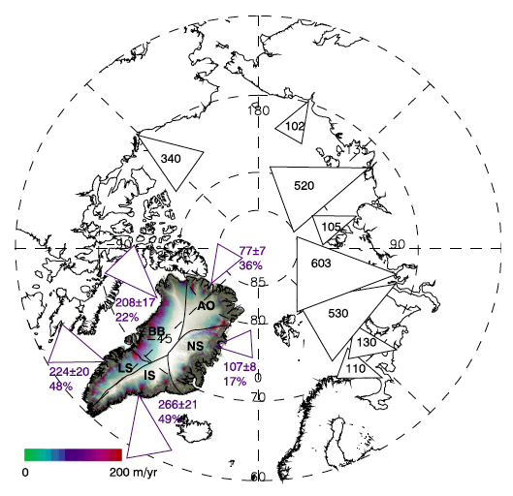
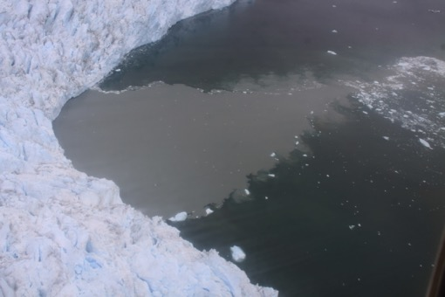
Consequences #2 Increased discharge
Freshwater discharge
into the North Atlantic
Material properties – iron, organic carbon …
Impact on dense water formation, AMOC, sea-ice
Ecosystems – stratification, nutrients
Bamber et al. 2012; Juul-Pedersen, 2015; Bhatia et al. 2013; Hood et al. 2015

Slide 4
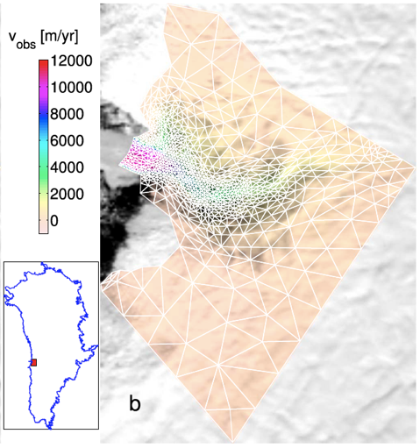
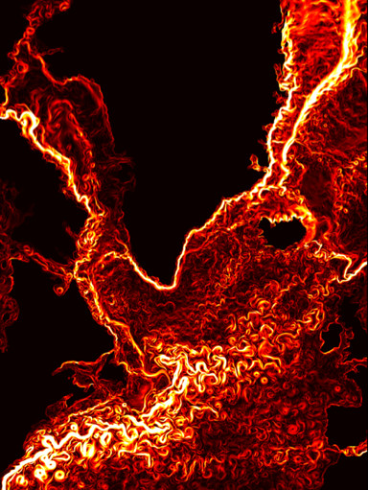
How do we predict future ice sheet changes and
their impact on the ocean ?
Wire ice sheet and ocean models
The challenges:
Limited understanding of glacier/ocean interaction
No data to inform understanding and models
Complex, multidisciplinary problem (oceanography, glaciology, climatology, paleo, atmospheric science, observationalists and modelers).

Slide 5
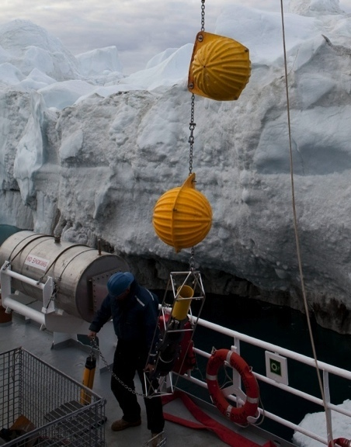
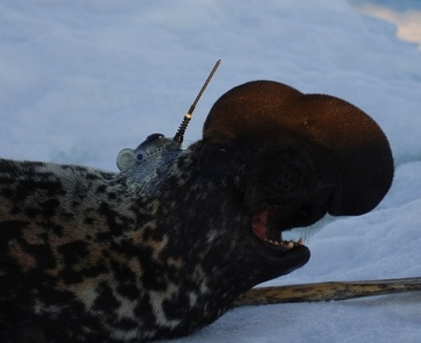
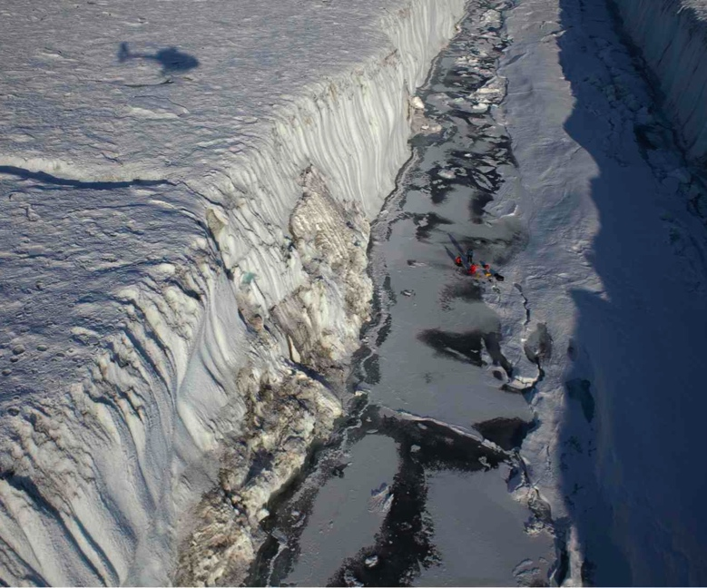
Primary SEARCH Land Ice Action Team Activity years 1,2
Greenland Ice/Ocean Observing System (GrIOOS)
Long-term glaciological, oceanographic, and atmospheric measurements at key sites around Greenland.
Understand time-evolving relationships between the ocean/glacier/atmosphere
Provide data to validate and force models.

Slide 6
Why SEARCH ?
Improved predictions required a coordinated effort that is beyond what a single individual, group, nation can achieve.
GrIOOS requires an effort that spans across
International boundaries
Disciplines
Methodology (from field to climate models)

Slide 7
Workshop: Greenland Ice Sheet-Ocean Observing System (GrIOOS)
December 13-14,
Fort Mason, San Francisco

Slide 8
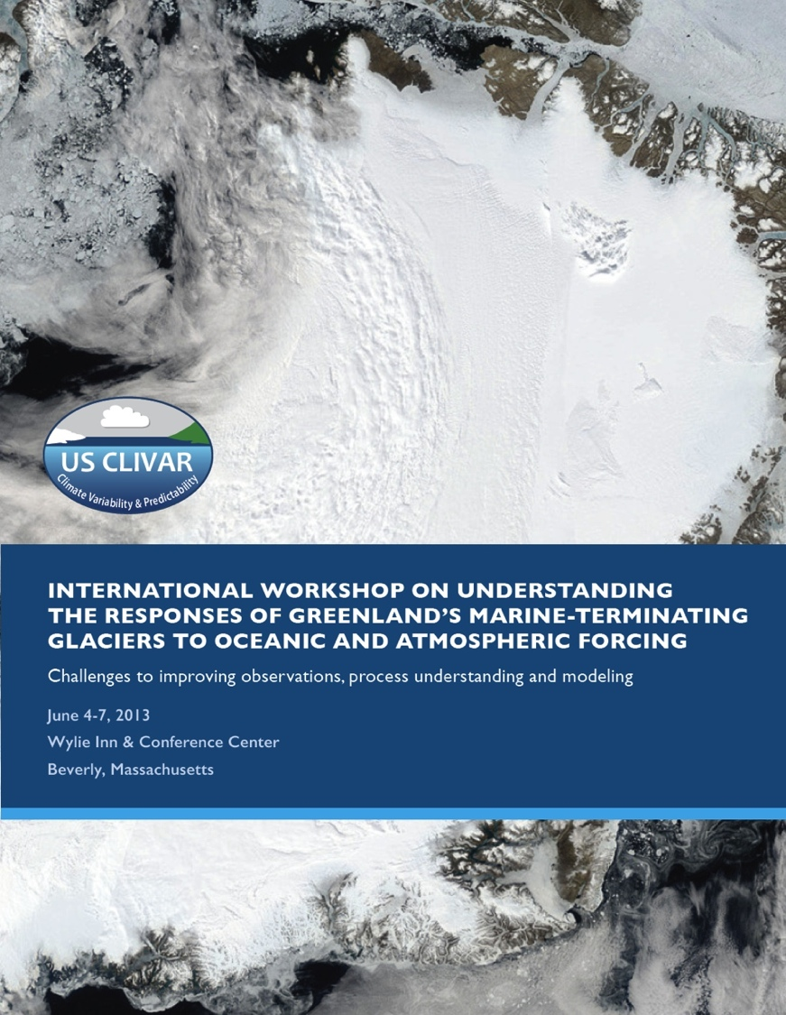
Heimbach et al. 2014
GrIOOS: a priority for Greenland Ice Sheet-Ocean Interactions
International Workshop on Greenland Ice/Ocean 2013
One of four top priorities:
Establishment of long-term glaciological, oceanic and atmospheric measurements to improve our understanding of, and ability to predict, Greenland Ice Sheet changes and their relation to the ocean, including the marine ecosystem, and the atmosphere.

Slide 9
GrIOOS Workshop: Discuss the design and implementation of a Greenland Ice Sheet Ocean Observing System (GrIOOS)
Long-term time series of critical in situ glaciological, oceanographic and atmospheric parameters at several key locations around Greenland.
Workshop Statistics:
~50 attendees from 7 countries selected by steering committee based on expressions of interests (oceanographers, glaciologists, climate modelers, ice sheet modelers, marine biologists, 1/3 early career)
NASA and NSF Program Managers
Greenlandic scientists and government representative
Joint Session and co-located with the Ice Sheet Modeling Intercomparison Project 6

Slide 10
Outcome of Workshop
List of essential variables to be measured
Prioritized list of sites to cover a variety of glacier/fjord parameters, ocean and atmospheric sectors
Integration with existing networks
Cost assesment
Identified international partnerships with shared data policies, uniform quality control protocols, minimum set of measurements.

Slide 11
Workshop Format
Background
Why an observing system ? (ocean forcing glacier, glaciers forcing ocean, impact on ecosystems, ice and ocean modeling needs)
What have we learned ? (Review of 12 glacier/fjord projects)
What measurements are already in place ? (in situ, remote sensing, mixed)
Measurement Techniques (Review of ocean, ice, atmospheric instrumentation, costs and feasibility)

Slide 12
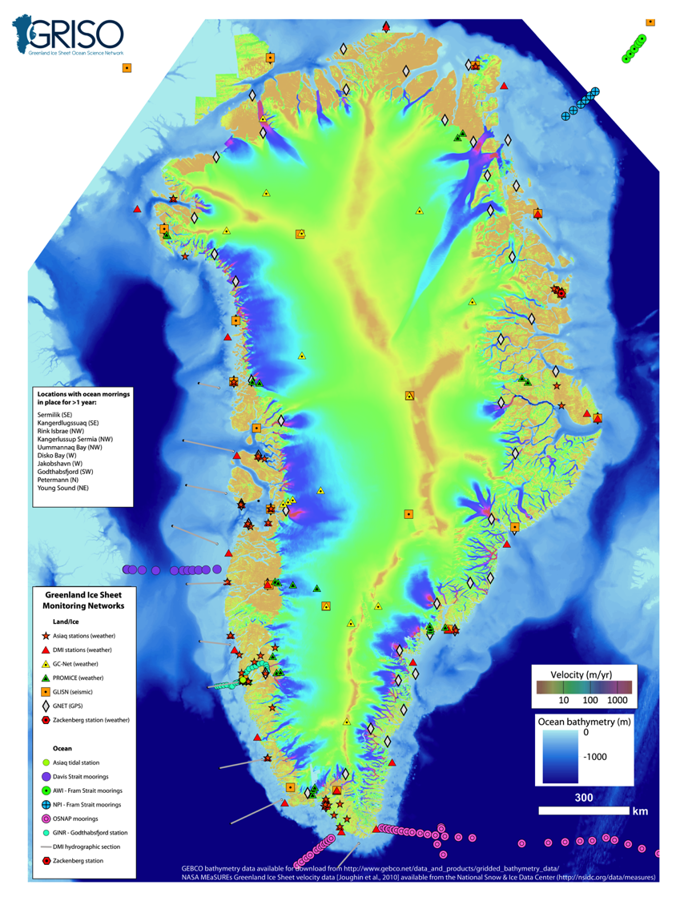
Existing networks

Slide 13
Workshop Format
Discussion
Brainstorming within three groups addressing:
What are the essential measurements (frequency, resolution)
What is already in place and can be synthesized easily?
Which sites and how many ?
Instrumentation and costs
Strategy for coordination, data policies and quality control
Final Group Discussion for synthesis

Slide 14
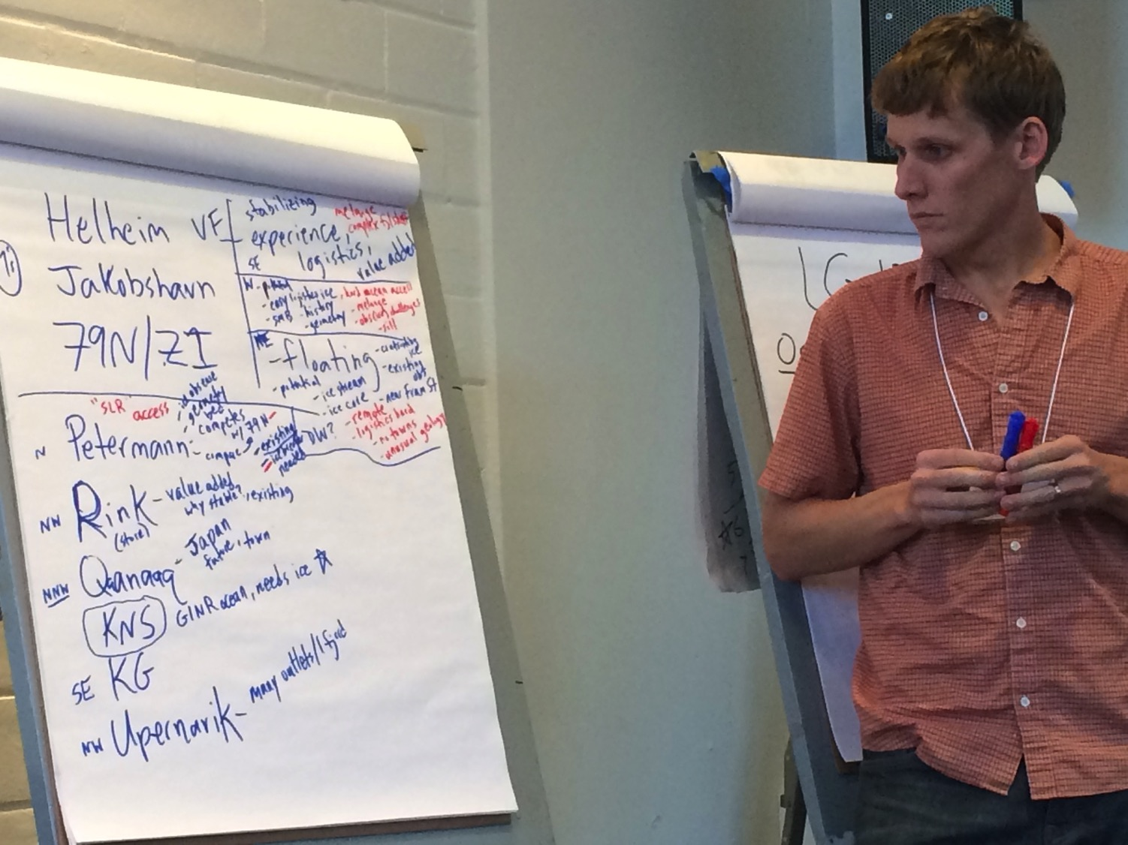

Slide 15
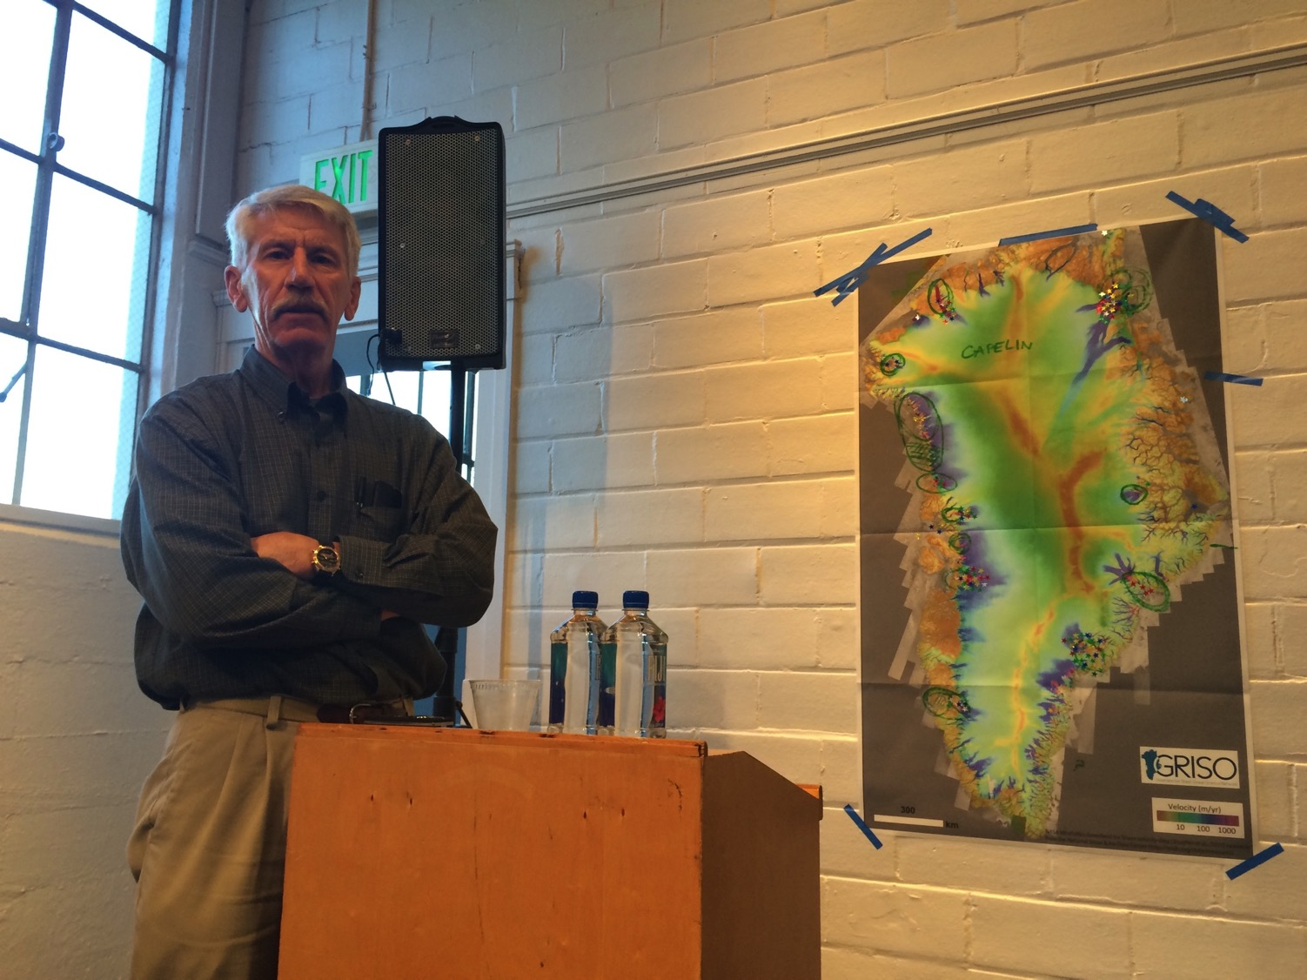

Slide 16
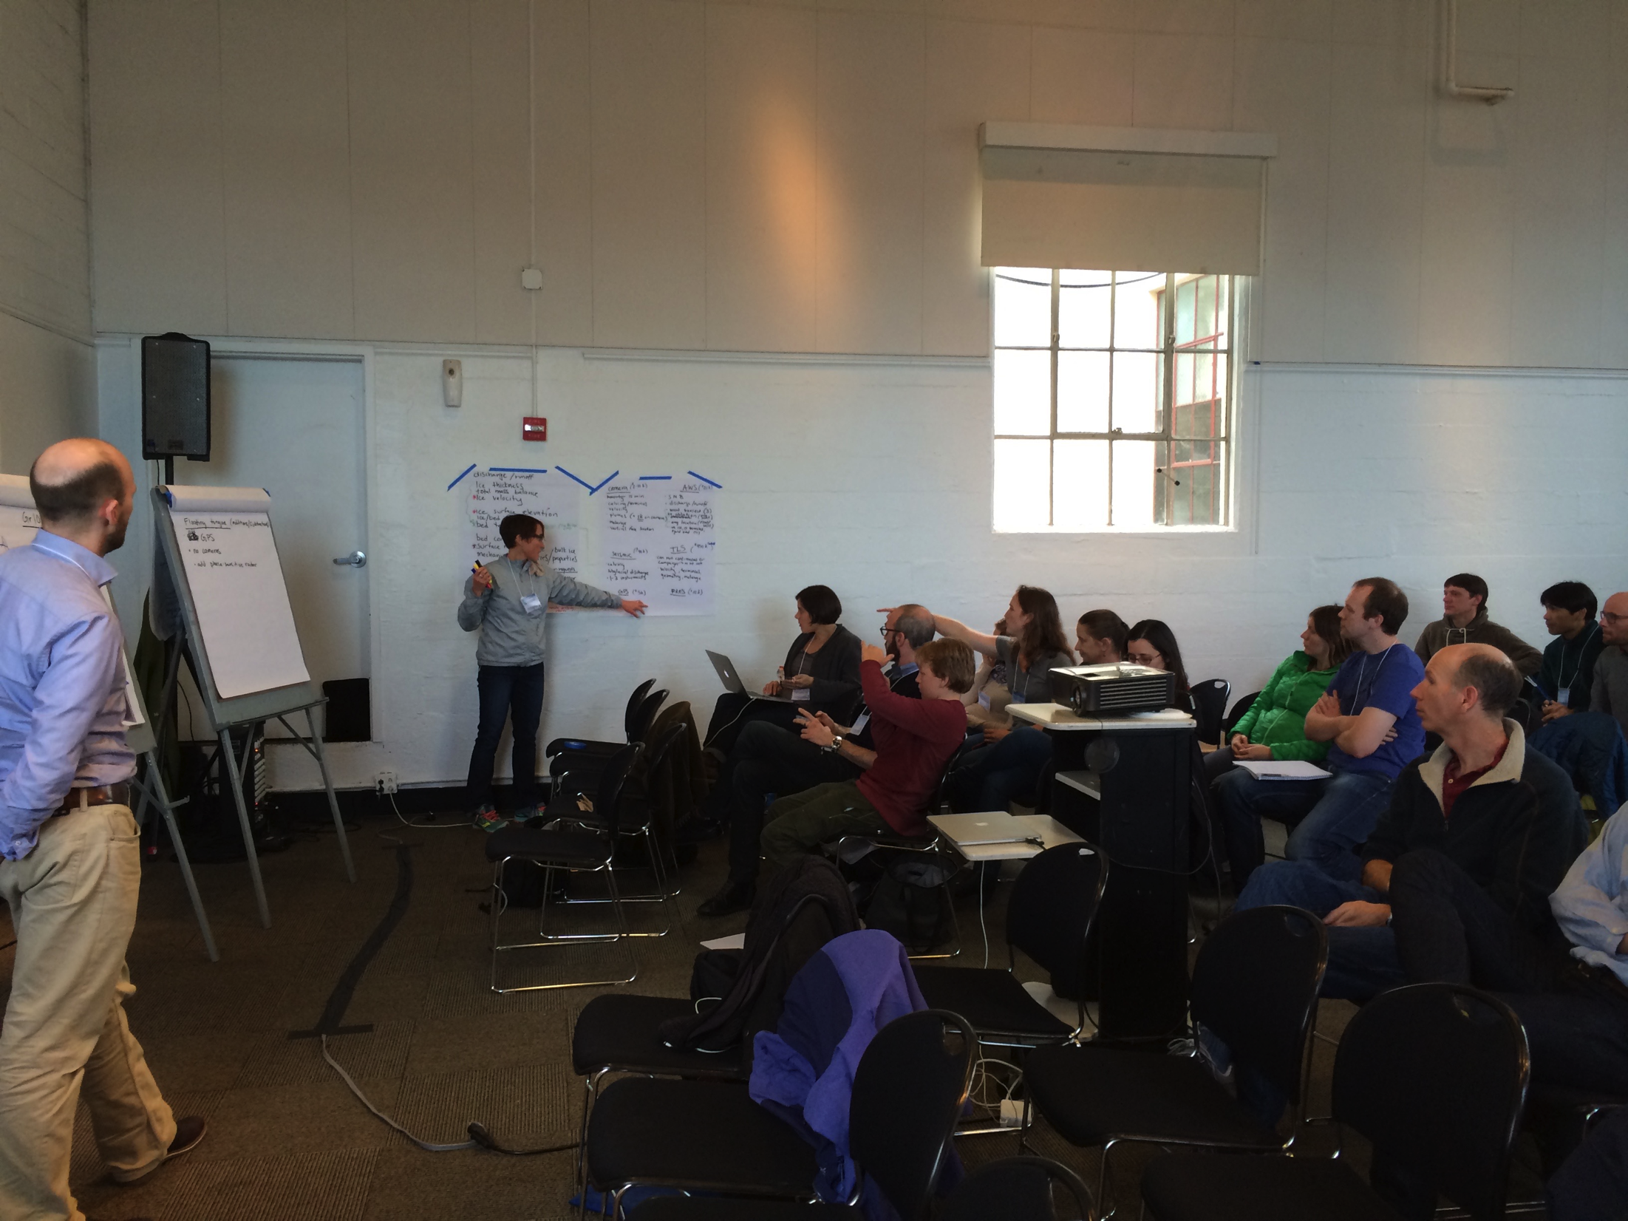

Slide 17
Preliminary Workshop Results
Essential measurements
Ocean: Temperature, salinity, pressure in the fjord and nearby shelf. Bathymetry is also a needed input.
Ice: Discharge runoff, ice velocity, ice elevation, surface mass balance, mélange, calving and terminus position.
Atmosphere: local winds and air temperature in the fjord, regional atmospheric forcing of the ocean and ice.
What is already in place and can be synthesized easily?
Many of the essential measurements can be derived from remote sensing products, existing atmospheric stations.
Notable exceptions are the fjord/shelf ocean measurements, fjord atmospheric conditions and high-resolution glaciological frontal parameters.
Which sites and how many ?
Instrumentation and costs
Strategy for coordination, data policies and quality control
Final Group Discussion for synthesis

Slide 18
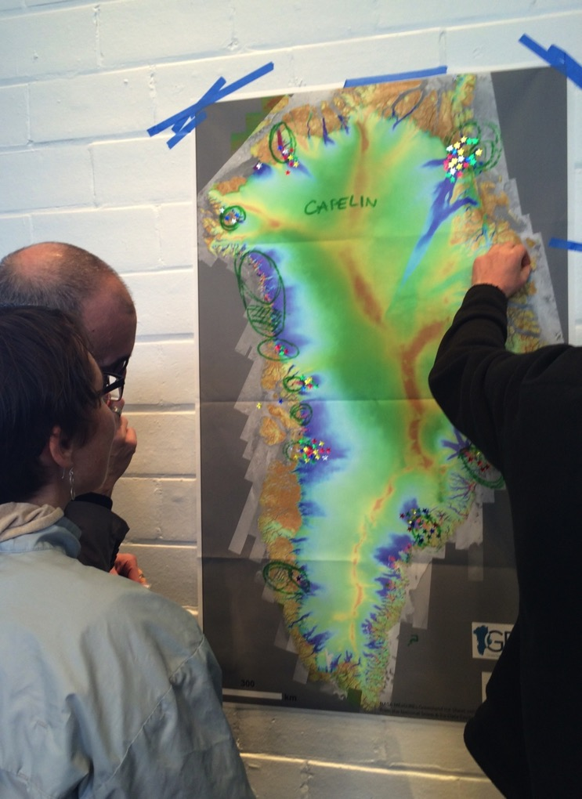
Site selection –
many sites are already being effectively monitored (some by international partners)
Ranking by Vote:
Helheim/Sermilik
NEGIS (79 North)
Jakobshavn
Petermann
Godthabsfjord
Rink
Upernavik
Kangerdlugssuaq
Qanaaq (Bowdoin)

Slide 19
Instrumentation
Ocean: Moorings ($100-200 k); Pressure-inverted echosounders (PIES, $35 k); Tagged Seals (for some sites)
Ice: cameras (15 min repeat interval) with infrared capability ($2-10k), seismic (1-3) for calving and subglacial discharge ($40k), GPS ($5k), Phase-sensitive radio echo sounding (pRES) ($10k).
Atmosphere: Automated Weather Station (AWS, $20k) – 3 potentially one the ice (~1000m), at the terminus and at the fjord mouth.

Slide 20
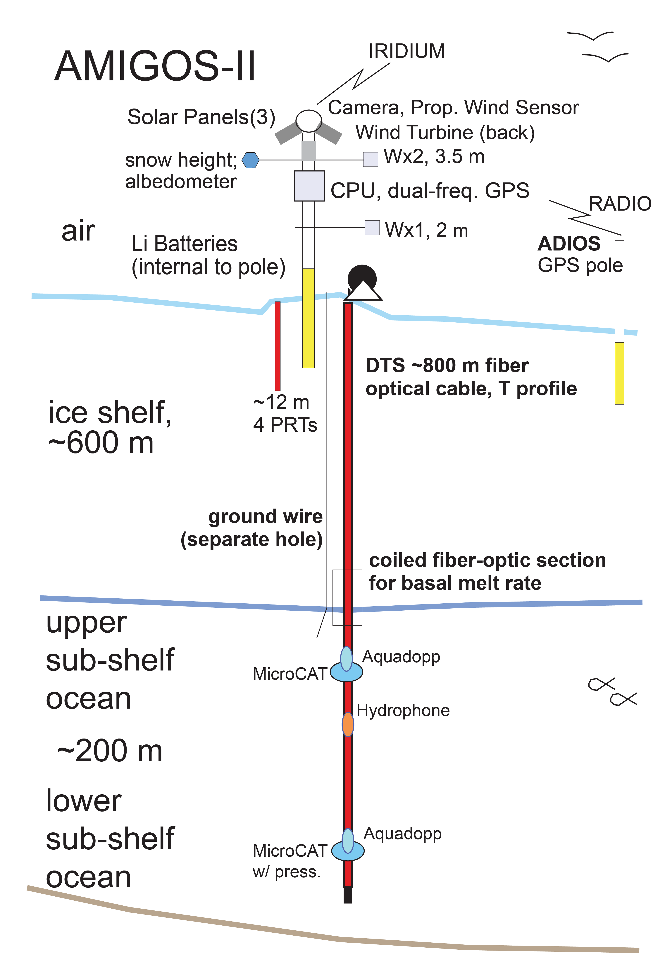
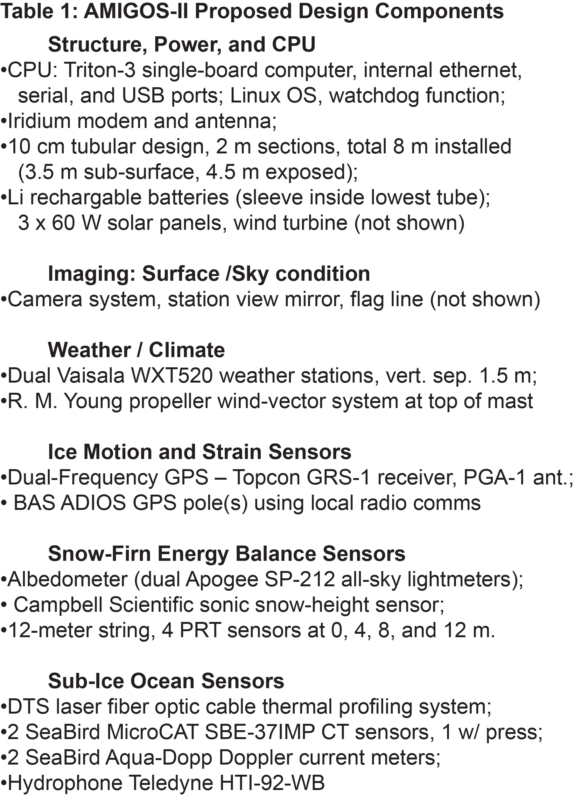

Slide 21
What’s Next:
Final Report (coming soon)
Preliminary report submitted as white paper for Arctic Observing Summit
Implementation Discussions
How to turn existing projects at sites into GriOOS nodes
How to establish new nodes
Centralized Data repository (facilitated by GRISO RCN)

Slide 22
Planned Activities Year 2
Workshop and Workshop Report
Drafted in early winter, circulated for community feedback and publication ~ Spring 2016
2. Follow up on report
National/International Funding Agencies
Coordination with existing networks
3. Arctic Stakeholders
Greenlandic fisheries
Arctic Encounters meeting, January 2016
4. Working with Modelers
- Working with leads of ISMIP6 towards a workshop that brings together ice sheet modelers and Greenland ice/ocean experts in spring of 2017 in preparation for the ISMIP6 model runs.

Slide 23
