Slide 1

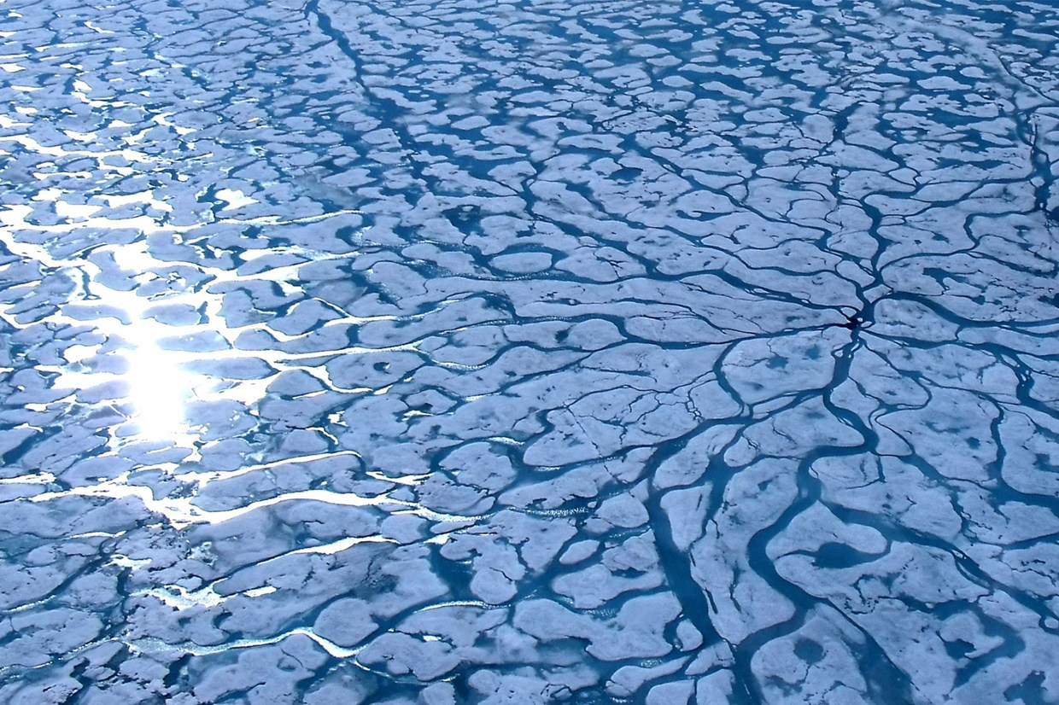
SEARCH Sea Ice Action Team
Co-Leads: Jennifer Francis (Rutgers University) & Henry Huntington (Huntington Consulting)
Research Associate: Matthew Druckenmiller (Rutgers University & NSIDC)
Mission: To advance understanding and awareness of the impacts of Arctic sea-ice loss by enabling collaboration, community engagement, and communication.
SEARCH Science Steering Committee Meeting
Boulder, CO
May 25-26, 2016

Slide 2
Overall Goals
Promote and enable research collaboration to develop synthetic science products
Develop a coherent source of accessible, comprehensive, and timely information that communicates connections between the science, key societal issues, and stakeholder needs
Facilitate sustained and sophisticated dialogues between the sea ice research community and decision-makers
Year-2 Plans
Curate a diverse range of communication material in collaboration with the Arctic sea ice research community and specific groups
Create a website — Sea Ice Matters — to host information across a series of high-level topics (initially for “Ecosystems”, “Your Weather”, and “Society”)
Host a Knowledge Exchange Workshop (Wash., DC in Sept 2016) with scientists and decision-makers to discuss stakeholder needs, emerging questions, and gaps in existing syntheses

Slide 3
Year 2 Activities (1 of 3)
Contributed to the first report of the 2016 Sea Ice for Walrus Outlook (SIWO)
Participated in SIPN’s 2016 Polar Prediction Workshop, May 4-6
  Conducted a survey to assess current challenges to prediction and prioritization of stakeholder engagement (25% response rate)
  Planning to summarize results in the context of recent related surveys (e.g., past SIPN workshops, AOOS/ACCAP, CliC, YOPP)
Providing a regional outlook to the 2016 Sea Ice Outlook (SIO) for the Chukchi-Beaufort Sea Region

Slide 4
Year 2 Activities (2 of 3)
Sea Ice Matters website to go live within a week. The full functionality of the site remains in development.
Collaborating with the Polar Interdisciplinary Coordinated Education (Polar-ICE) program to develop a map-based data story for 2015-2016 sea ice season, leading up to the September minimum.
Developing a survey to assess the status of science around the many topics to be highlighted within Sea Ice Matters.
  What is the state of our understanding? What are key gaps and challenges?
  How well is the scientific community organized to collaboratively address the most pressing questions?
  To what extent are stakeholder communities engaged?
Work on the Arctic sea ice science review paper (i.e., synthesis of syntheses) to begin in summer 2016

Slide 5
Year 2 Activities (3 of 3)
Eos article on the SIAT’s 2015 AGU Arctic Science Communication Event accepted: “Arctic science communication event mixed art, blogging, sound, and personal reflections”
Proposed a 2016 AGU Session: “Arctic sea ice as the great intermediary of global environmental change: Emerging paradigms linking the Arctic with lower-latitude systems”
Planning a workshop at the 2016 Aleutian Life Forum (August 16-20 in Unalaska): ”Connecting sea ice, science, and societal resilience: Improving awareness of sea ice's role in shaping human activities in the Bering Sea”
  Will directly inform the SIAT’s Knowledge Exchange Workshop in September 2016

Slide 6
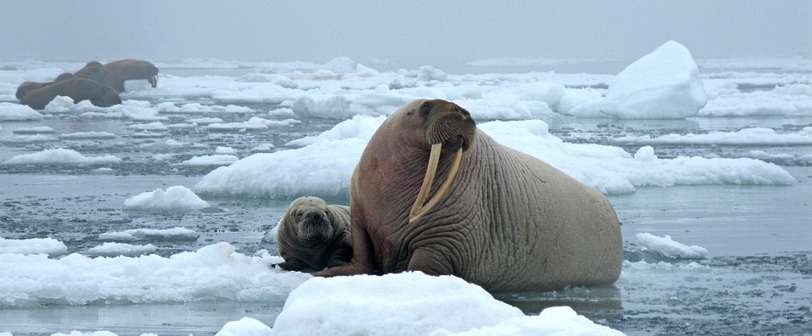
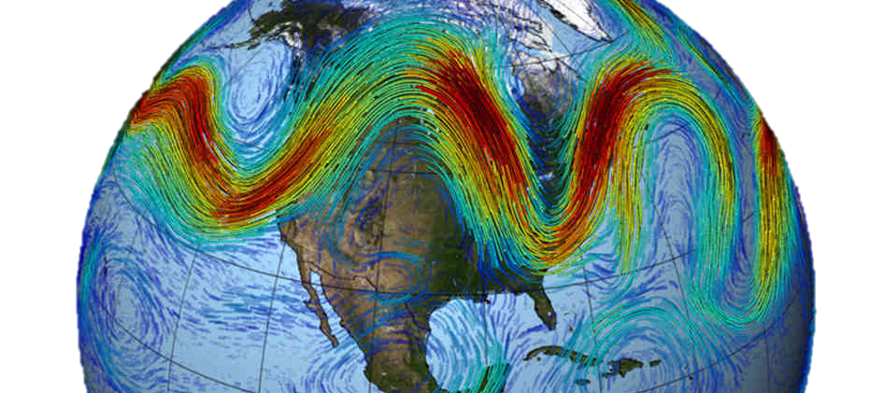
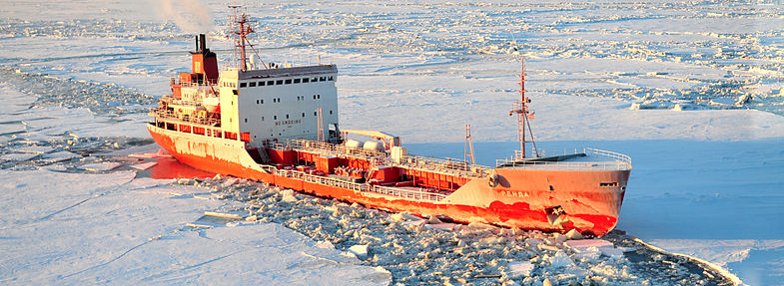
First SIAT Knowledge Exchange Workshop on the Impacts of Arctic Sea Ice Loss
September 14-16, 2016 in Washington, DC
The workshop will gather 30-50 invited experts to discuss impacts of sea-ice loss on:
Arctic ecosystems. How are marine ecosystem structure and primary productivity changing, and what are the implications for the Arctic and beyond?
Lower latitude weather. What are the linkages between Arctic sea ice loss, amplified Arctic warming, and changing mid-latitude weather patterns?
Human activities in the Bering, Chukchi, and Beaufort Seas. What roles can improved understanding of current and future sea ice conditions play in informing the actions and decisions of Arctic residents and regional stakeholders?

Slide 7

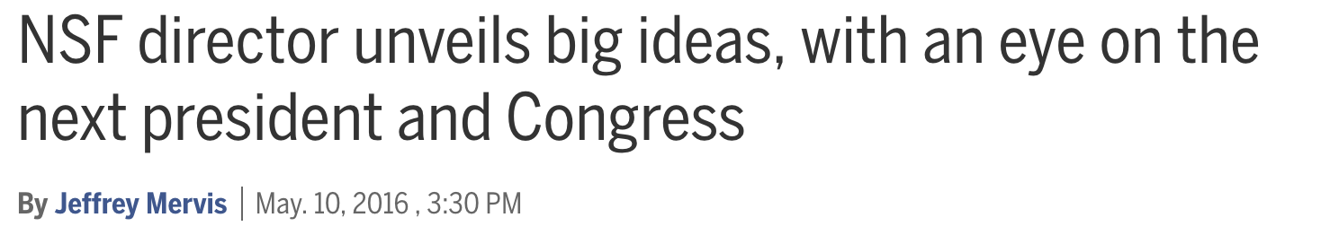
Navigating the New Arctic
Key Questions – Sea Ice Action Team is addressing 3 of 4
How will the dramatic changes in sea ice alter marine ecosystem structure and primary productivity? How will the new Arctic Ocean ecosystem function?
What new indicators and theory are needed to understand adaptive capacity of Arctic individuals and communities experiencing the unprecedented rate of Arctic environmental and social change?
How will permafrost thaw and the changing Arctic water cycle alter Arctic terrestrial ecosystems and greenhouse gas emissions?
What is are the linkages between Arctic warming and changing mid-latitude weather patterns?
Notes:
http://www.sciencemag.org/news/2016/05/nsf-director-unveils-big-ideas-eye-next-president-and-congress

Slide 8
Other Activities
Participated in the SEARCH video series on the state of Arctic-change science (in production)
Participating in the SEARCH Communications WG
Seeking endorsement from Year of Polar Prediction (YOPP)

Slide 9
Budget Assessment
Inadequate funds ($13K) available to support strong participation in the Knowledge Exchange Workshop; Currently looking for additional funding sources (e.g., ONR, NPRB)
Notes:
Quick update on corresponding budget expenditures and budget plan to support the activities. Please highlight if spending is as proposed, underspent, or overspent. It may be easiest to update the budget template form for this.

Slide 10
Sea Ice Action Team Members
Jennifer Francis (co-lead) – Rutgers University
Henry Huntington (co-lead) – Huntington Consulting
Matt Druckenmiller (research & associate) – Rutgers & NSIDC
Lawrence Hamilton – University of New Hampshire
Bob Henson – Weather Underground
Marika Holland – NCAR
Martin Jeffries – IARPC
Brendan Kelly – SEARCH Program
Don Perovich – Cold Regions Research & Engineering Lab (CRREL)

