Slide 1


Study of Environmental Arctic Change (SEARCH) Planning Meeting
19-20 Nov 2015
Seattle, WA

Slide 2
Science
Town Hall
SEARCH/ Agency Mtg
SSC Mtg
Priorities & Goals draft
Final Goals, objectives and proposal
Science Plan
Understanding Arctic Change Task Force Report
Strategy
ADI Task Force Report
Implementation
Strategy Plan
Reports White paper
State of AON Workshop
ARCUS Ways Forward Memo
Arctic Observing Summit
Arctic Obs. Integration Workshop
Interagency AON Working Group Mtg
Interagency/OSTP Arctic Observations Mtg
Implementation
Implementation
Workshop Report
US AON Coordination Workshop
Framework & 5yr plan
Kickoff Meeting
2001 2003 2005 2007 2009 2011 2013 2015
2002 2004 2006 2008 2010 2012 2014 2016

Slide 3

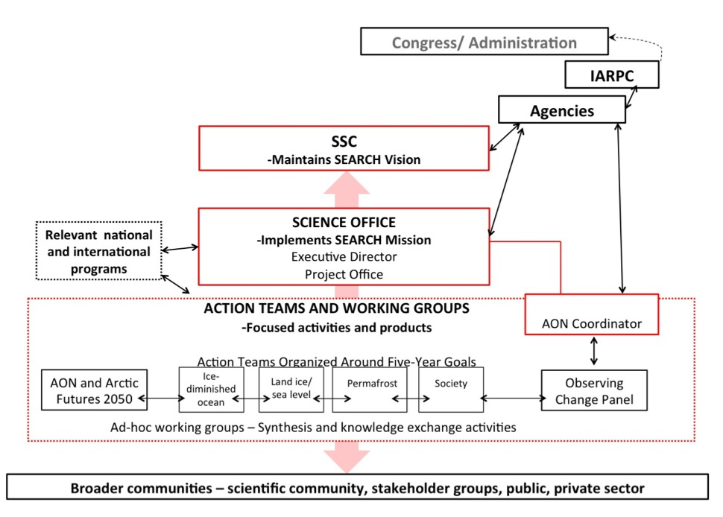
SEARCH Structure & Activities
www.arcus.org/search-program

Slide 4
AON & Sustained Observations
AON as major contribution to International Polar Year (IPY):
  Focus on guiding science questions developed by the research community: SEARCH Implementation Workshop (2005); National Academies Panel (2006)
  Captured key aspects of a major transformation of the Arctic system: Ocean warming, atmospheric circulation changes, MY sea ice reduction, permafrost thaw and landcover change, human and ecosystem responses
  Transformed approach to sustained observations – autonomous obs. technology; advanced remote sensing approaches, community-based observations
  Lasting international partnerships
Continued refinement and discussion of cooperative observing approaches (e.g., Interagency Arctic Observing Coordination WS), sunset of ARRA support and urgency of information needs prepare ground for next step
White paper to initiate conversation: Arctic Services: A Framework for Effective and Sustained Observations in the Arctic
Notes:
Themes: Ice diminished Arctic Ocean; consequences of permafrost warming and loss; land ice loss; societal and policy implications; focused but allow specific progress across broad spectrum – will be put up for discussion (cf website)

Slide 5
Arctic Observing Framework
Effective observing network provides robust, well-calibrated measurements to serve scientific research, operations, and planning
Needs of scientific research and operations should drive network development
Network that reflects a systems perspective allows for integration of data across domains and scales in support of science, operations, testing and improving predictive models, and adapting to emerging or anticipated impacts
A single, all-encompassing network is difficult to achieve: Framework built around services and outcomes that draws on existing components can help ensure efficient data gathering, integration, and dissemination
Role of SEARCH: Represent broad capabilities and needs of the science community – offering protocols to facilitate, organize, and coordinate necessary exchanges and help assemble the observations framework
Notes:
Themes: Ice diminished Arctic Ocean; consequences of permafrost warming and loss; land ice loss; societal and policy implications; focused but allow specific progress across broad spectrum – will be put up for discussion (cf website)

Slide 6
Arctic Observing Framework
An effective, integrated network adds value to observations by:
Identifying common interests at the level of basic observational data products and recognizing their over-arching societal importance as well as their importance for different missions and operations
Coordinating between the agencies to delineate roles and responsibilities thereby minimizing duplication
Providing a systems perspective to optimize investments and return value
Developing a protocol for updating the sustained observation network to foster adaptation to emerging science questions, adoption of new technology, etc.
Data standards for achieving interoperability to optimize data exchange and integration
Notes:
Themes: Ice diminished Arctic Ocean; consequences of permafrost warming and loss; land ice loss; societal and policy implications; focused but allow specific progress across broad spectrum – will be put up for discussion (cf website)

Slide 7
Arctic Observing Framework
Four critical steps towards a more efficient, robust, and integrated Arctic observing system:
Agree on a framework (e.g., ecological services, societal benefit areas, or some other) for assessing Arctic observing priorities
Use that framework to iteratively assess priorities
Coordinate Arctic observing efforts with international initiatives under the auspices of International Arctic Science Committee (IASC) and/or the Arctic Council through the Sustaining Arctic Observing Networks (SAON) process
Implement priority observations through an Interagency Arctic Observing System
Notes:
Themes: Ice diminished Arctic Ocean; consequences of permafrost warming and loss; land ice loss; societal and policy implications; focused but allow specific progress across broad spectrum – will be put up for discussion (cf website)

Slide 8
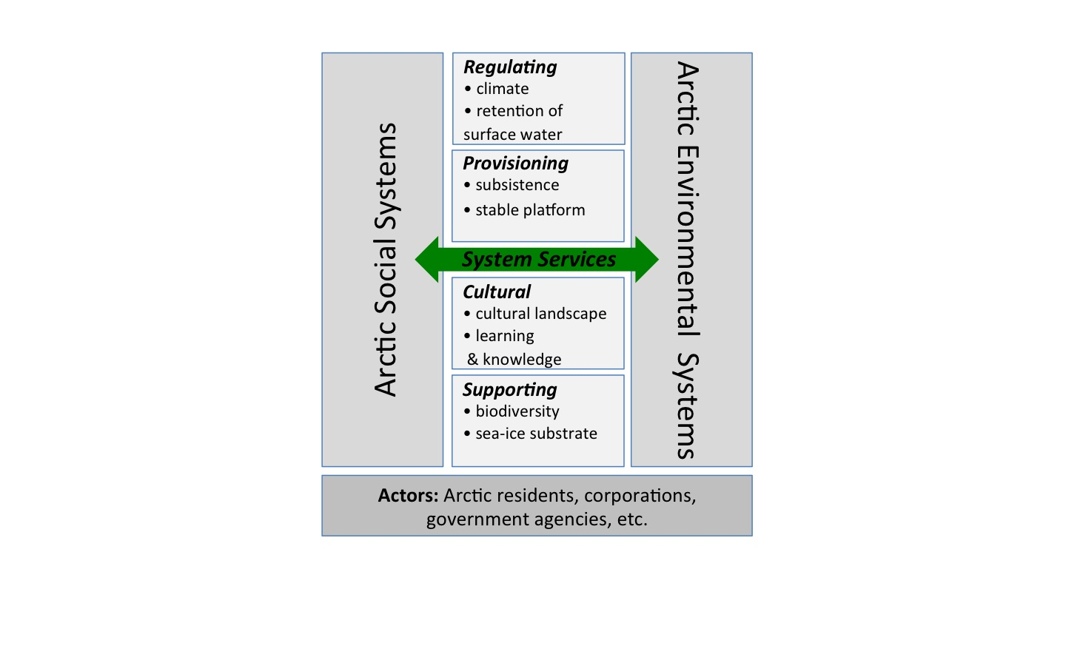
Arctic Observing Framework
Notes:
Themes: Ice diminished Arctic Ocean; consequences of permafrost warming and loss; land ice loss; societal and policy implications; focused but allow specific progress across broad spectrum – will be put up for discussion (cf website)

Slide 9
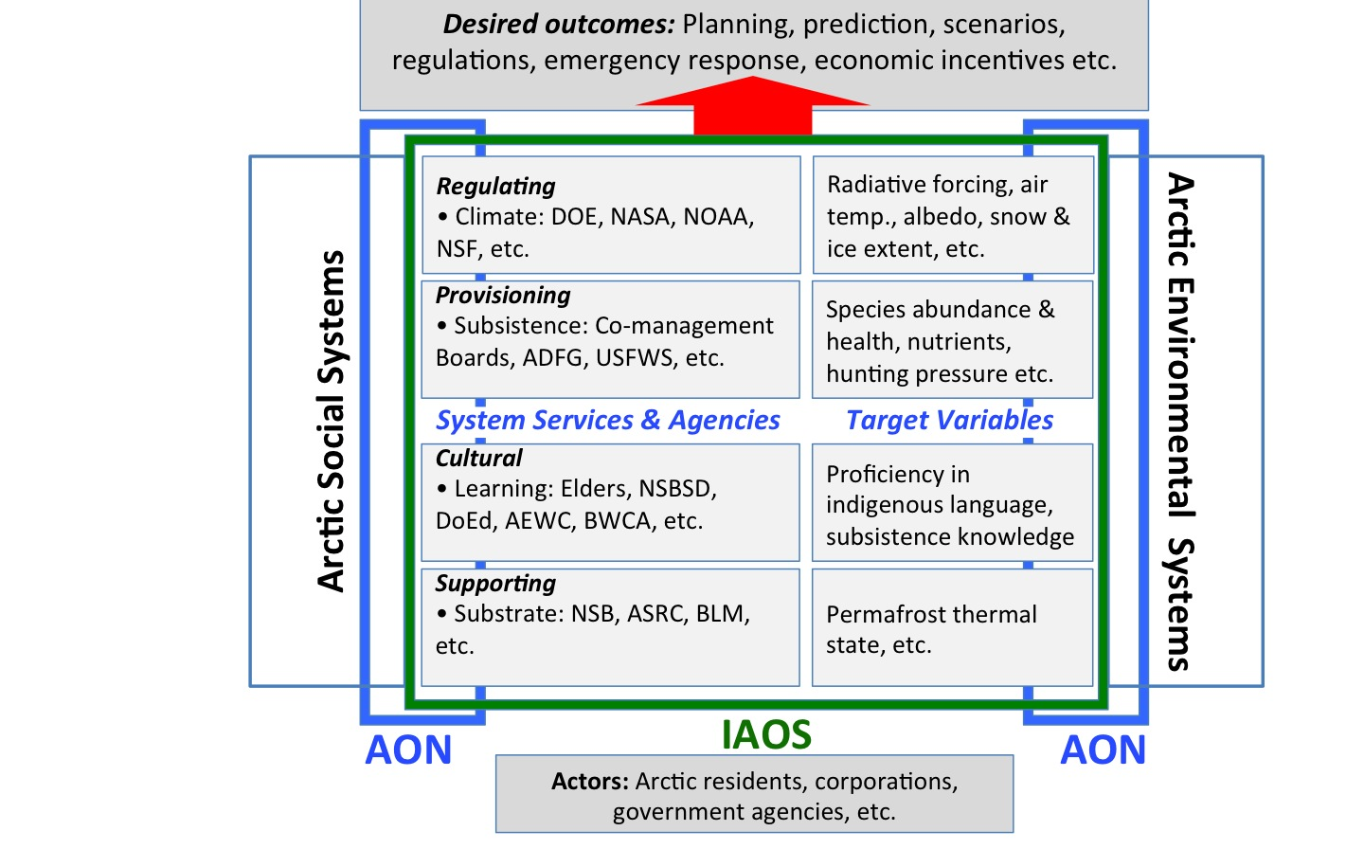
Arctic Observing Framework
Notes:
Themes: Ice diminished Arctic Ocean; consequences of permafrost warming and loss; land ice loss; societal and policy implications; focused but allow specific progress across broad spectrum – will be put up for discussion (cf website)

