Slide 1

SEARCH SSC Meeting 2-4 Oct 2012
Hajo Eicken (hajo.eicken@gi.alaska.edu)
Chair, SEARCH Science Steering Committee
• The Arctic of the Future & SEARCH
Notes:
AON: projects & data – data to information
ADI: pilot projects & survey – synthesis & report
National AON Coordination Meeting
Arctic Observing Summit
Guidance: UAC & RC
SIO/SIWO as examples of guidance

Slide 2
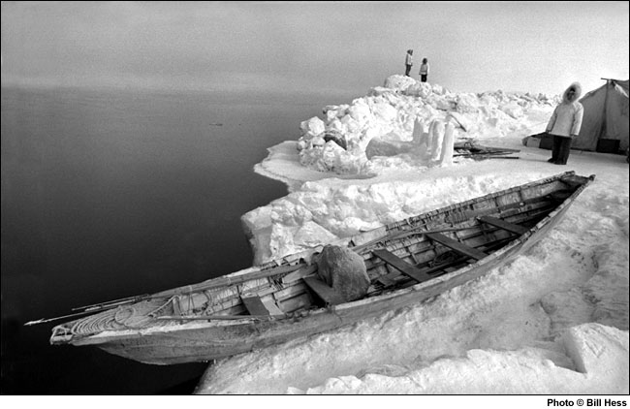
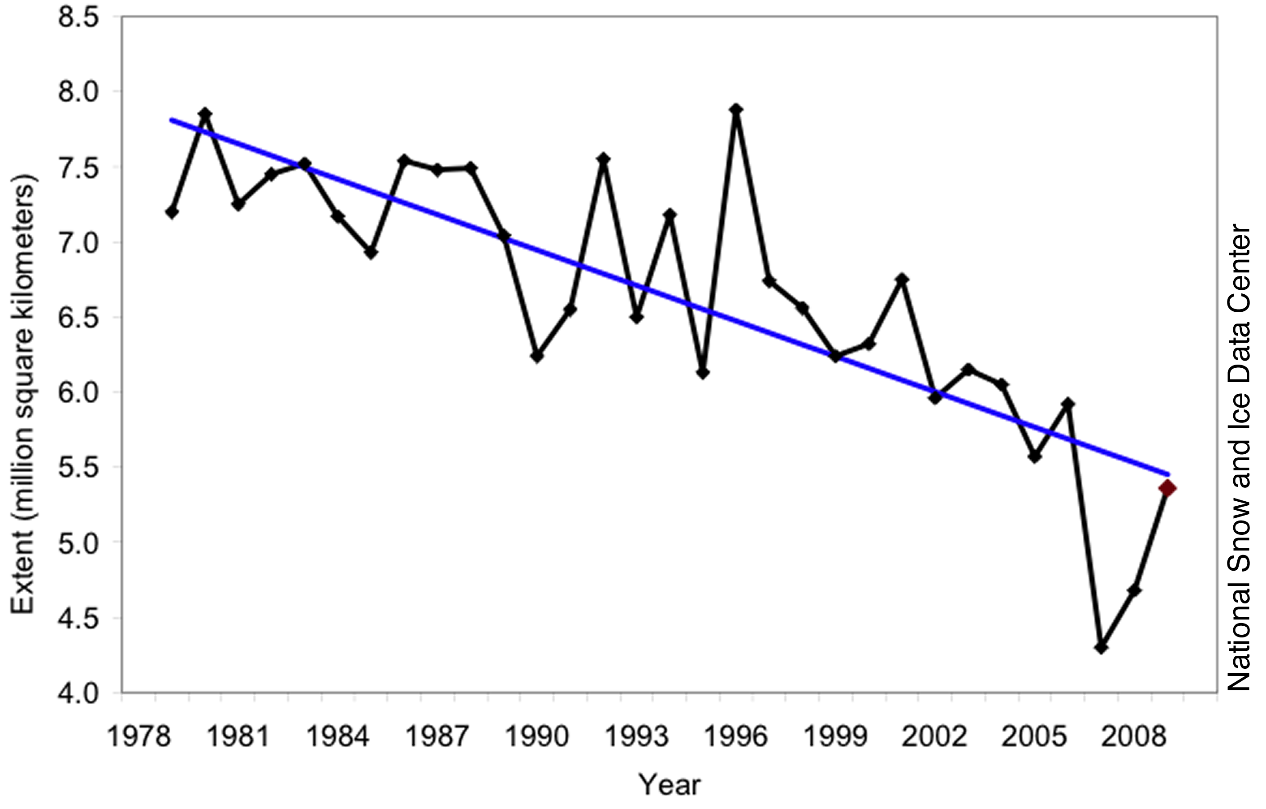
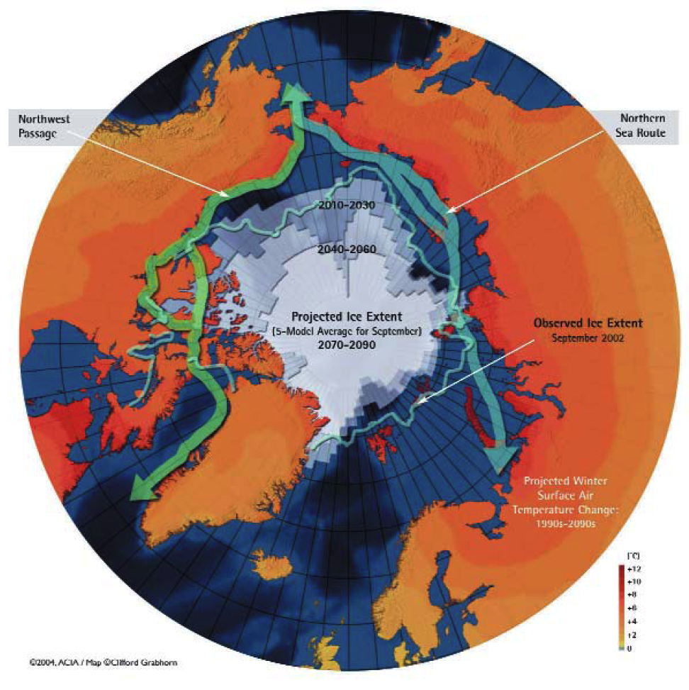
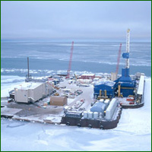
A changing North
Regime shifts in climate and the environment about to exceed range of recent past variability and change
Barrow whaling camp
(Photo: Bill Hess)
NSIDC
Sweeping impacts of change on Northern populations and cultures
Increasing inter-dependence between the Arctic region and global processes
ACIA
BP Northstar
Photo: BP
Expansion of global geopolitical and economic interests into the North
Notes:
Interconnected change
Problems broader than specific research interests: blurring of fundamental vs applied research
Implications for interaction with stakeholders/decision makers – advocacy vs. honest brokers – who to take money from in support of research and under what conditions?

Slide 3
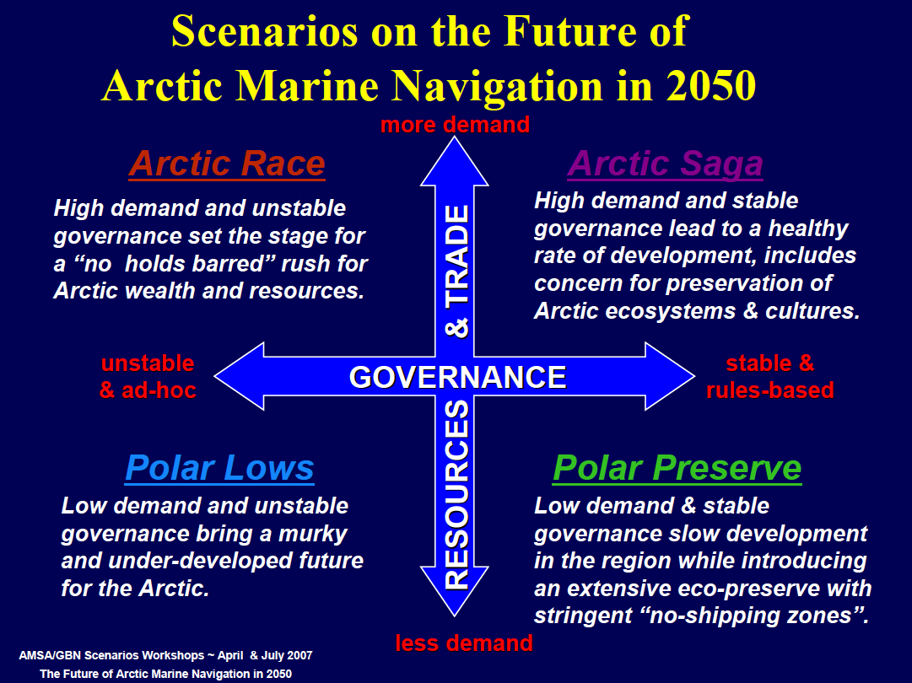
AMSA
Brigham
Notes:
-broader question: Arctic of 2050
-AMSA assumes sea ice goes the way models say
-scenarios for different stakeholders

Slide 4
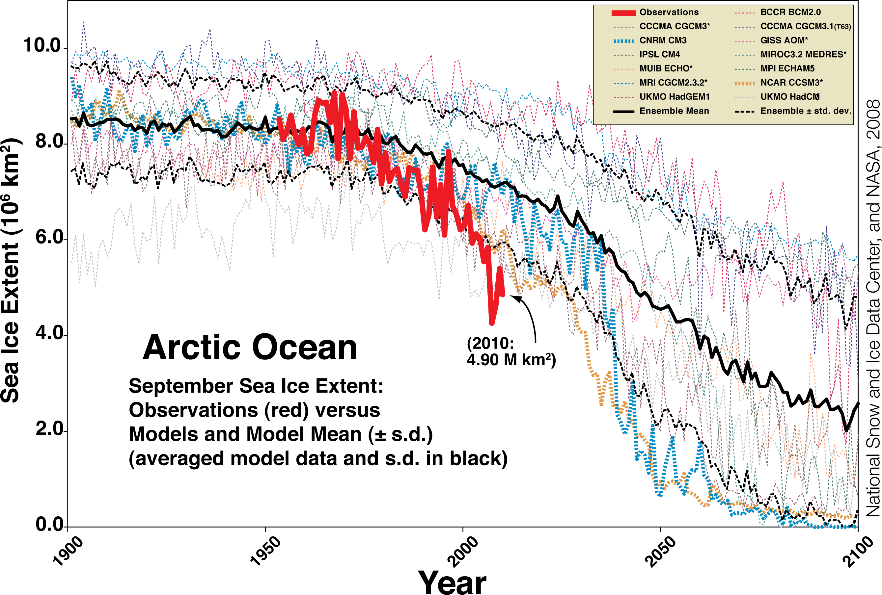
Stroeve et al., 2007 (updated 2010)

Slide 5
Wang & Overland, GRL, 2012

Slide 6
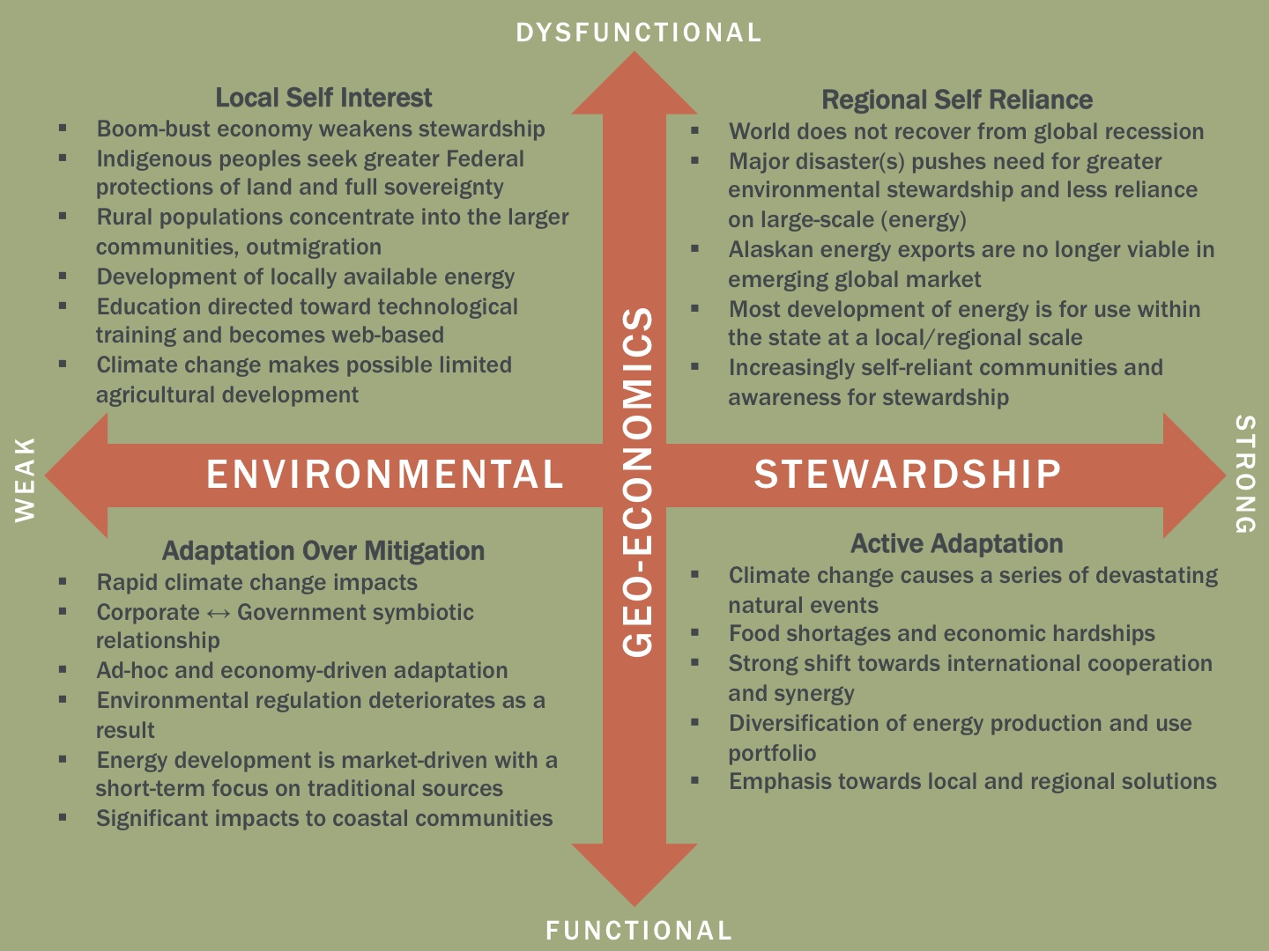
Smith, Barker, Cost, Daniel, Prior, Wong, 2012

Slide 7
Jasper Innovation Forum
Global North 2050

Slide 8
Smith, 2010

Slide 12
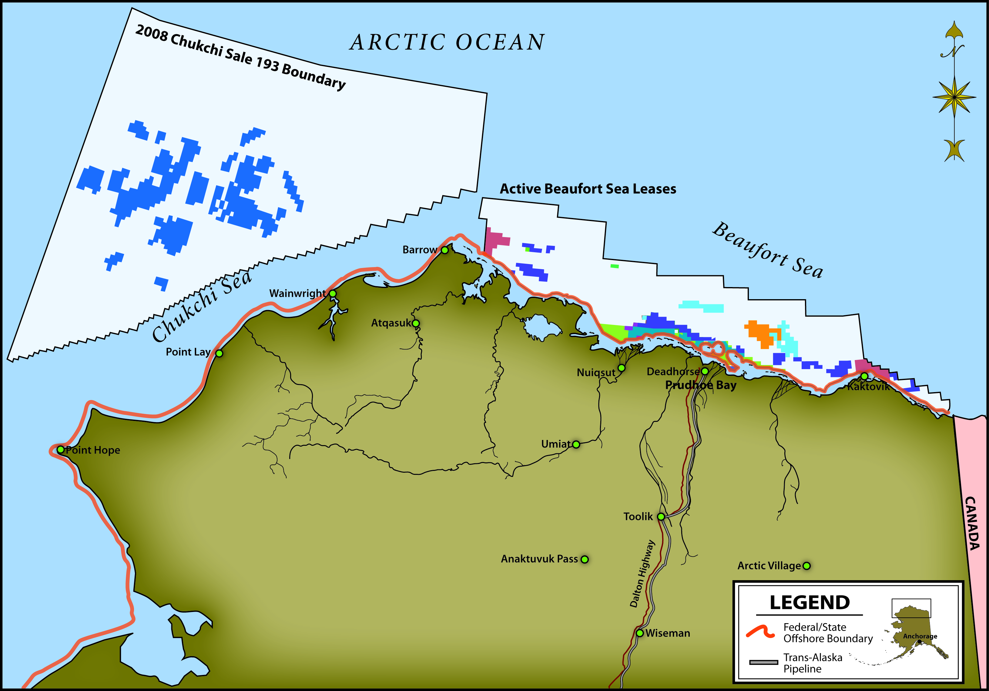
Pew Trust, 2011

Slide 14
aoos.org Alaska Ocean Observing System

Slide 15
AMSA
Brigham
Notes:
-broader question: Arctic of 2050
-AMSA assumes sea ice goes the way models say
-scenarios for different stakeholders

Slide 16
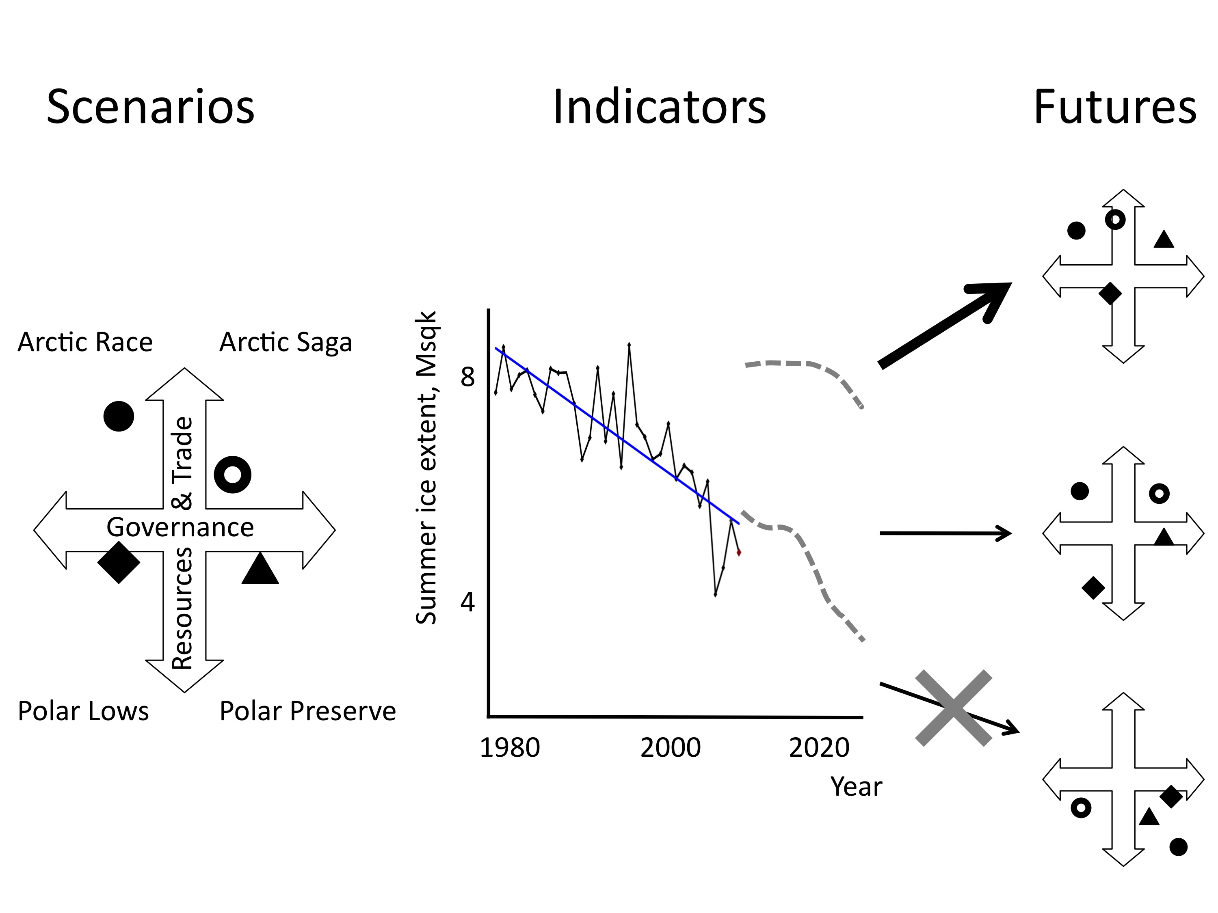
Decision-making in a changing Arctic
GCM output
Observations
Stroeve et al., 2010
Eicken & Lovecraft, Ch. 9, Nx2020, 2011
Notes:
Scenarios vary for different stakeholders because stakeholders also want to shape the future
The question: how to get from scenario to future? Right now more decision making (or at least thinking) based on GCM output than anything else (certainly that is what scientific community focuses on)
Need to fill in that gap, and some progress made: Stroeve et al. showed that sea ice summer ice extent decline at lower end of model envelope
use to exclude physically impossible scenarios

Slide 17
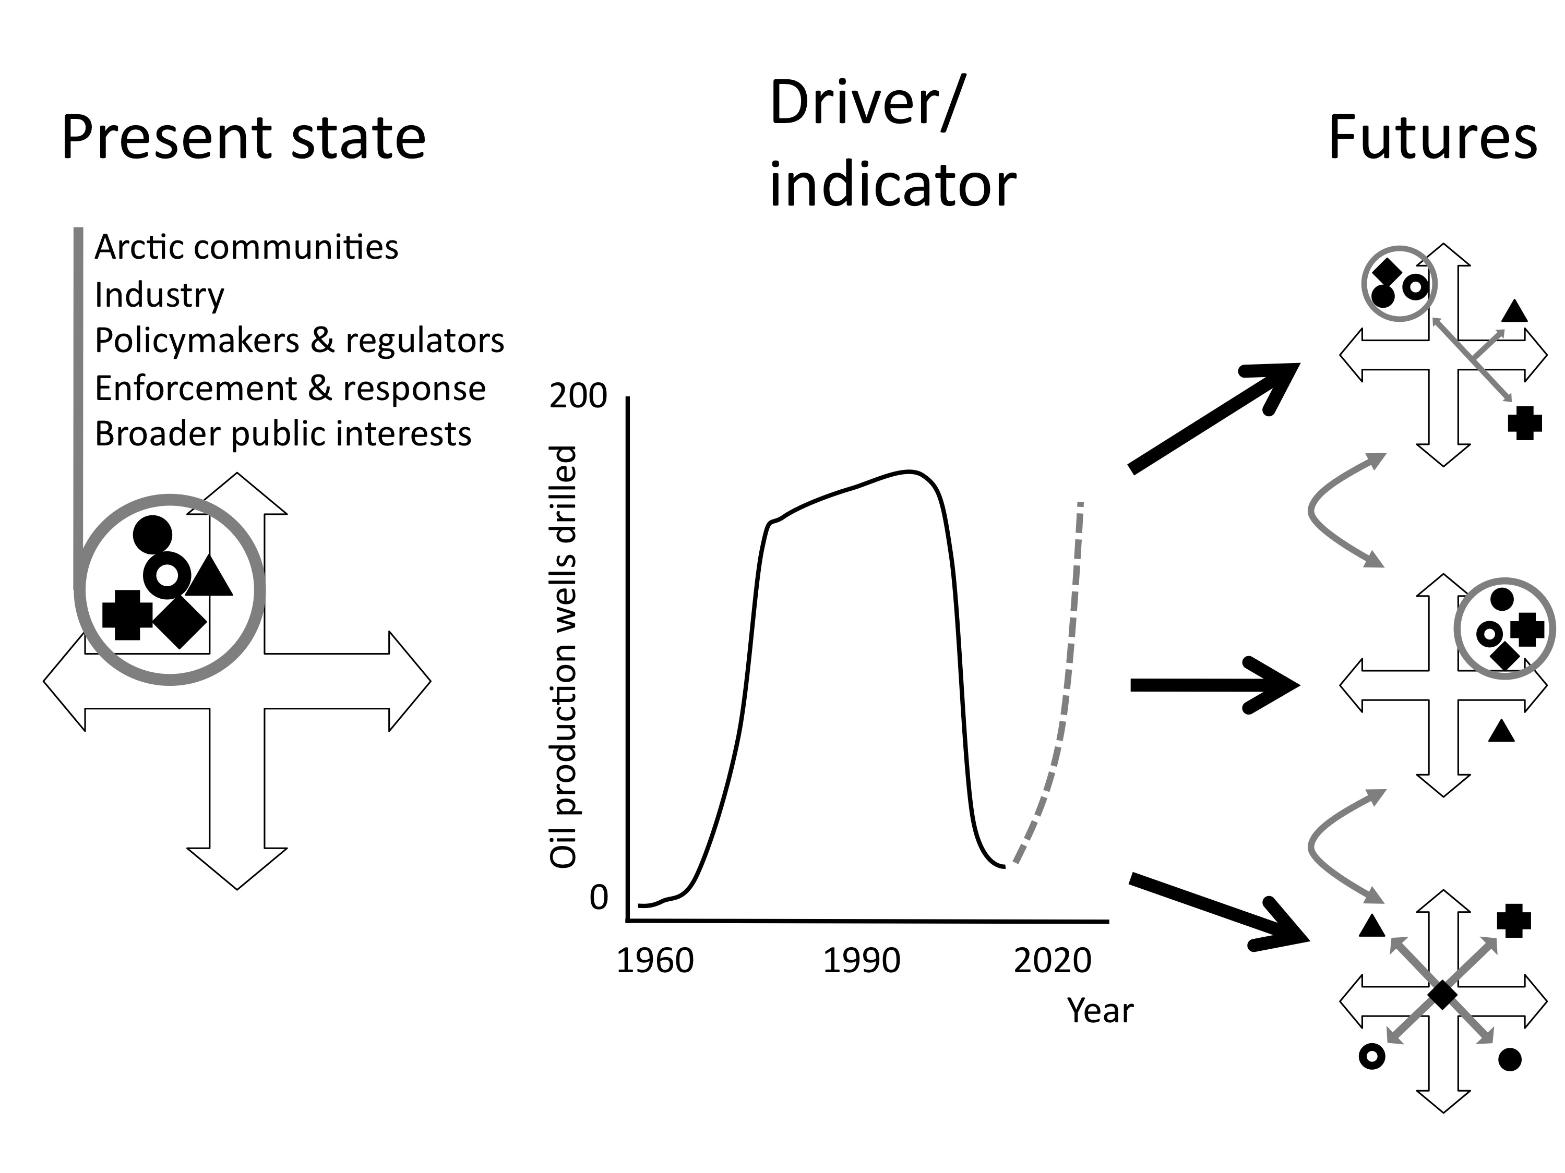
Decision-making in a changing Arctic
Eicken & Lovecraft, Ch. 9, Nx2020, 2011

Slide 18
ISAC Responding to Change Workshop; Murray et al., 2012

Slide 19
From scenarios to action
Bodies of knowledge
  Scientific
  Practical
  Local
  Indigenous
Holders of knowledge
  Communities & practicioners
  Repositories & archives
  Institutions & frameworks
Action: Response to Arctic change
  Passive system response
  Active response through adaptation, mitigation, negation, etc.
Scales of action
  Local
  Regional
  National
  Global

Slide 20
SEARCH SSC Meeting 2-4 Oct 2012
Hajo Eicken (hajo.eicken@gi.alaska.edu)
Chair, SEARCH Science Steering Committee
• The Arctic of the Future & SEARCH
• SEARCH Structures & Functions
Notes:
AON: projects & data – data to information
ADI: pilot projects & survey – synthesis & report
National AON Coordination Meeting
Arctic Observing Summit
Guidance: UAC & RC
SIO/SIWO as examples of guidance

Slide 21

SEARCH Objectives
The overall objective of SEARCH is to
Understand the nature, extent and future development of the system-scale change presently seen in the Arctic.
SEARCH is built around three basic elements:
• Observing Change - Observing Network well underway
• Understanding Change - Modeling & synthesis
• Responding to Change - Implementation in early phase
www.arcus.org/search/

Slide 22
SEARCH’s
Tripartite
Approach to Arctic
Change
Understanding
• Process &
scenario
modeling
• Prediction
Responding
• Adaptation
• Mitigation
• Sustainability
• Decision support
• Education
Observing
• AON data &
information
• AON design/optimiz’n
• Cross-sector/int’l
coordination

Slide 23
What is SEARCH?
• Collaborative scientific program
• Works with academic and government agency scientists to prioritize, plan, conduct, and synthesize research focused on Arctic environmental change
• Guided by Science Steering Committee and several panels and working groups with broad representation of the research community
• Response of the research community
Arctic change
Notes:
Response of Arctic research community to Arctic change: challenge in of itself – are we up to the challenge? By & large YES; lots of opportunities for new people to come in with new ideas and different perspectives; goal is to create a forum for such exchange through a range of activities

Slide 24
SEARCH
Key Documents & Milestones
• 2001 SEARCH Science Plan
• 2003 SEARCH Implementation Strategy Document
• 2005 SEARCH Implementation Workshop Report
• 2008 SEARCH/DAMOCLES Arctic Observation Integration Workshops & Report
• 2009 SEARCH State of the Arctic Observing Network (AON) Workshop & Report
• 2010 Interagency AON Working Group Meeting
• 2012 SEARCH/ARCSS Understanding Arctic Change Task Force Report
• 2012 – in press: AON Design & Implementation Task Force Report
• 2012 – in prep.: US Arctic Observing Coordination Workshop
Notes:
Mission specifics: stakeholders; creating a forum for communication (reflected in specific activities such as Arctic Observing Coord meeting; AOS, sea ice outlook etc.)

Slide 25
SEARCH 5-Year Goals
Improve Understanding and Prediction of Sea Ice Changes and the Consequences for Ecosystems, Human Activities, and Climate
Understand the Consequences of the Loss of Shallow Permafrost on Arctic and Global Systems
Improve Predictions of Future Land-Ice Loss and Impacts on Sea Level
Analyze Societal and Policy Implications of Arctic Environmental Change
Notes:
Themes: Ice diminished Arctic Ocean; consequences of permafrost warming and loss; land ice loss; societal and policy implications; focused but allow specific progress across broad spectrum – will be put up for discussion (cf website)

Slide 26
ADI Task Force Conclusions and Recommendations
Management structure:
AON Scientific Steering Group (AON-SSG) is recommended to provide a management structure
  responds to input from the SEARCH SSC, the scientific community, AON stakeholders, and federal or state agencies
SSG composition would reflect this diversity
  Able to advise NSF and other agencies supporting the AON on network goals
  provide input on how individual projects address these goals and how different observations may be prioritized
  May require the formation of ad-hoc working groups that focus on specific issues

Slide 27
Elements of AON Design and Optimization Hierarchy
AON design elements | Activity | Implementation | Discussion in report
Problem definition | Development of science goals and definition of actionable science questions | SEARCH program, agencies, stakeholders, AON Science Steering Group | Section 2 (AON science question alignment chapter)
Strategy | Feedback and uncertainty analysis, identification of metrics, model-based assessments, process studies | Working groups, funded projects, ad-hoc meetings (researchers, agencies, stakeholders) | Section 6.2.1 (Heuristic feedback and uncertainty analysis)
Tactics | Target quantity definition and measurement options, model-based assessments | Synthesis forums (e.g., Sea Ice Outlook, flagship site teams), funded projects and ad-hoc meetings (researchers, agencies, stakeholders) | Section 6.2.2 (Sea Ice Outlook section)
Deployment scale | Sampling array design | AON projects, OSSE/OSE teams | Section 4.2.4 (OSSE chapter/case study)

Slide 28
ISAC Responding to Change Workshop; Murray et al., 2012

Slide 29
Elements of AON Design and Optimization Hierarchy
AON design elements | Activity | Implementation
Problem definition | • Scenarios • Institutional analysis • Scientific research | • STAP issues group • SEARCH SSC/panels • Assessments
Strategy | • Scenario consistency analysis • Institutional analysis • Model-based assessments • Process studies | • Working groups • Funded projects • Ad-hoc meetings
Tactics | Target quantity definition and measurement options, model-based assessments | • Synthesis forums (e.g., Flagship site teams, Sea Ice Outlook), funded program (e.g., LCCs) and ad-hoc meetings
Deployment scale | Sampling array design | • Site teams • OSE/OSSE projects

Slide 30
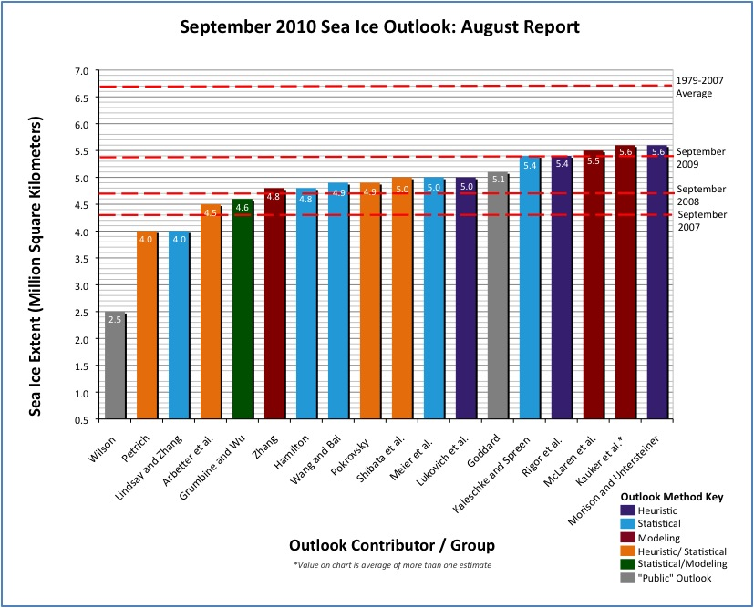
SEARCH Arctic Sea Ice Outlook
International effort to anticipate, track & evaluate Arctic seasonal ice evolution starting in the summer of 2008 with contributions by more than 20 international expert groups
Regional outlook: Regional ice development important to stakeholders & decision-makers
www.arcus.org/search/seaiceoutlook
Notes:
Activities to synthesize and link: outlook

Slide 31
