Slide 1
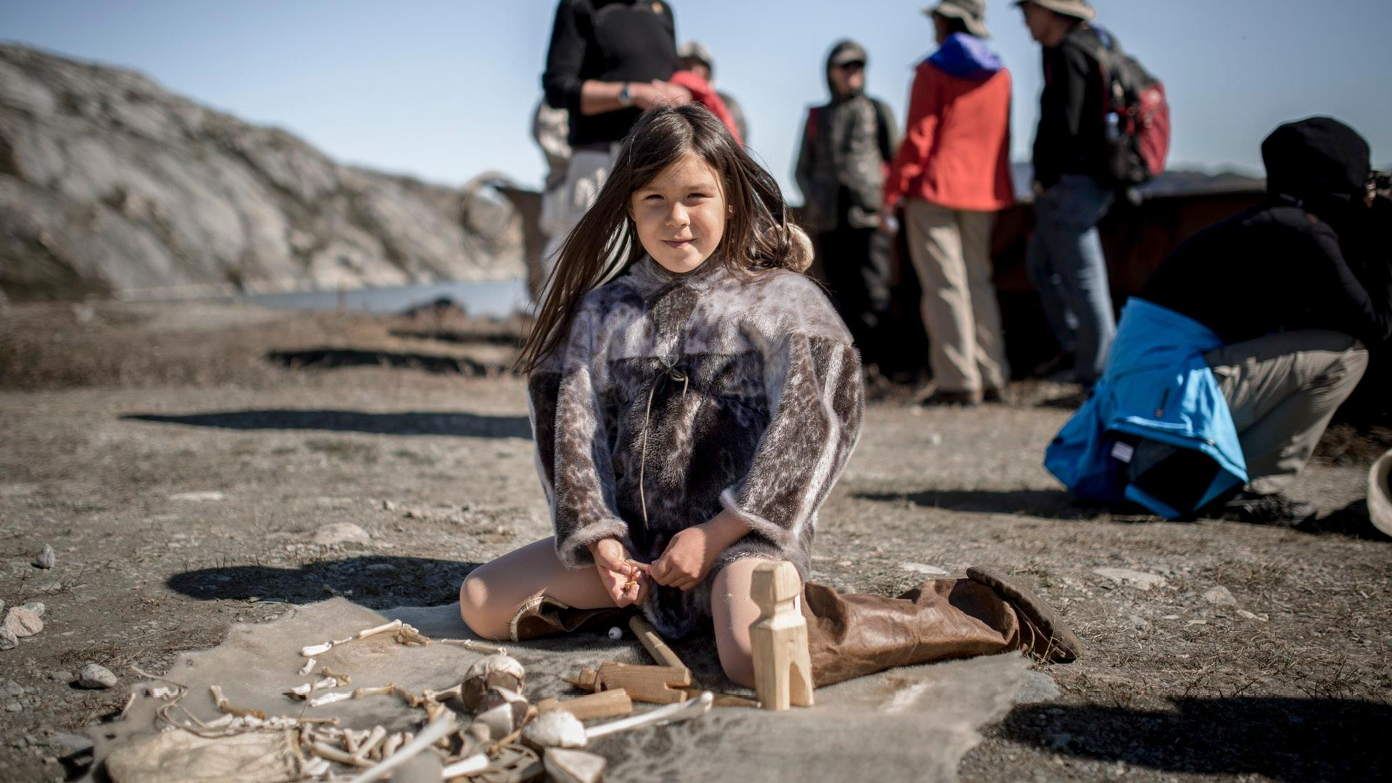
UArctic 2022
uarctic.org

Slide 2

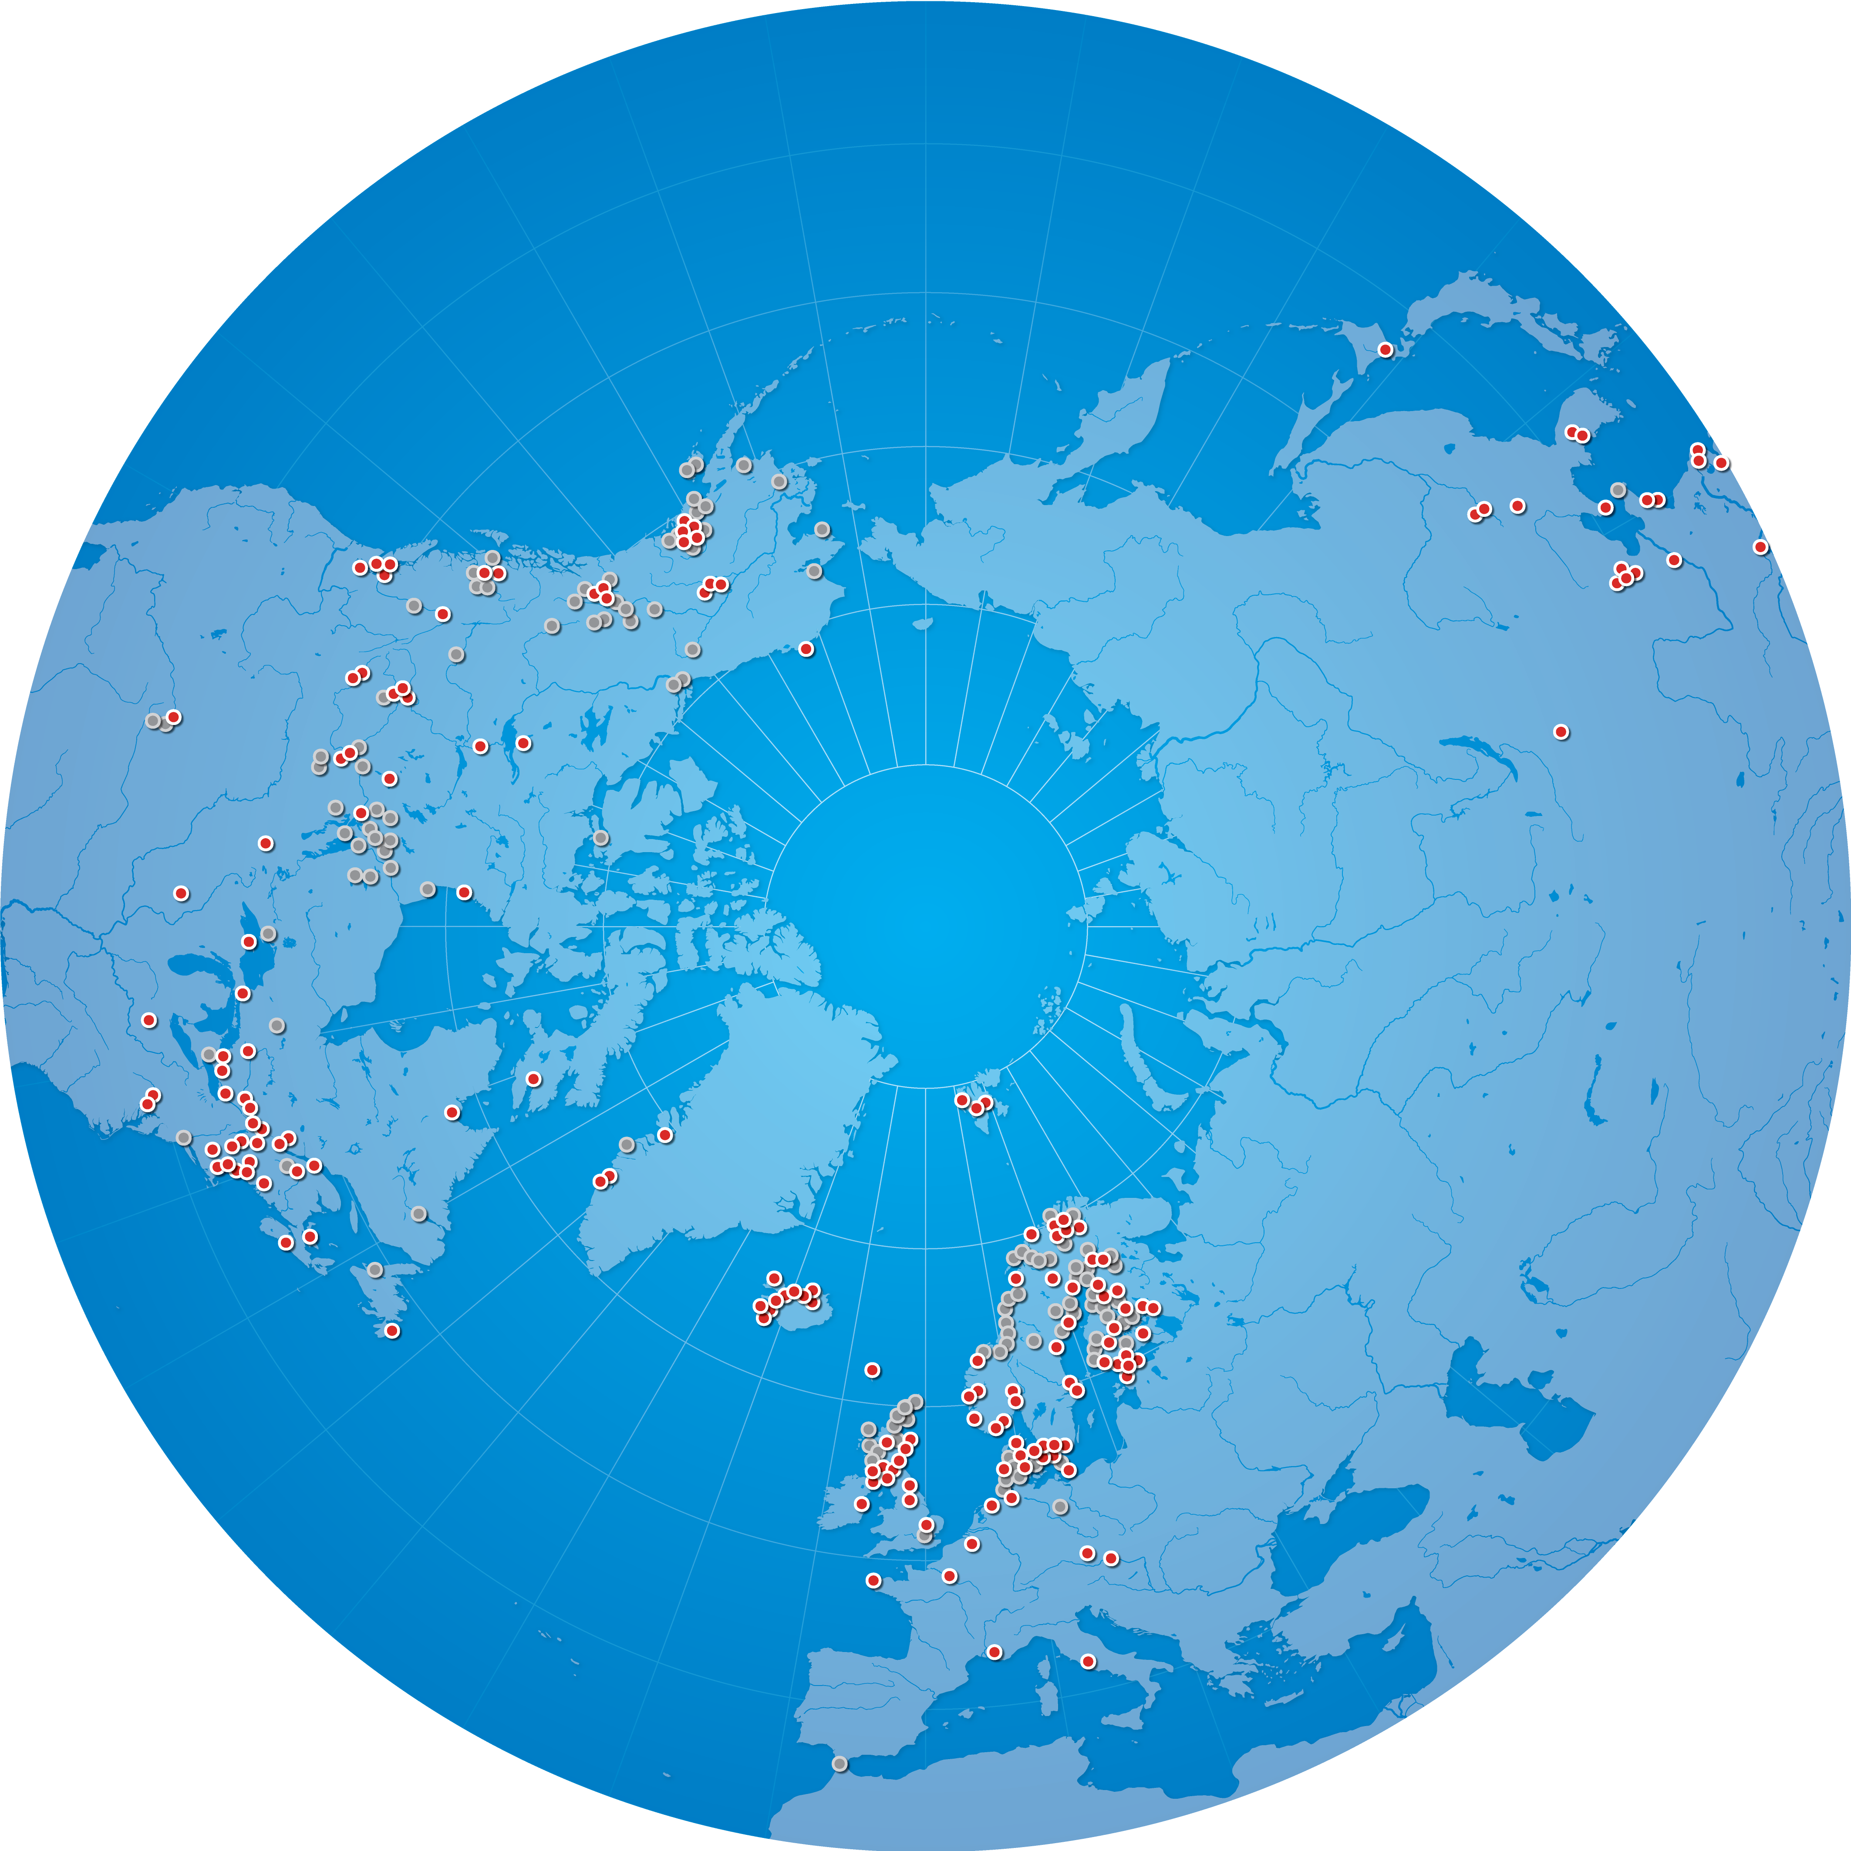



New UArctic members
In 2022 UArctic welcomed 11 new members to the network, bringing UArctic's total membership to 176:
Mount Royal University
Université de Sherbrooke
University of Jyväskylä
University of Maine at Fort Kent
University of Southern Denmark
SmartICE
Nansen Environmental and Remote Sensing Center
Aix-Marseille Université
Heriot-Watt University
Glasgow School of Art
Université de Bretagne Occidentale

Slide 3
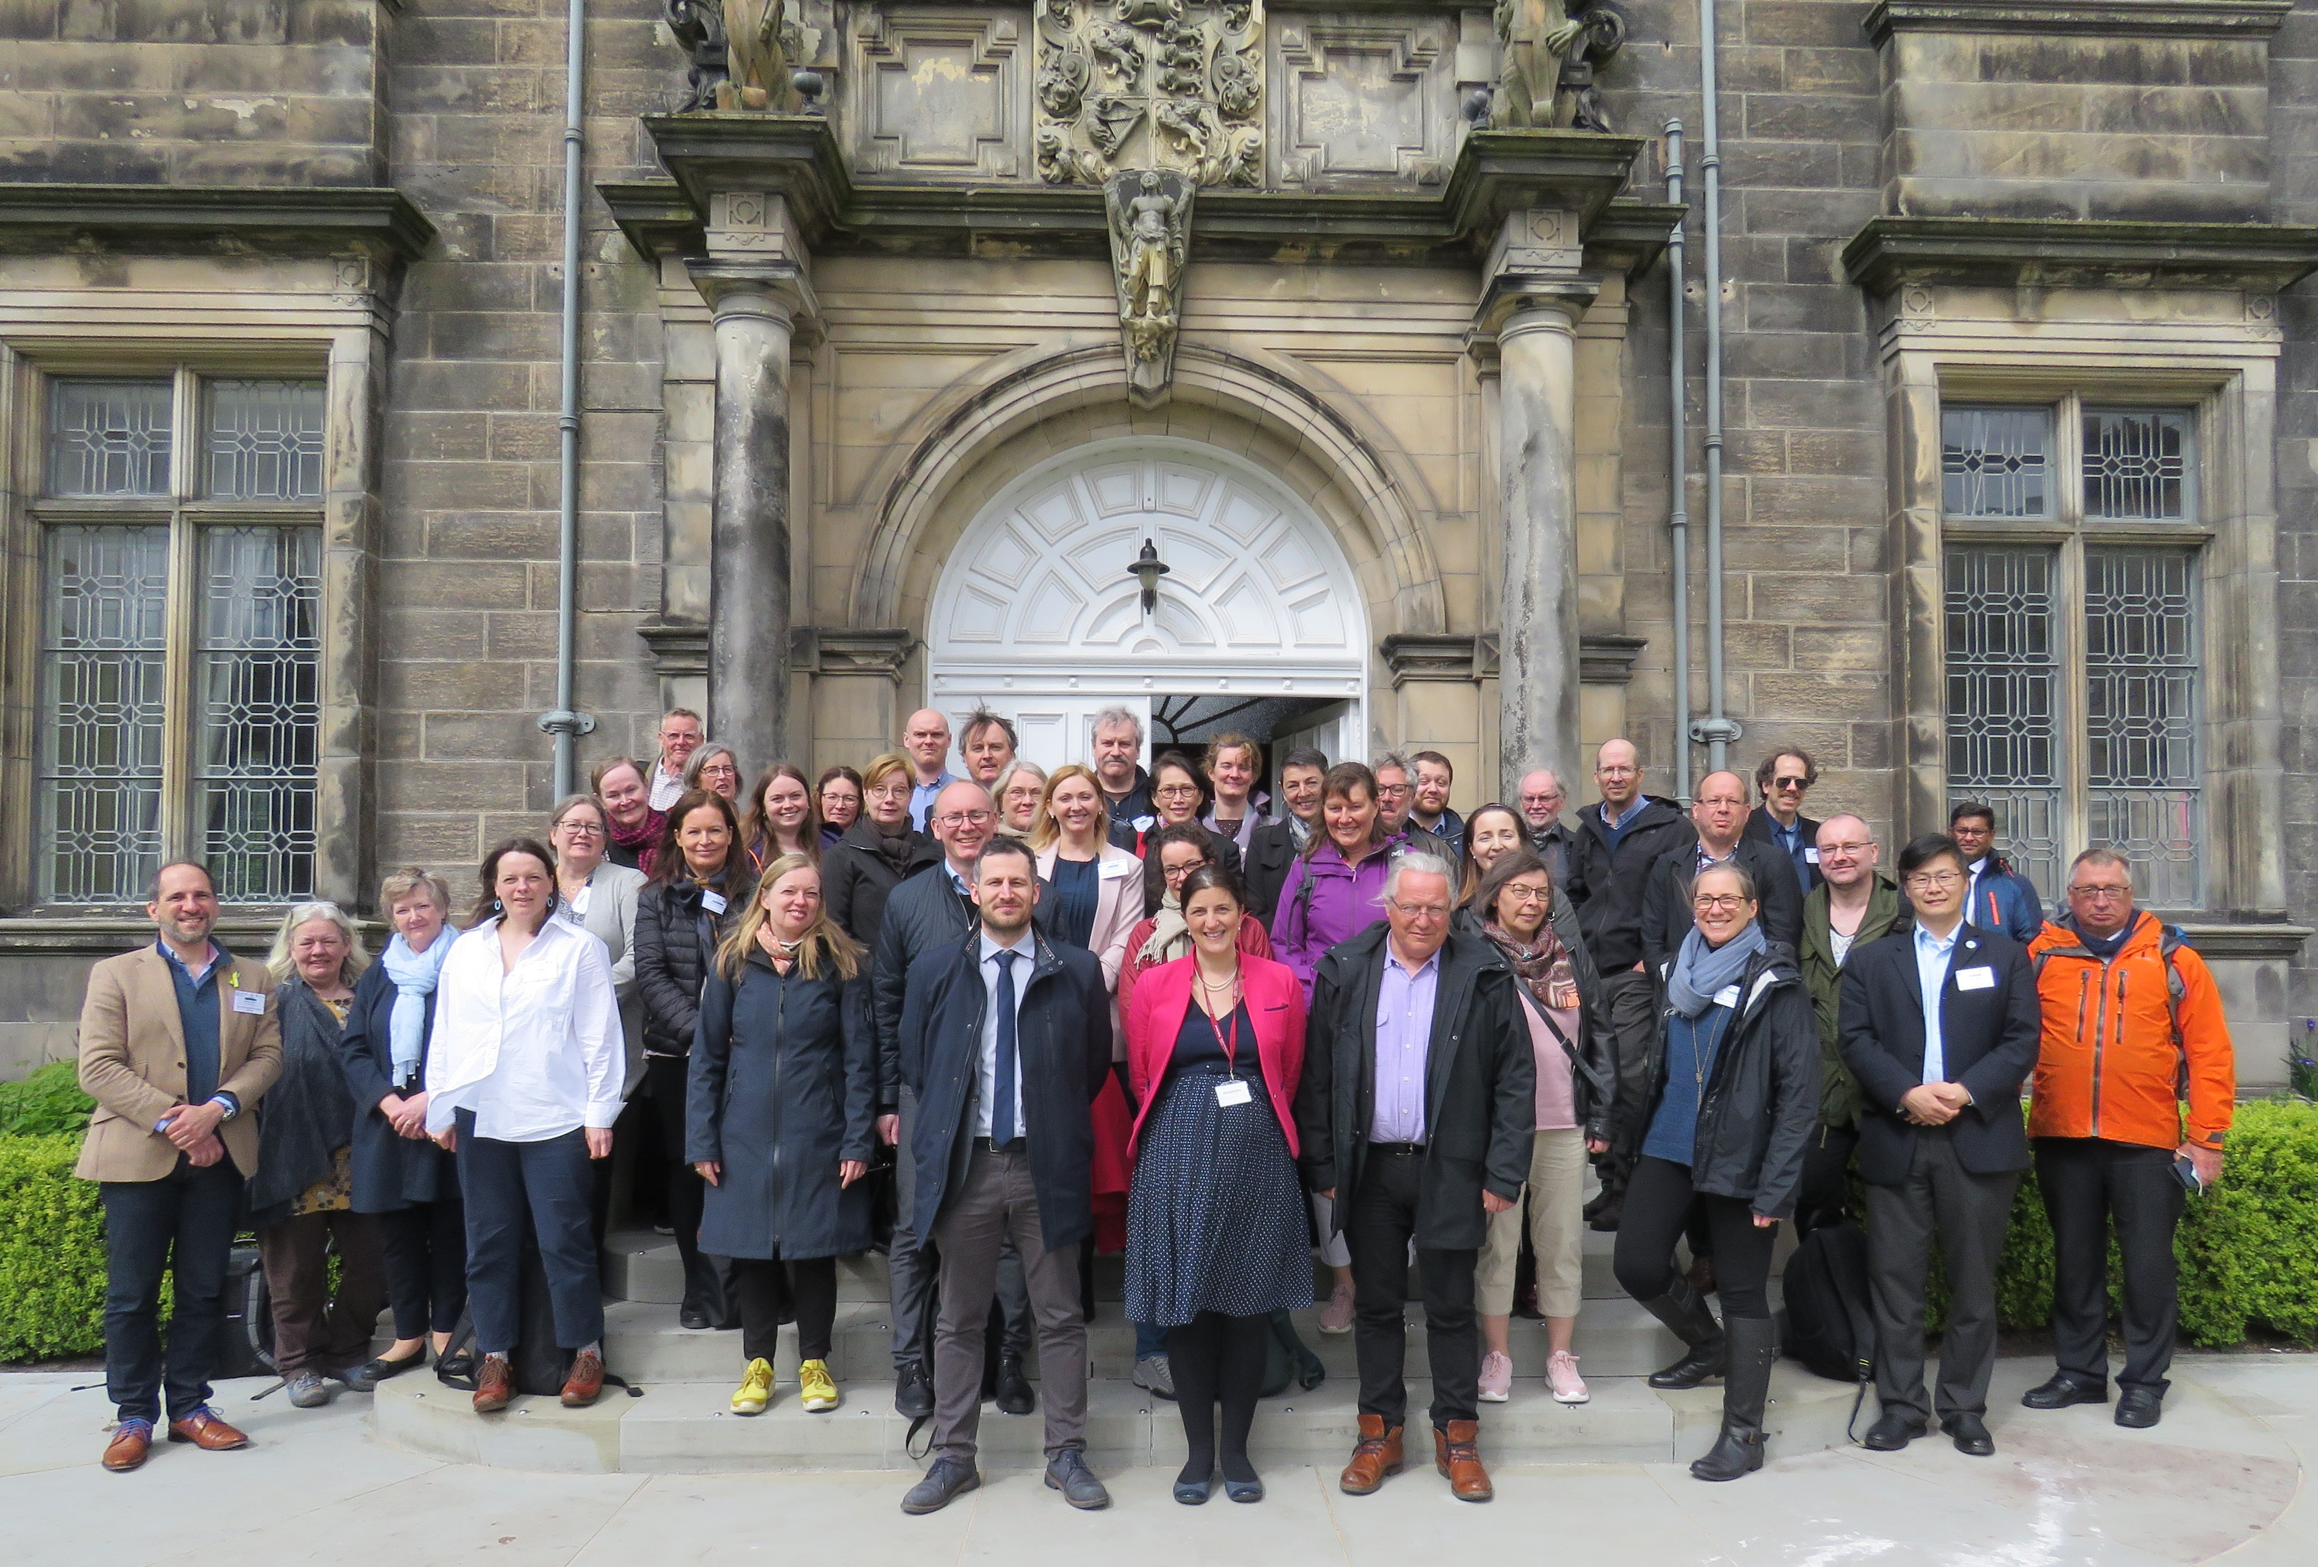
New Thematic Networks
The Assembly welcomed four new Thematic Networks:
Thematic Network on Decolonization of Arctic Library and Archives Metadata (DALAM), hosted by Polar Libraries Colloquy
Thematic Network on Digital North: Three-Dimensional Technologies and Arctic Education, hosted by UiT The Arctic University of Norway, Norway
Thematic Network on Frozen Arctic Conservation, hosted by University of Lapland, Finland
Thematic Network on Northern and Arctic Island Studies Research, hosted by University of the Highlands and Islands, Scotland
Thematic Networks leaders meeting in St. Andrews, Scotland, May 2022

Slide 4

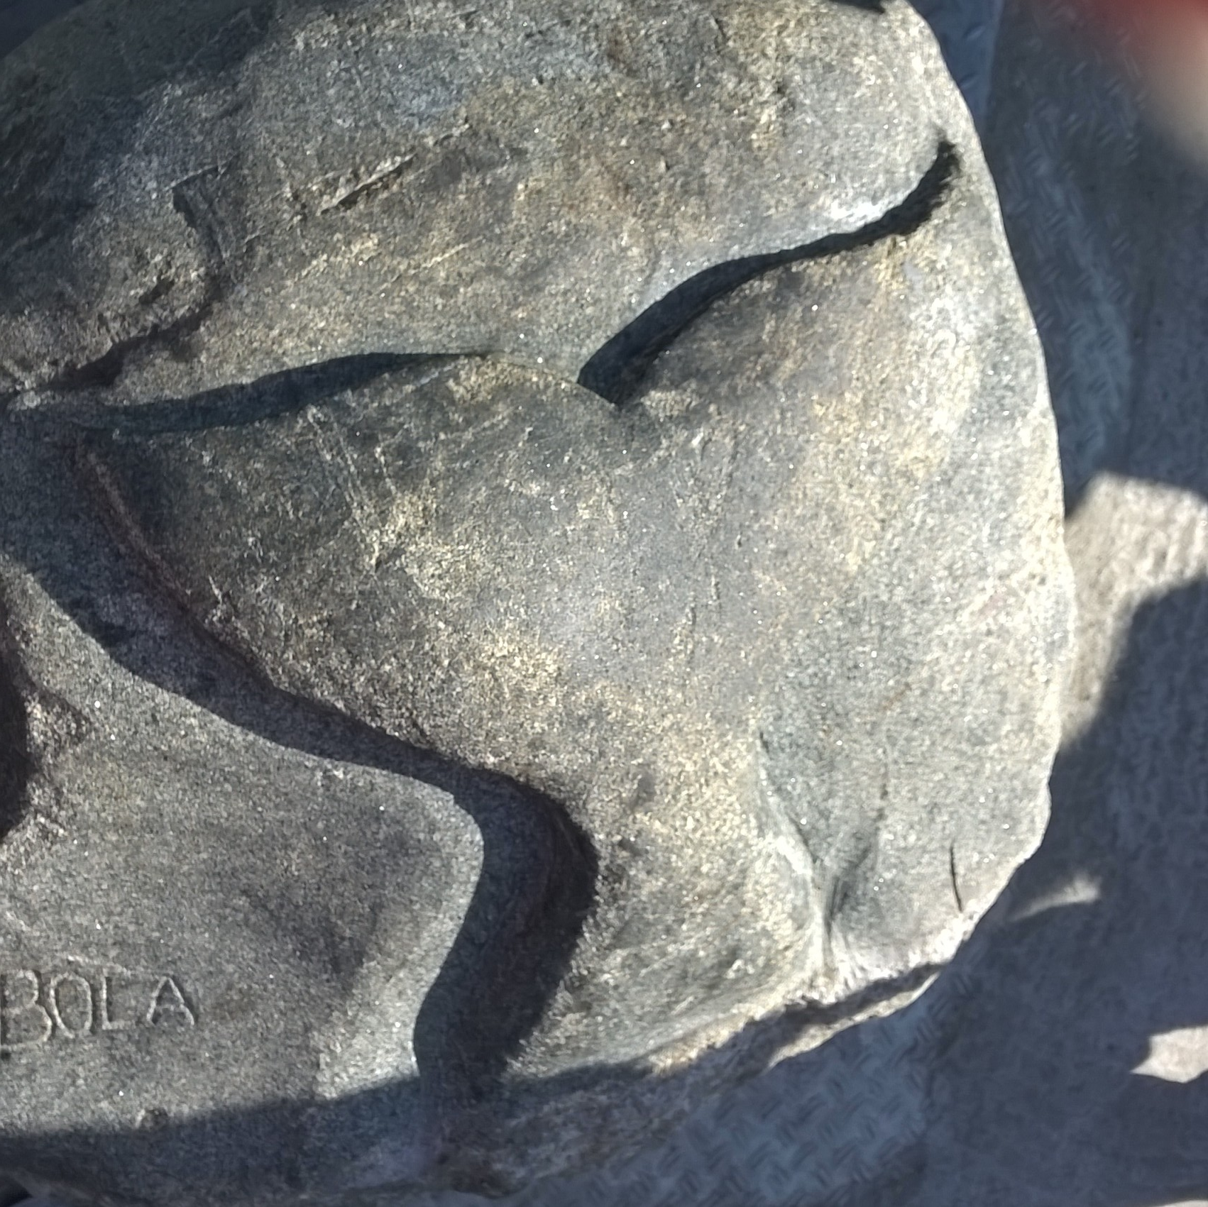
UArctic Chairs
David Anderson - UArctic Chair in Anthropology of the Arctic, University of Aberdeen
Odd Jarl Borch - UArctic Chair in Societal Safety and Security, Nord University
Jan Borm - UArctic Chair in Arctic Humanities, University of Versailles Saint-Quentin-en-Yvelines
Melody Brown Burkins - UArctic Chair in Science Diplomacy and Inclusion, Dartmouth
Bing Chen - UArctic Chair in Marine and Coastal Environmental Engineering (Arctic-MCEE), Memorial University of Newfoundland
Hanne Christiansen - UArctic Chair in Permafrost Physical Processes, University Centre in Svalbard
Kamrul Hossain - UArctic Chair in Arctic Legal Research and Education, University of Lapland
Timo Jokela - UArctic Chair in Arctic Art, Design and Culture, University of Lapland
Roland Kallenborn - UArctic Chair in Arctic Environmental Pollution Research, Norwegian University of Life Sciences
Karl Kreutz - UArctic Chair in Arctic Ice, Climate and Environmental History, Climate Change Institute - University of Maine
David Natcher - UArctic Chair in Water, Energy and Food (WEF) Security in the Arctic, University of Saskatchewan
Philip Steinberg - UArctic Chair in Political Geography, Durham University
Tuija Turunen - UArctic Chair in Education for Social Justice and Diversity, University of Lapland
https://www.uarctic.org/activities/chairs/

Slide 5
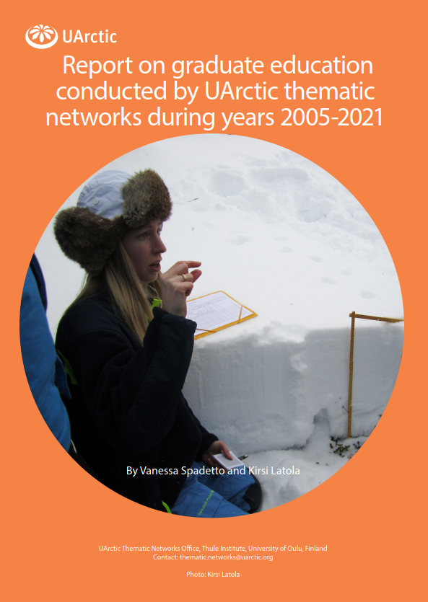
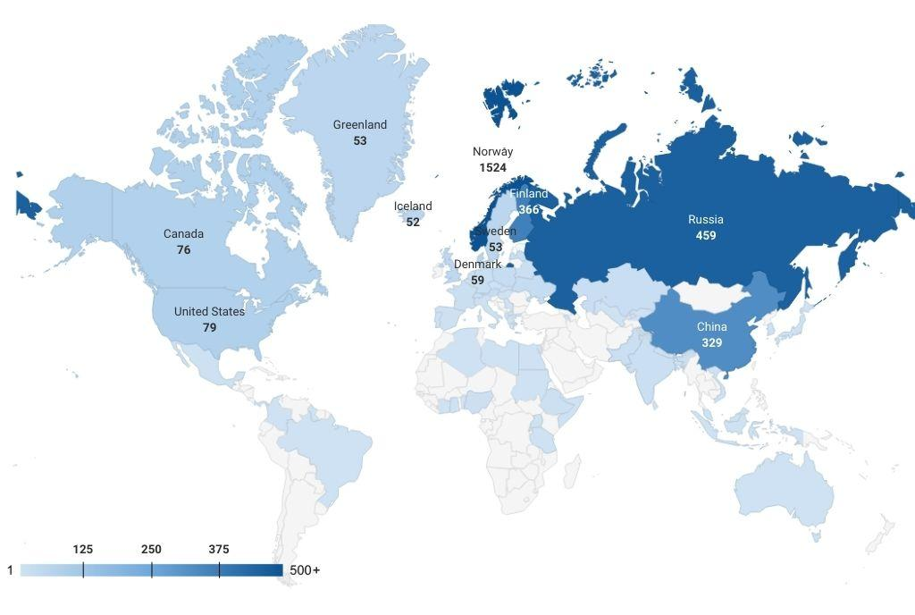
47 thematic networks & UArctic Institutes
474 graduate courses (Masters, PhD, field, onsite, online…)
Approx 11 000 students from 67 nations
Impact assessment, SWOT analysis and recommendations

Slide 6

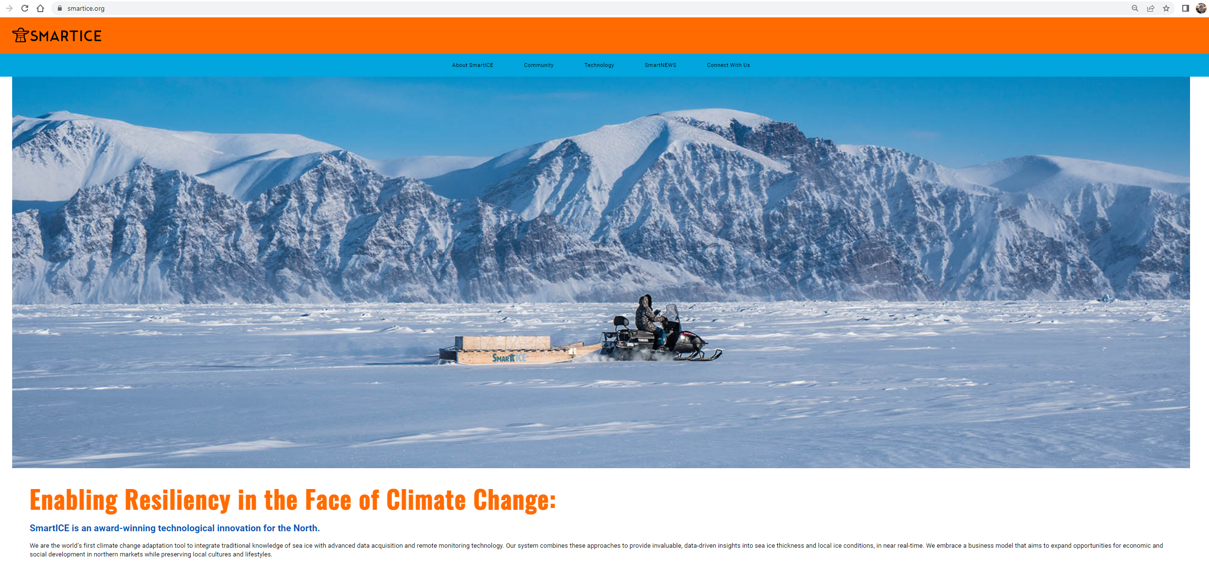
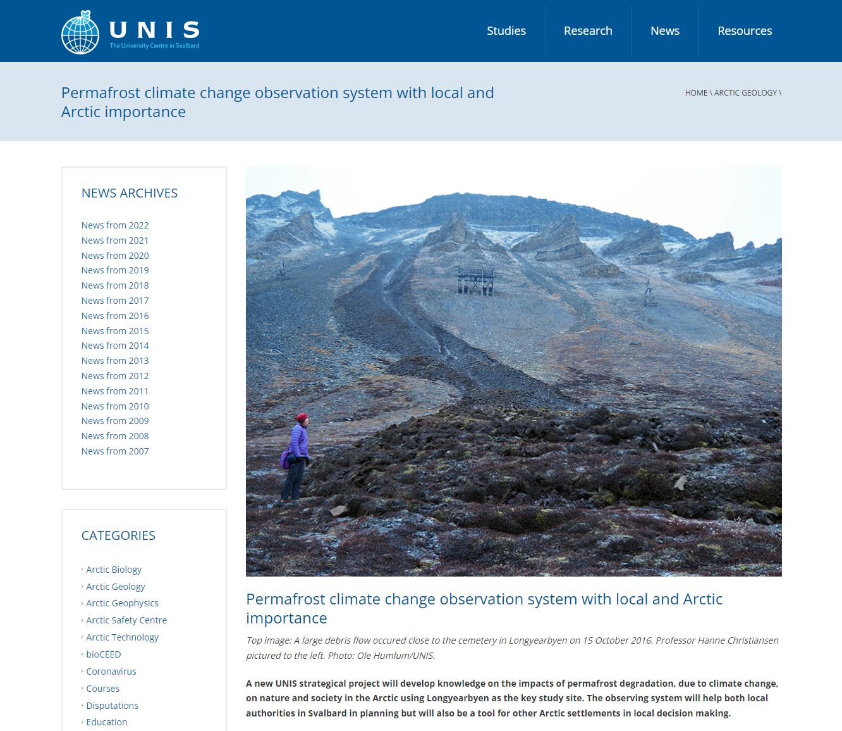


Arctic Academic Action Award
The Frederik Paulsen Arctic Academic Action Award serves to promote and raise awareness of promising projects which address climate change through concrete actions and plans.
2021 Award Winner: Trevor Bell, the SmartICE project
2022 Award Winner: Marius O. Jonassen and Hanne H. Christiansen, The PermaMeteoCommunity project
Prize 100 000 eur, a joint Award
by Arctic Circle and UArctic.

Slide 7
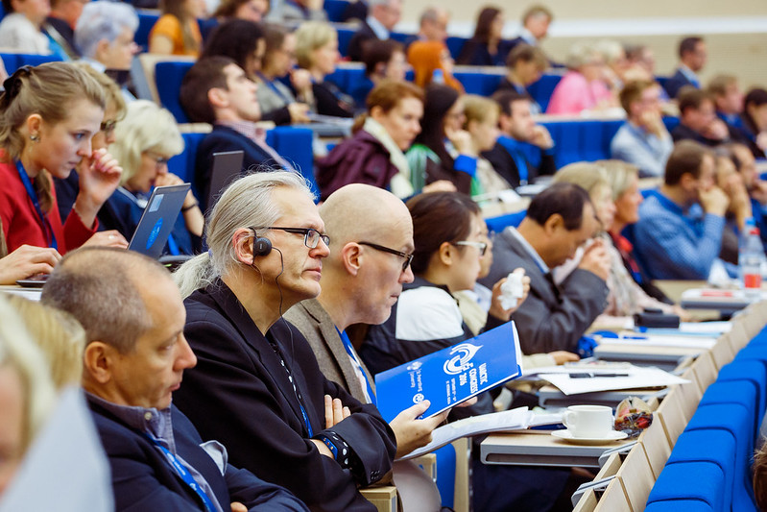
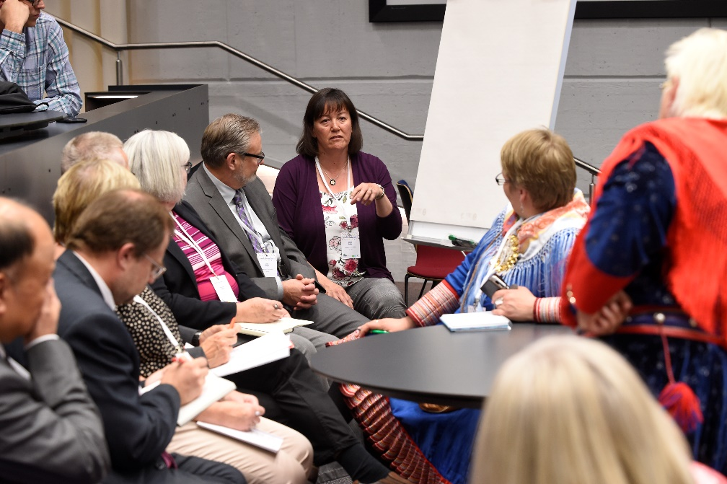


Arctic Congress 2024
Save the date!
Arctic Congress 2024 will take place May 29 - June 2, 2024 in Bodø, Norway hosted by Nord University.
The Congress will a joint together three events: UArctic Congress, the International Congress of Arctic Social Sciences (ICASS 2024) and the High North Dialogue 2024. Bringing these events together in Bodø - a 2024 European Cultural Capital - will be a showcase of Arctic cooperation, and provide excellent opportunities to meet and exchange without extra travel.

Slide 8
Thank you!
Want to know more?
uarctic.org

