Slide 1
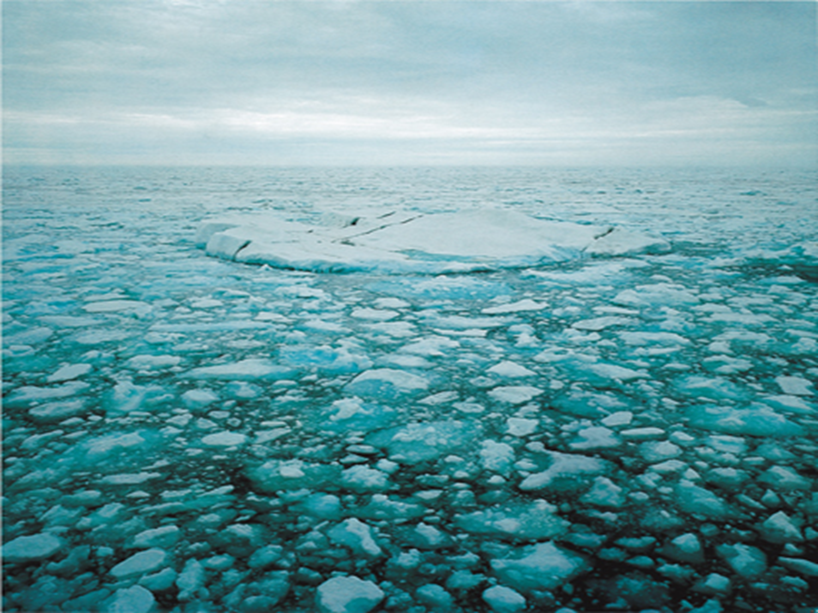
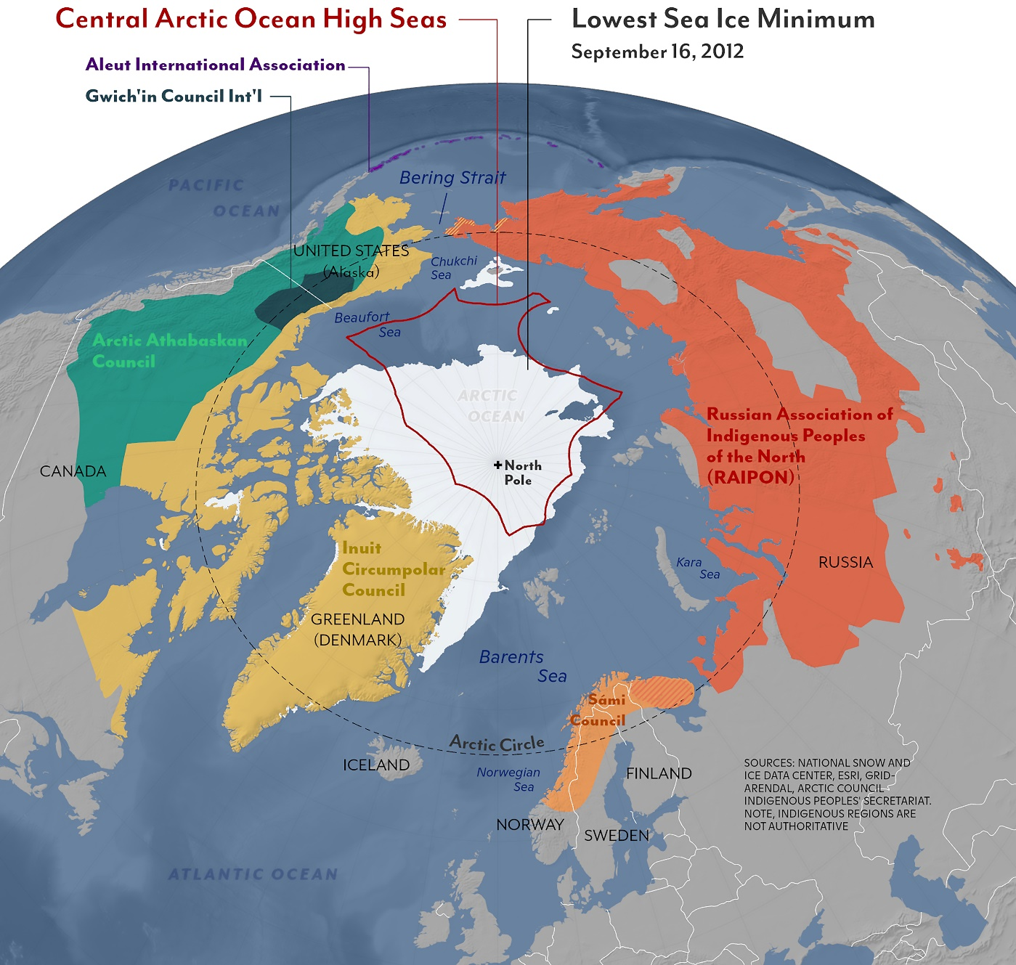
Stakeholders, Rightsholders and Other Actors
Professor Paul Arthur Berkman
United Nations Institute for Training and Research (UNITAR)
paul.berkman@unitar.org | pberkman@law.harvard.edu

Slide 2
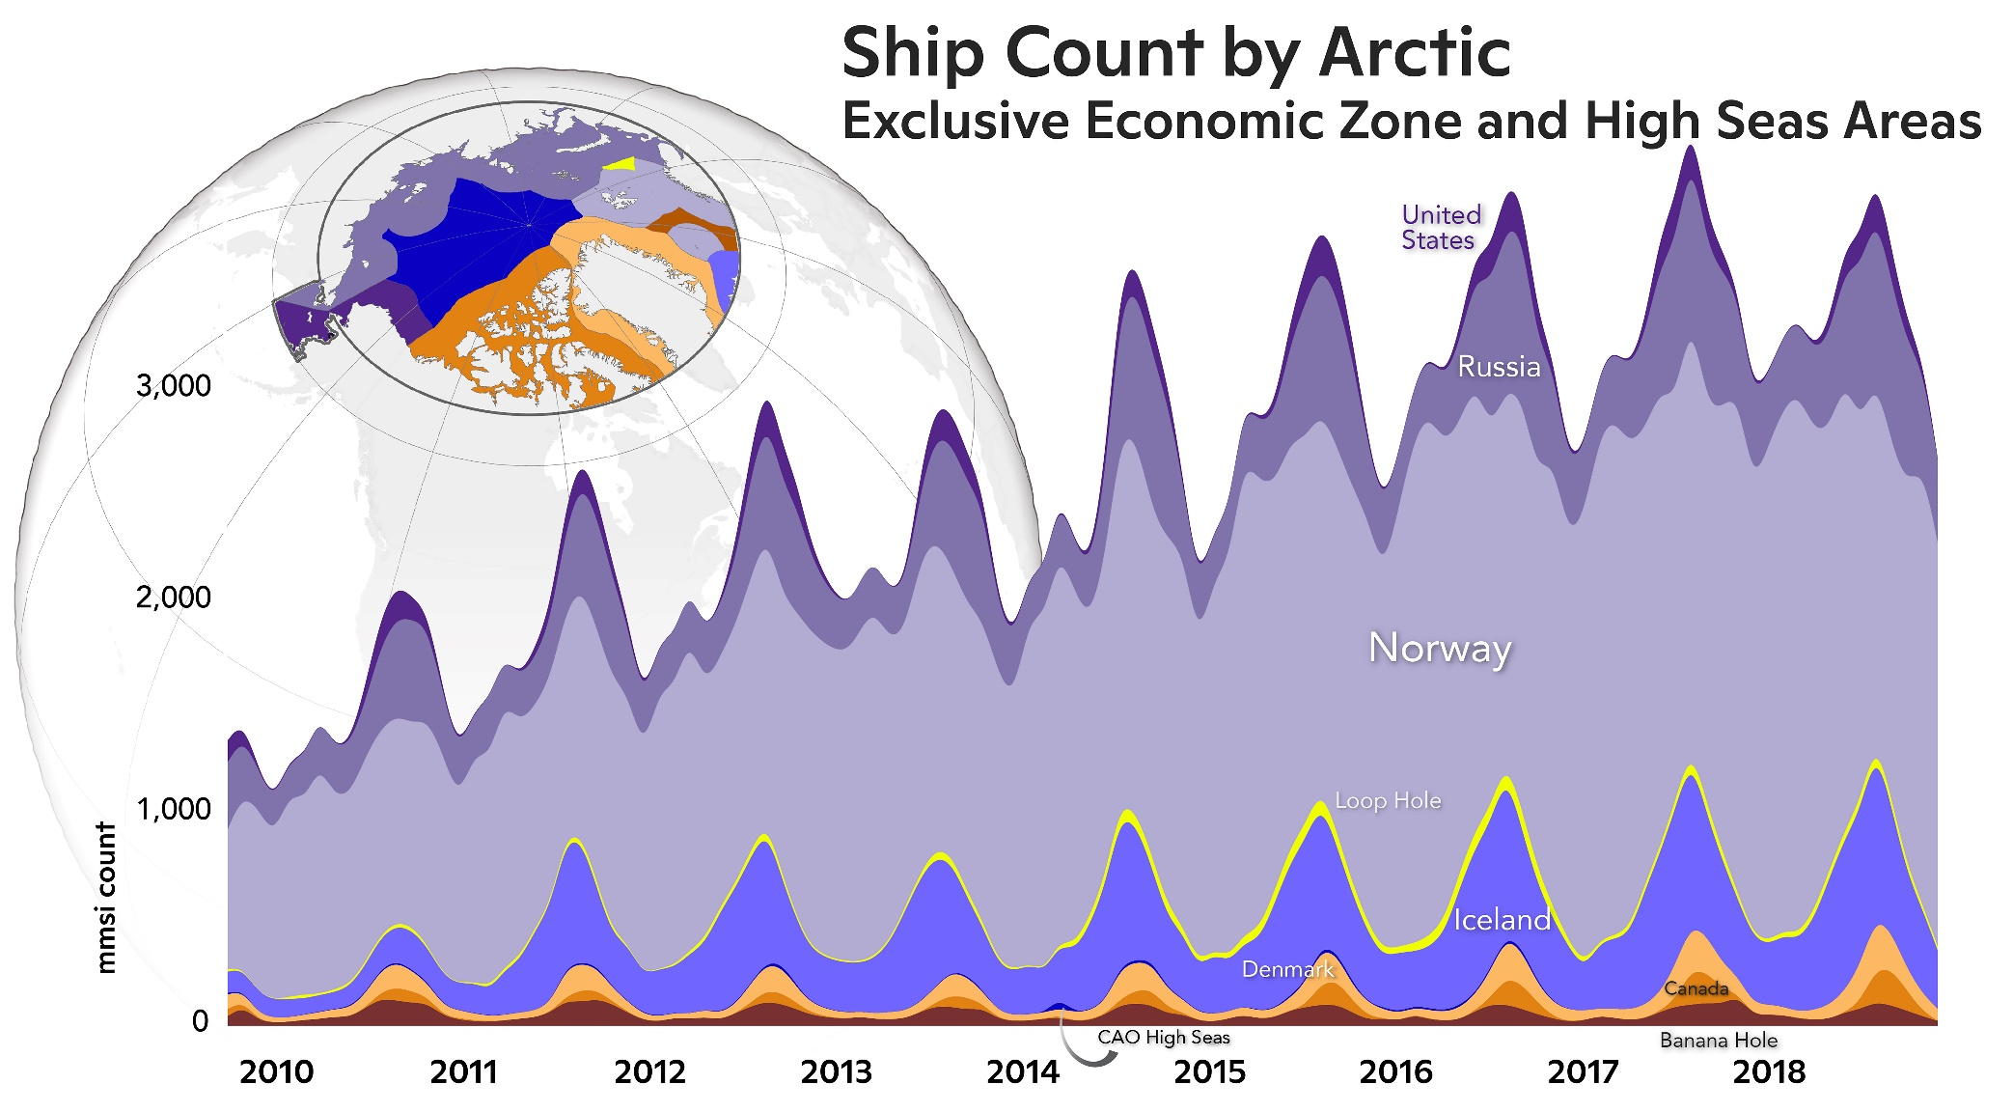
International, Interdisciplinary and Inclusive
Biogeophysical
Socio-Economic

