Slide 1
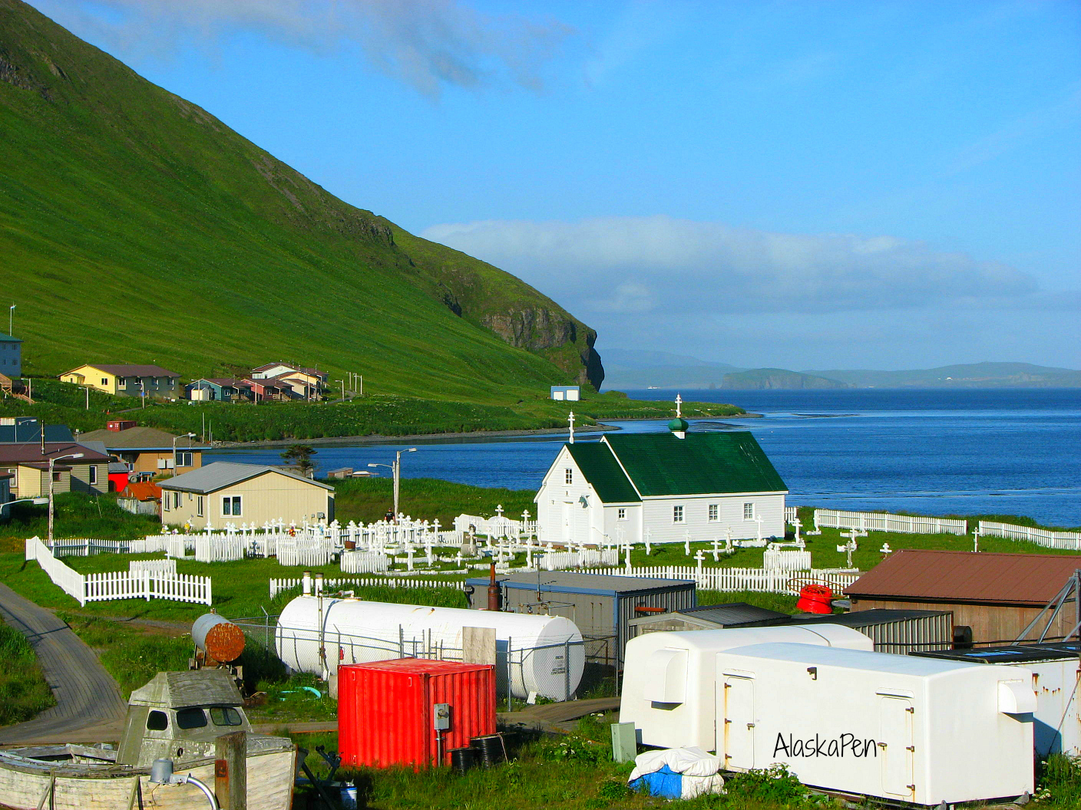
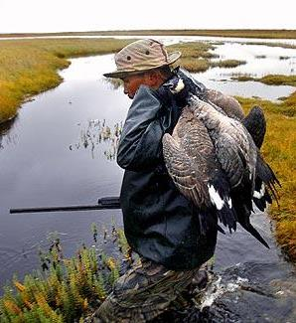
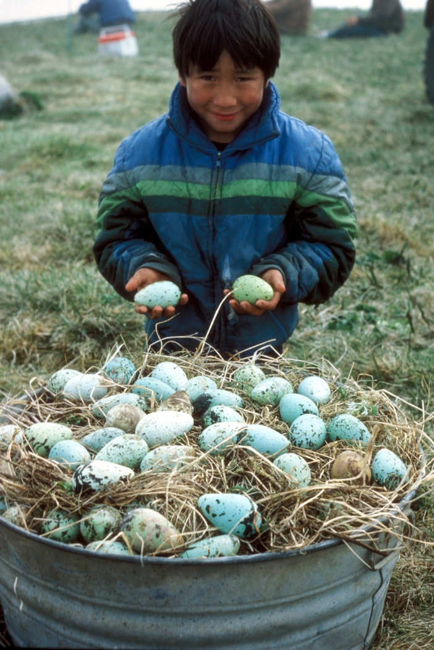
Generational Shifts in Subsistence Harvest Patterns
Arctic Research Collaboration Workshop
Implications for:
Food security in rural villages
Preservation of traditional ecological knowledge
Lara Mengak
Division of Subsistence
AK Dept. Fish and Game
lara.mengak@alaska.gov
907-267-2269
Notes:
Subsistence – “customary and traditional uses” of fish and wildlife, the unique importance of wild resources, and the continuing role of subsistence activities in sustaining the long-established ways of life in Alaska
Super Households – concept that the majority of harvest is being done by only a few households in a village
Small resources – small amounts of harvest predicting loss of harvest specialization; specifically, birds

