Slide 1
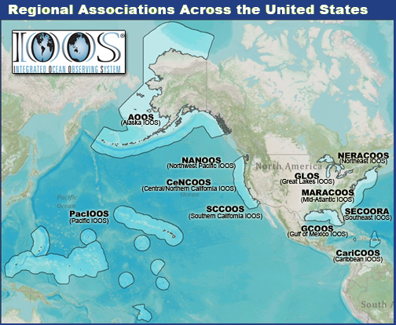
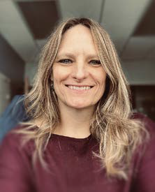
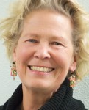
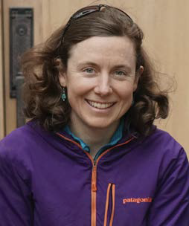
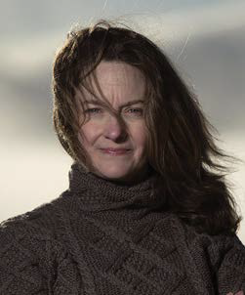
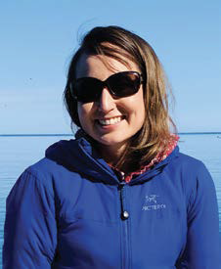
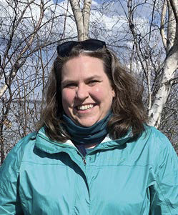
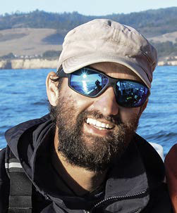
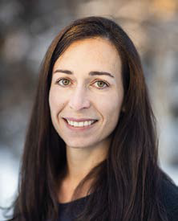
AOOS Background
Who is AOOS?
Part of Integrated Ocean Observing System (IOOS)
NOAA Program
1 of 11 Regional Associations across U.S.
Governed through Memorandum of Agreement with member from state & federal agencies, academe institutions, research facilities, industry, non-profit, Alaska Native
Staff
Sheyna Wisdom, Executive Director, started in Jan 2021
Molly McCammon staying on as Senior Advisor through at least Dec 2022
Alice Bailey, Director of Outreach, will start in Dec 2022
Megan Onders, Director of Engagement, started in Jul 2022
Jill Prewitt, Regional Data Sharing Coordinator
Thomas Farrugia, Alaska Harmful Algal Bloom (AHAB) Coordinator
Darcy Dugan, Director of Ocean Acidification (OA) Network
Carol Janzen, Director of Operations
Holly Kent, Director of Administration
1

Slide 2
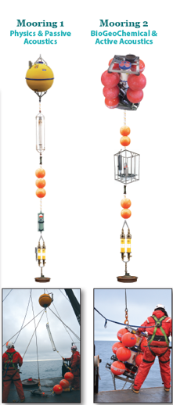
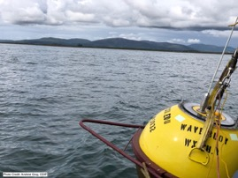
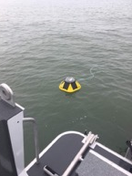
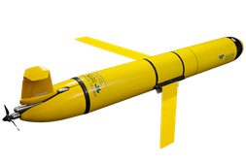
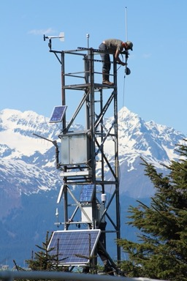
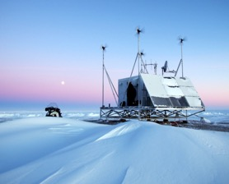
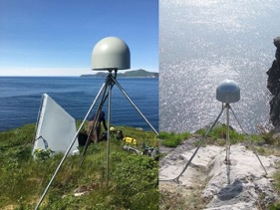
AOOS Arctic Observing Assets and Activities
Ecosystem Moored Observatories
Moored Ecosystem Observatories in Chukchi Sea, southern and northern Bering Sea
OA sensors on the Beaufort Lagoon Ecosystems Long Term Ecological Research Moorings in the Beaufort Sea
Wave Buoys
Seasonal Coastal Data Information Program (CDIP) Wave Buoy in Nome
New projects to support community wave buoy installations using Sofar buoys
Weather Stations
17 Weather stations co-installed with AIS stations
Glider Surveys
Annual glider surveys in Chukchi Sea mapping marine mammal acoustic detection and oceanographic data
Ecosystem glider surveys planned for Bering Sea 2023
High Frequency Radar (HFR) Installations
3 sites in Chukchi & Beaufort Sea coasts
2 sites in Bering Strait region, with new one in 2022
Water Level Stations
2 GNSS-Reflectometry water level stations in Norton Sound & Utqiaġvik
2 NWLON-LITE water level stations in Bristol Bay region
7 iGage & Radar water level stations in western AK communities
2

Slide 3
What is next for AOOS?
New Grants
U.S. Integrated Ocean Observing System (IOOS)/NOAA 5-year cooperative agreement 2021-2025
National Science Foundation (NSF) Convergence Accelerator Program Phase II: Sofar Wave Buoys in Indigenous communities
Infrastructure and Investment in Jobs Act (IIJA) upgrade to equipment and new Regional Ocean Partnership projects.
This includes support to ARCUS for two Sea Ice for Walrus Outlook observers to come to Alaska Marine Science Symposium and purchase of hand-held weather meters.
Stakeholder Outreach/Engagement
Hired two new personnel to expand outreach and engagement
New KNOM Ocean Knowledge Radio Show
Data Portal Enhancements
Seek New Partnerships
Continue to Cultivate Existing Partnerships
Continue Innovative Technologies
3

