Slide 1
Arctic Research at Rutgers
Rutgers has a long tradition of Arctic research, dating back John Tedrow’s work on Arctic soils in the mid-1900s.
Today’s Rutgers Arctic researchers are found in several departments, studying social systems, atmosphere, ocean, microbiology, hydrology, and glaciers.
Here are some examples of current Arctic Research at Rutgers:
Fjord and tidewater glacier dynamics and biogeochemical inputs
Greenland fjord circulation dynamics – application of temperate estuarine frameworks to Greenland’s glacial fjords
Direct measurements of submarine melting at LeConte Glacier, AK with coordinated underwater acoustic, optical, and in-situ unmanned observations
Impact of increased glacial meltwater on nutrients, trace elements, and isotopes in SW Greenland fjords and the adjacent Labrador Sea.
Contact: Rebecca Jackson (rjackson@marine.rutgers.edu) and Robert Sherrell (sherrell@marine.rutgers.edu)
2 / 3

Slide 2
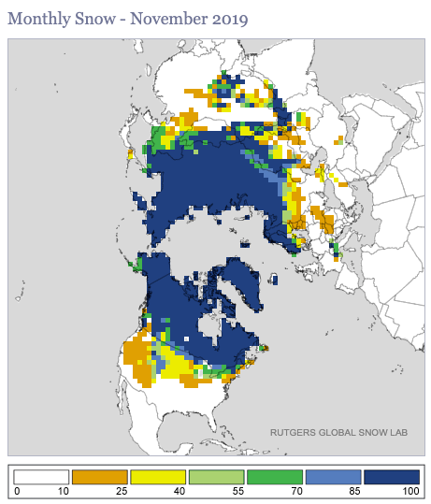
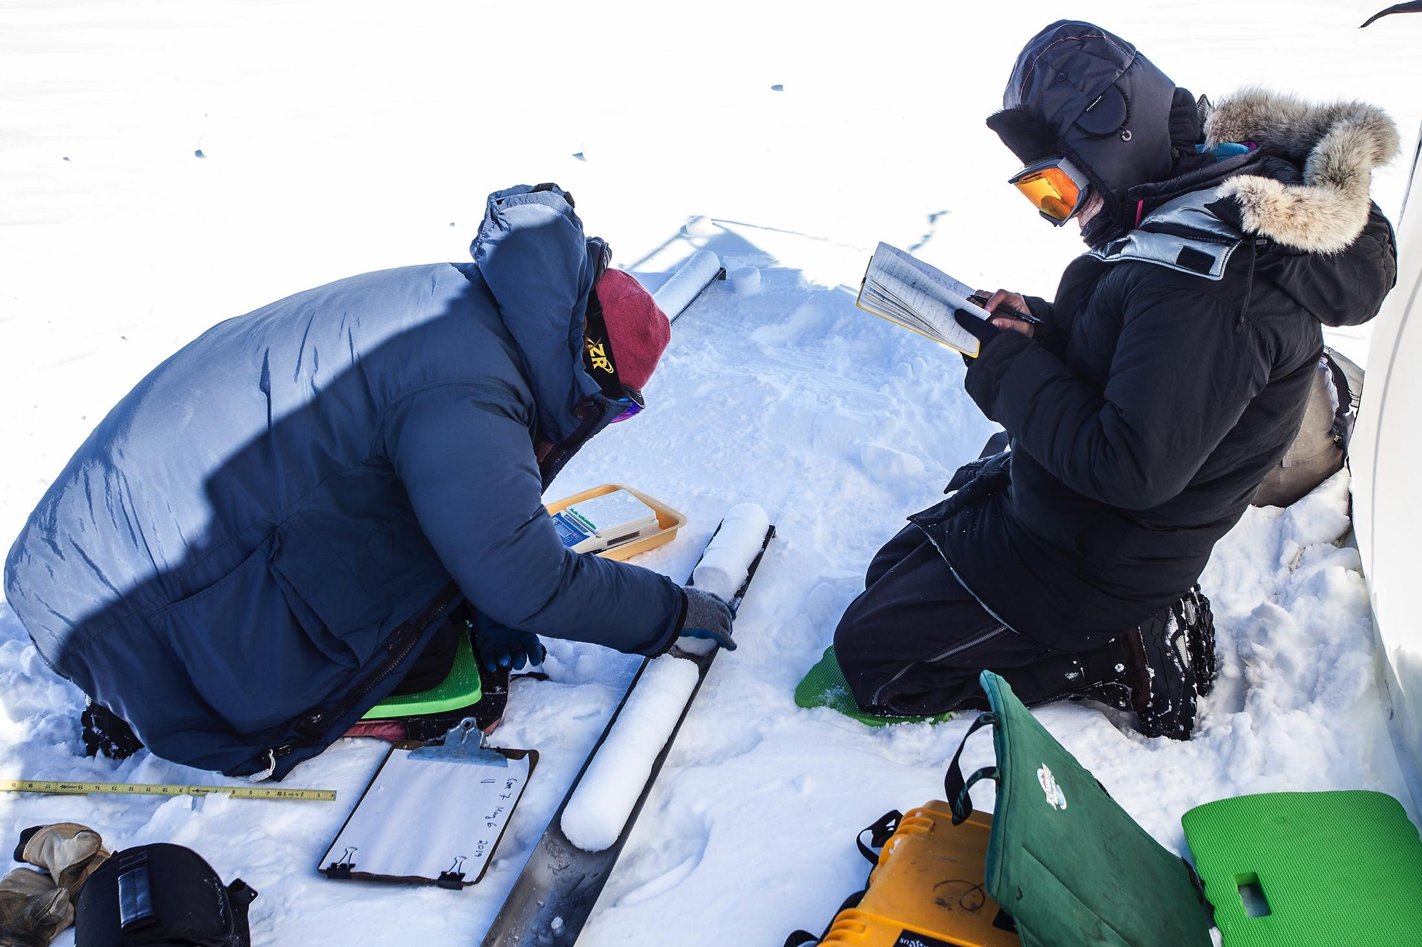
Northern Hemisphere snow cover
Long term monitoring of snow cover
High quality climate data records
Contact: David Robinson (david.robinson@rutgers.edu)
Greenland Ice Sheet hydrology and climate
Supraglacial & proglacial stream measurements; validation of model output
Supraglacial stream catchment and atmospheric characterization with UAV observations
Firn structure – evolution of density and ice layers through time
Chemical composition of surface snow layer
Coupled ocean-atmosphere controls on ice sheet surface melt and mass balance
Contact: Åsa Rennermalm (asa.rennermalm@rutgers.edu)
2 / 3

Slide 3
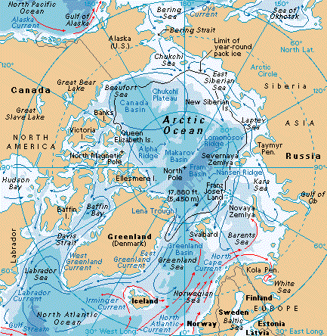
Arctic land hydrology and climate
Climate model projections of 21st century changes in river discharge
Recent and projected changes in freshwater pathways in the Arctic
Arctic Amplification and climate feedbacks (e.g. water vapor)
Mapping and modeling nesting habitat for Arctic breeding shorebirds to inform conservation management
Tundra microorganism activity in subzero temperatures
Contact: Jim Miller (miller@marine.rutgers.edu)
Ecology and microbiology
Contact: Richard Lathrop (lathrop@crssa.rutgers.edu) and Max Haggblom (haggblom@rutgers.edu)
3 / 3

