Slide 1

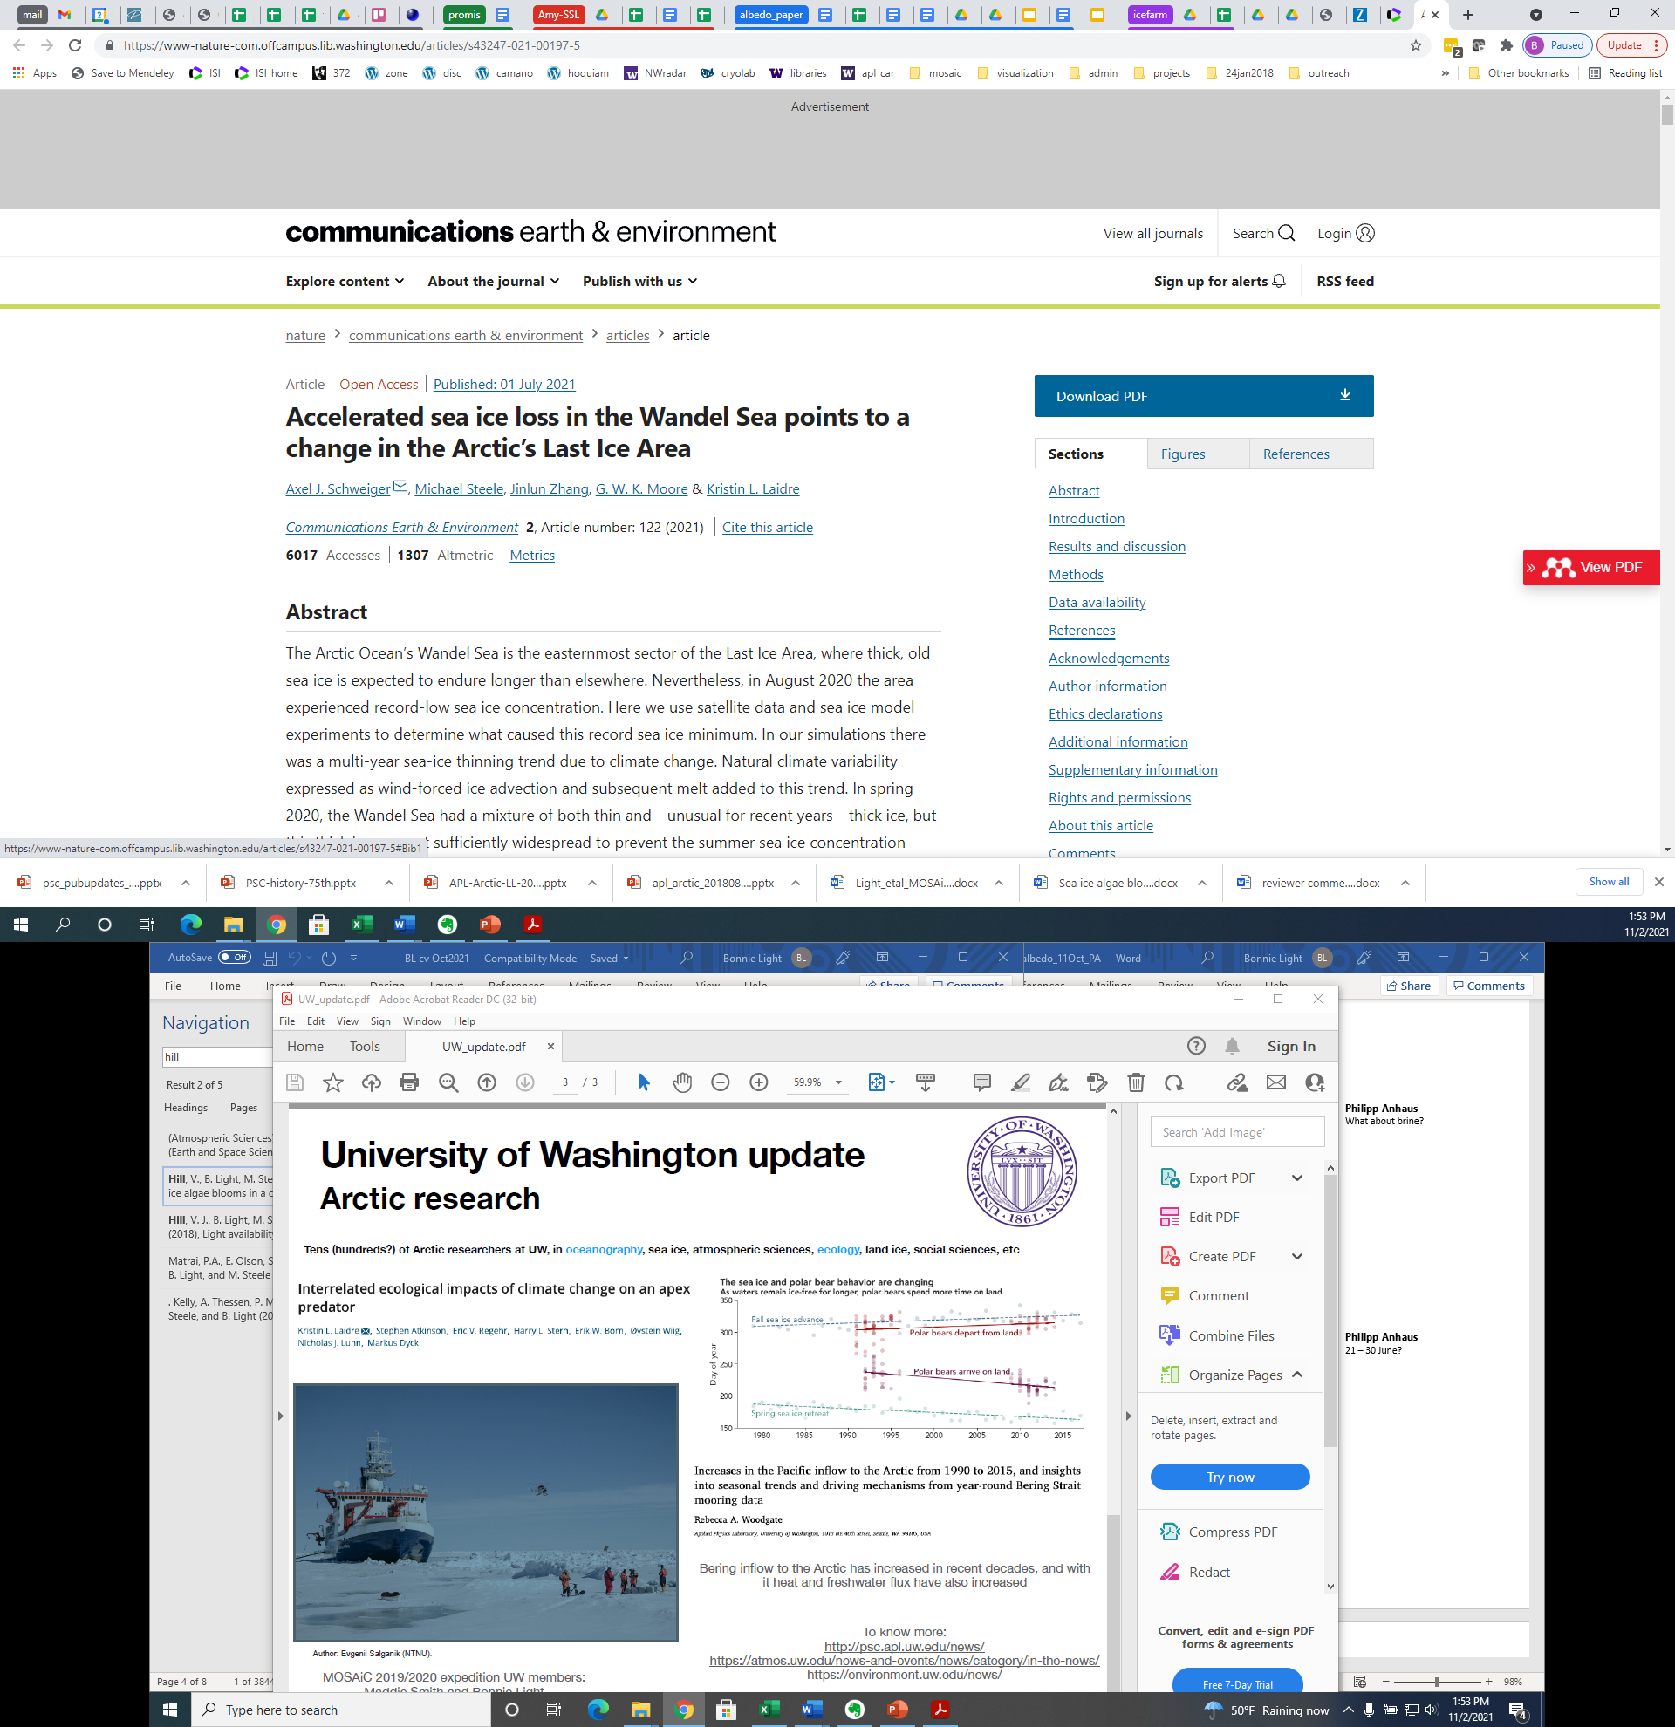
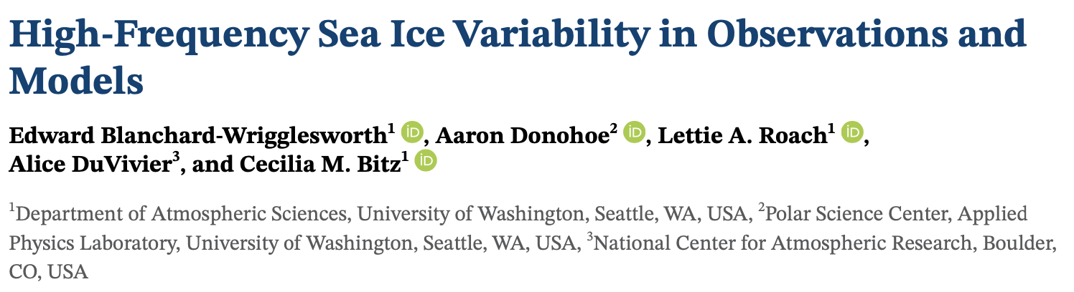
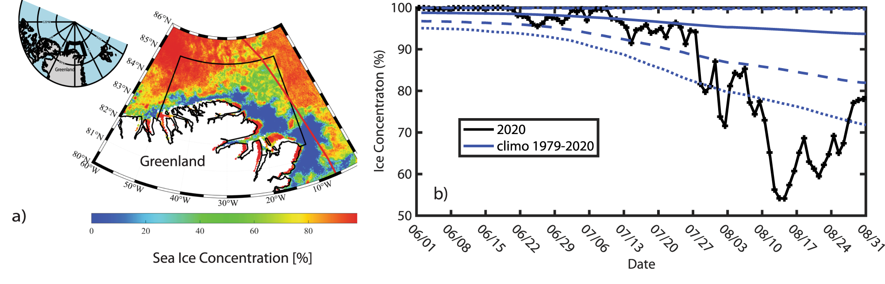
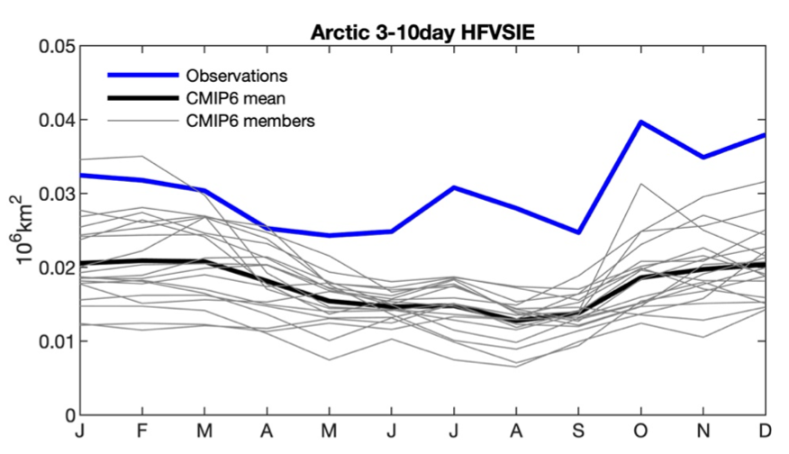
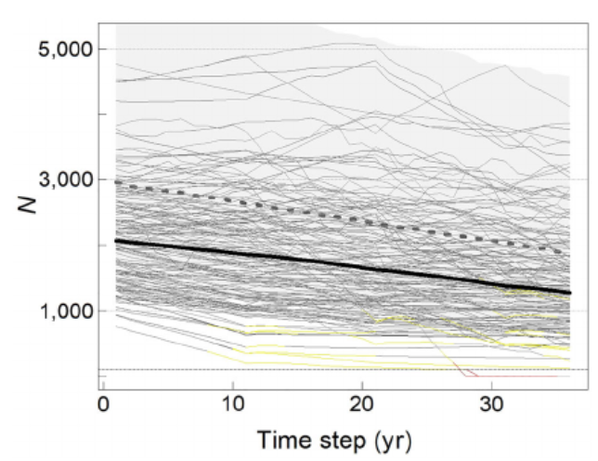
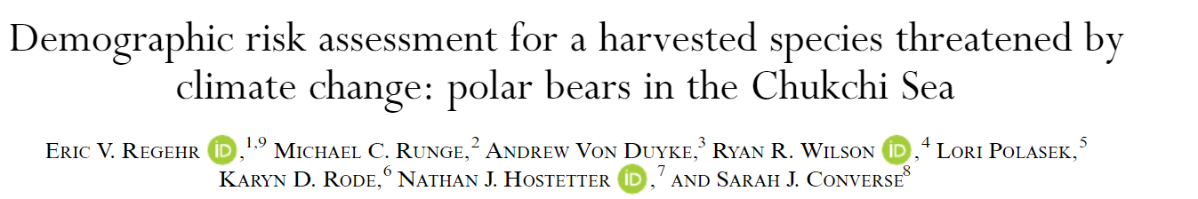
University of Washington update
Arctic research
Arctic research spans many disciplines (oceanography, sea ice, atmosphere, ecology, climate, land ice, social sciences, +++) and several UW units:
Dept of Atmospheric Sciences within College of Environment
School of Oceanography
Polar Science Center – Applied Physics Lab
- Model variability < observed variability
- Waves & ice/ocean interactions?

Slide 2
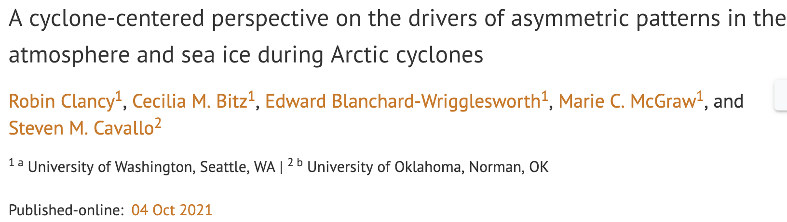
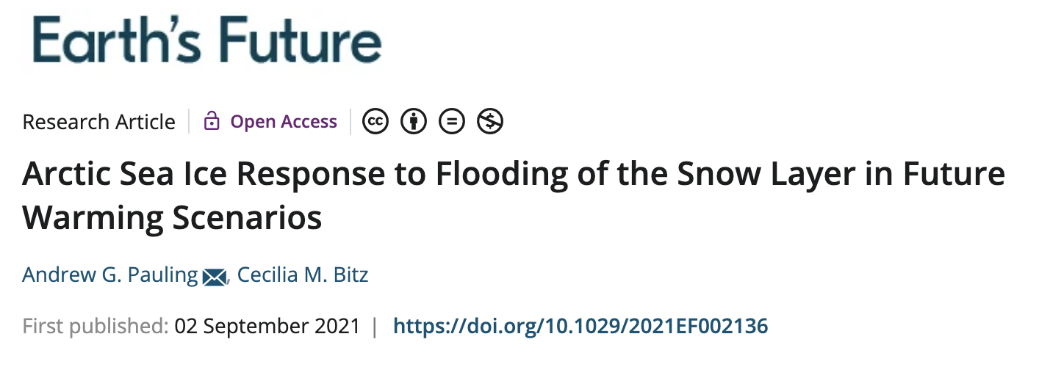
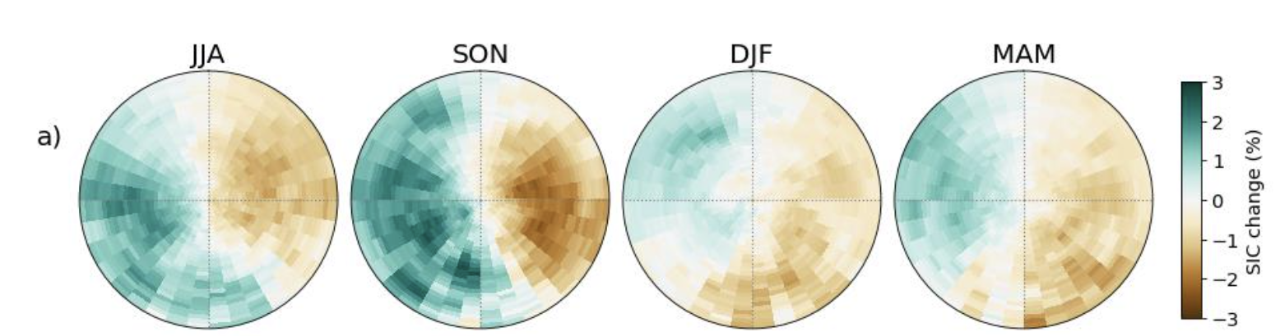
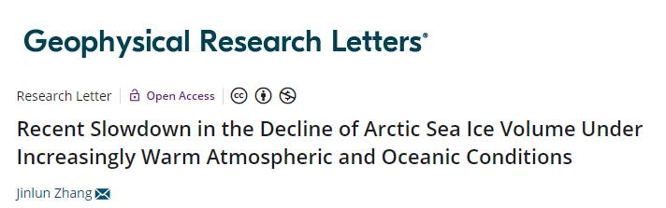
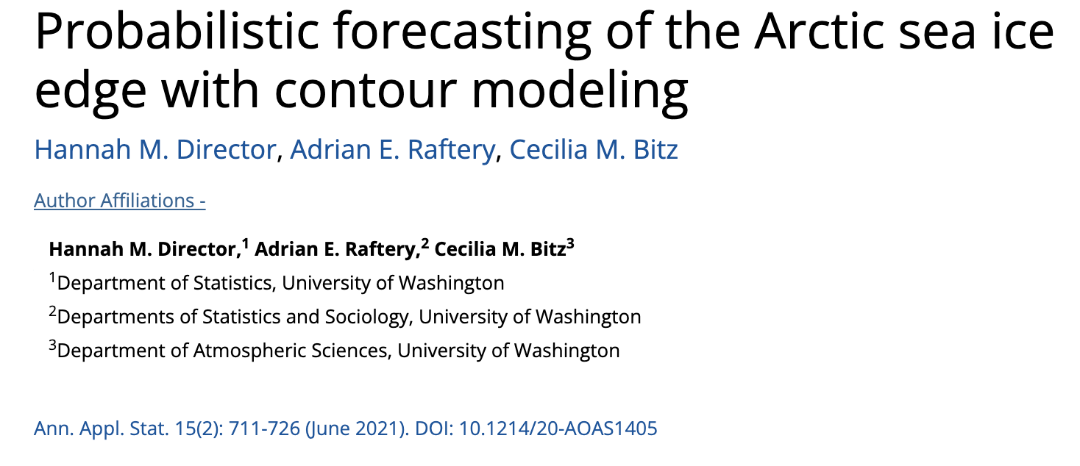
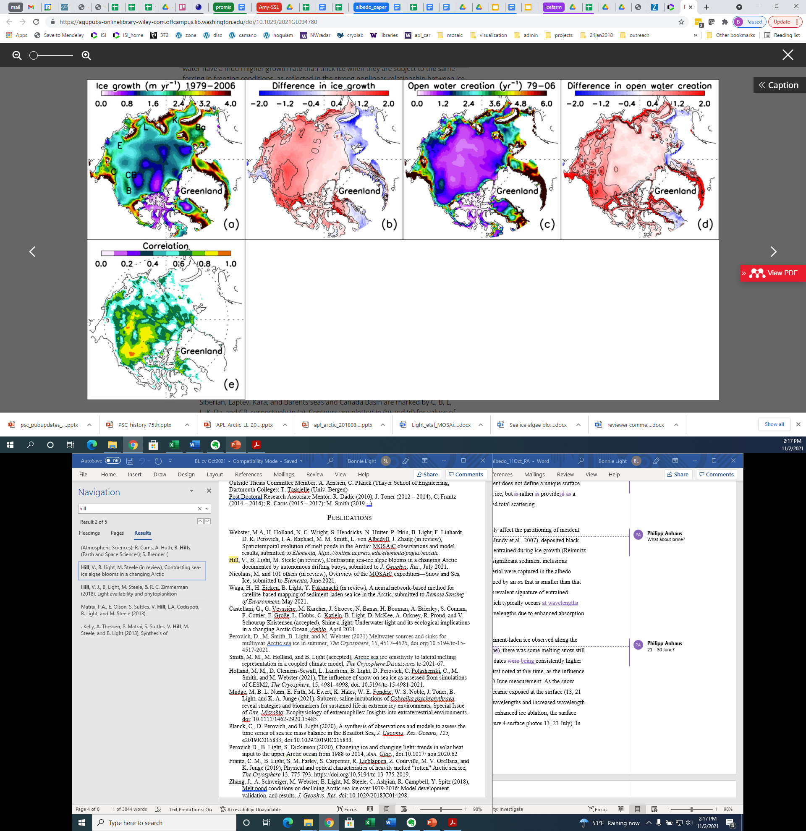
Study of geoengineering proposal shows that neither natural nor artificial flooding of snow on Arctic sea ice is sufficient to offset projected declines of Arctic sea ice
Sea ice concentration changes associated with Arctic cyclones in each season, shown as the anomaly in change from 5 days before to 5 days after a cyclone passage over a point. Cyclones re-distribute rather than impact overall sea ice.
New sea ice forecast that combines ensemble output with observed recent distribution shows enhanced skill

Slide 3
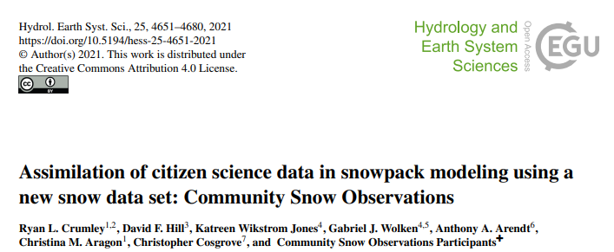
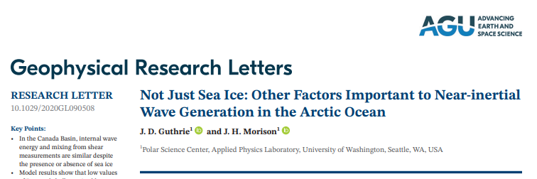
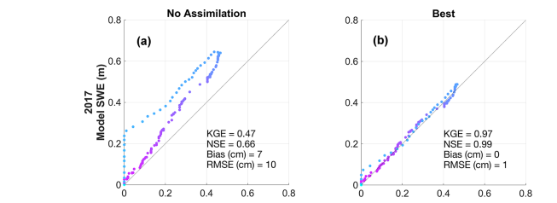
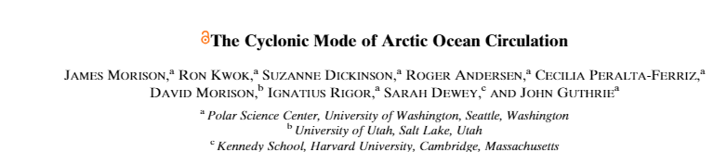
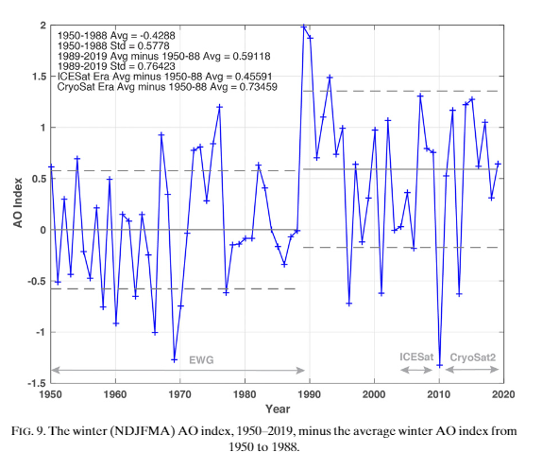
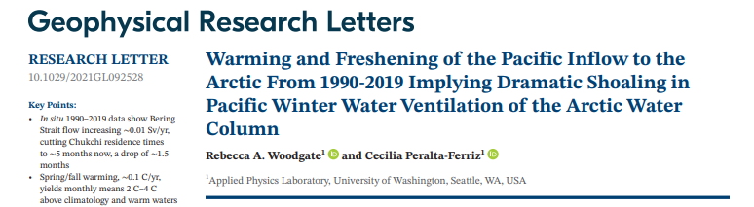
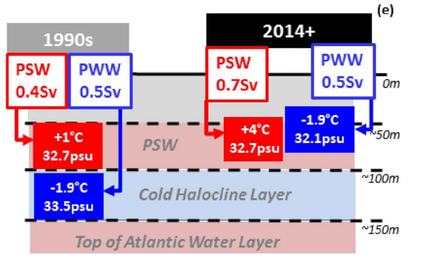
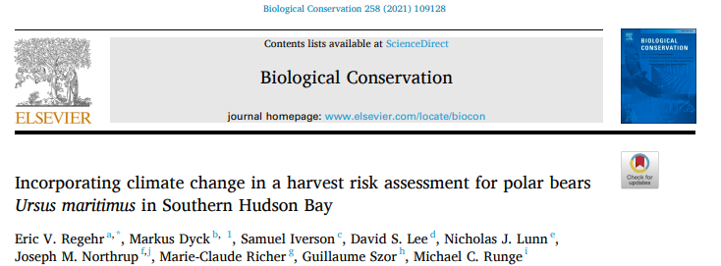
To learn more:
http://psc.apl.uw.edu/news/
https://atmos.uw.edu/news-and-events/news/category/in-the-news/
Coming soon…MOSAiC publications!

