Slide 1
Cold Climate Housing Research Center Becomes
NREL’s New Center of the North
CCHRC Joined the National Renewable Energy Laboratory in July 2020
Significance & Impact
Expands work in advancing energy efficiency and clean energy in Arctic communities
Launched a new partnership with the national lab adding 20 years of experience researching and demonstrating energy efficient, durable, affordable housing and infrastructure in the Arctic. More at https://medium.com/@nationalrenewableenergylab/adding-an-alaska-housing-research-center-furthers-our-labs-reach-1d8345cc1978
Notes:
[INSERT FIGURE CAPTION & CREDIT]
[Figure: CCHRC’s Research & Testing Facility in Fairbanks, Alaska. Source: CCHRC-NREL]
[INCLUDE FOR PUBLICATION HIGHLIGHT SLIDES]
Publication Highlight
Article Title: XX
Publication Title: XX
Impact Factor: X.XX
Publication Date: [MONTH DAY, YEAR]
Publication Link: [URL WITH LIVE LINK]
NREL Authors: [FIRST NAME LAST NAME]
[INSERT MORE DETAILED NOTES DESCRIBING:
NEED FOR RESEARCH.
RESEARCH ACTIVITIES.
WHAT MAKES RESEARCH/APPROACH UNIQUE.
SIGNIFICANCE & IMPACT.
PARTNERS.
LINK TO PUBLISHED REPORT/ARTICLE FOR MORE INFO.]
[INCLUDE FOR NON-PUBLICATION HIGHLIGHT SLIDES]
NREL team includes:
[LIST TEAM MEMBERS BY FIRST NAME LAST NAME.]

Slide 2
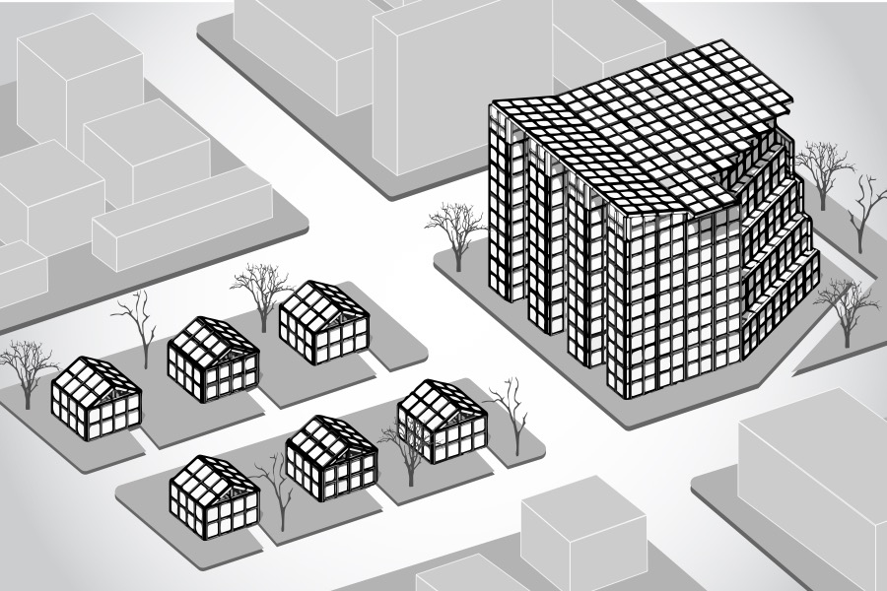
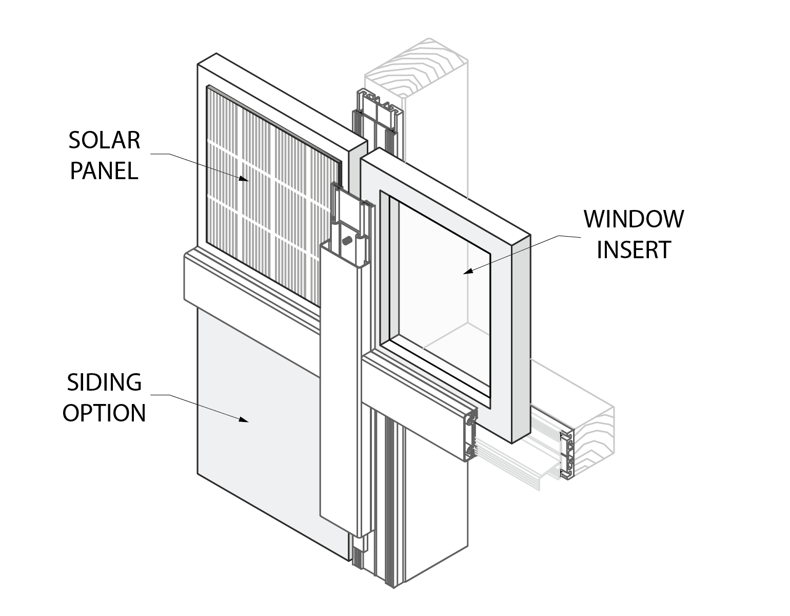
Developing ”New Iglu” to Bring Affordable, High-Efficiency Housing to the Masses
CCHRC was awarded DOE’s “Advanced Building Construction” Award to develop a prototype
New Iglu is an affordable, flat-pack building system combining cutting edge vacuum insulation with well-established building components to create modular building kit
Borrows structural frame and curtain wall glazing system used in high rise buildings across the world
High-efficiency buildings could be used from the Arctic to the Tropics
Made it to final round of $2-million Wells Fargo “Housing Affordability Breakthrough Challenge”
Significance & Impact
Provides a durable, energy efficient, low-cost, quick deployable modular building technology with the potential to transform the housing industry.
Provides a practical solution for low-income housing that reduces energy use and dependence on fossil fuels
Notes:
[INSERT FIGURE CAPTION & CREDIT]
[Figures: Testing Vacuum Insulated Panels at CCHRC. Diagram of New Iglu Building System. Source: CCHRC-NREL
[INCLUDE FOR PUBLICATION HIGHLIGHT SLIDES]
Publication Highlight
Article Title: XX
Publication Title: XX
Impact Factor: X.XX
Publication Date: [MONTH DAY, YEAR]
Publication Link: [URL WITH LIVE LINK]
NREL Authors: [FIRST NAME LAST NAME]
[INSERT MORE DETAILED NOTES DESCRIBING:
NEED FOR RESEARCH.
RESEARCH ACTIVITIES.
WHAT MAKES RESEARCH/APPROACH UNIQUE.
SIGNIFICANCE & IMPACT.
PARTNERS.
LINK TO PUBLISHED REPORT/ARTICLE FOR MORE INFO.]
[INCLUDE FOR NON-PUBLICATION HIGHLIGHT SLIDES]
NREL team includes:
[LIST TEAM MEMBERS BY FIRST NAME LAST NAME.]

Slide 3
An Experimental Factory Line for Advanced Building Construction
Working Toward Arctic Resilience with HUD Healthy Homes Grant
Project Aims to Improve Health, Safety & Quality of Life in Native Village of Buckland
Significance & Impact
Hundreds of subsistence villages struggle with high energy costs & unhealthy indoor air quality, deepening stress and inequality among indigenous populations. In the northwest Arctic village of Buckland, more than 2/3 of homes lack proper ventilation.
Comprehensive “healthy homes” program includes home surveys, energy planning, and retrofits of up to 40 buildings to improve community-wide housing stock
Local capacity-building effort hires and trains crews to perform surveys and retrofit work
Provides holistic approach to energy efficiency that incorporates local culture, economic development, and quality of life
Notes:
[INSERT FIGURE CAPTION & CREDIT]
[Figure: Aerial View of Buckland, Alaska. Source: US Army Corps of Engineers
[INCLUDE FOR PUBLICATION HIGHLIGHT SLIDES]
Publication Highlight
Article Title: XX
Publication Title: XX
Impact Factor: X.XX
Publication Date: [MONTH DAY, YEAR]
Publication Link: [URL WITH LIVE LINK]
NREL Authors: [FIRST NAME LAST NAME]
[INSERT MORE DETAILED NOTES DESCRIBING:
NEED FOR RESEARCH.
RESEARCH ACTIVITIES.
WHAT MAKES RESEARCH/APPROACH UNIQUE.
SIGNIFICANCE & IMPACT.
PARTNERS.
LINK TO PUBLISHED REPORT/ARTICLE FOR MORE INFO.]
[INCLUDE FOR NON-PUBLICATION HIGHLIGHT SLIDES]
NREL team includes:
[LIST TEAM MEMBERS BY FIRST NAME LAST NAME.]

Slide 4
Launched “Solarize” Approach to Help Small Community Meet Renewable Energy Goals
Incentivizing Cold-Climate Efficiency in Juneau, AK
Pilot project will inform future efforts to help Juneau attain 80% renewable energy for space heating and transportation by 2040
Up to 150 homeowners can sign up for one of three groups in a “solarize” campaign for ductless heat pump retrofits and energy efficiency measures.
Regional workforce development initiative will ensure local contractors can meet future demand.
State and national partners will inform efforts and help apply final program guide to other rural locations with no natural gas access.
PI: Vanessa Stevens
Significance & Impact
Validate climatic boundaries of ductless heat pumps
Inform local and regional efforts to pursue beneficial electrification strategies
Pilot program to reduce household energy use by up to 50%
Notes:
[INSERT FIGURE CAPTION & CREDIT]
[Figures: Air Source Heat Pump System in Southeast Alaska. Source: Alaska Heat Smart.
Juneau, Alaska. Source: Catchfly Photography in Juneau
[INCLUDE FOR PUBLICATION HIGHLIGHT SLIDES]
Publication Highlight
Article Title: XX
Publication Title: XX
Impact Factor: X.XX
Publication Date: [MONTH DAY, YEAR]
Publication Link: [URL WITH LIVE LINK]
NREL Authors: [FIRST NAME LAST NAME]
[INSERT MORE DETAILED NOTES DESCRIBING:
NEED FOR RESEARCH.
RESEARCH ACTIVITIES.
WHAT MAKES RESEARCH/APPROACH UNIQUE.
SIGNIFICANCE & IMPACT.
PARTNERS.
LINK TO PUBLISHED REPORT/ARTICLE FOR MORE INFO.]
[INCLUDE FOR NON-PUBLICATION HIGHLIGHT SLIDES]
NREL team includes:
[LIST TEAM MEMBERS BY FIRST NAME LAST NAME.]

