Slide 1
MEMBERS *CWG term ends June 2016
Communications Working Group (CWG)
Allen Pope | National Snow and Ice Data Center
Bob Bindschadler | SEARCH Science Steering Committee SEARCH Land Ice Action Team
Brendan Kelly (Lead) | SEARCH Executive Director SEARCH Sea Ice Action Team Member
Christina Schädel | Northern Arizona University SEARCH Permafrost Action Team Staff
Jessica Rhode | Interagency Arctic Research Policy Committee
Olivia Lee | University of Alaska Fairbanks
Matthew Druckenmiller | Rutgers University SEARCH Sea Ice Action Team Staff
Staff: Helen Wiggins, Brit Myers, & Lisa Sheffield Guy | Arctic Research Consortium of the U.S.

Slide 2
Key Goals
To communicate the State-of-the-Science including advances, future directions, and needs in order to achieve SEARCH’s science goals.
To listen and respond to requests for information, tools, and resources from our key audiences and to provide science-based answers to questions, information, and facilitation.
To facilitate SEARCH networking among, stakeholders, agencies, scientists and decision makers to achieve SEARCH’s science goals and to better address stakeholder needs through Arctic research.
To provide a consistent, unified, and concise message of SEARCH’s mission and role in the Arctic community.

Slide 3
Key Topics
Arctic community resilience, sustainability, and adaptation to environmental change
Arctic 2050/scenarios
Cross-cutting science topics and syntheses (sea ice, land ice, permafrost)
Arctic Observing Network
Understanding and predicting consequences of changing Arctic sea ice
Understanding how degradation of near-surface permafrost will affect Arctic and global systems
Predicting future land-ice loss and impacts on sea level
Understanding societal and policy implications of Arctic environmental change

Slide 4
What is SEARCH?
How do we provide a consistent, unified, and concise message of SEARCH’s mission and role in the Arctic community?
Clear mission statement
Tagline
Elevator speech
Hint: we should all have the same answer

Slide 5
The Mission
Advancing and communicating scientific understanding to help society respond to a rapidly changing Arctic
OR
Advancing and communicating scientific understanding of Arctic system processes to help society respond to a rapidly changing Arctic

Slide 6
Tagline
Advancing knowledge for action in a rapidly changing Arctic
SEARCH: Advancing knowledge for action in a rapidly changing Arctic
Other versions:
SEARCH: Advancing actionable science for a rapidly changing Arctic
SEARCH: Advancing knowledge for response in a rapidly changing Arctic

Slide 7
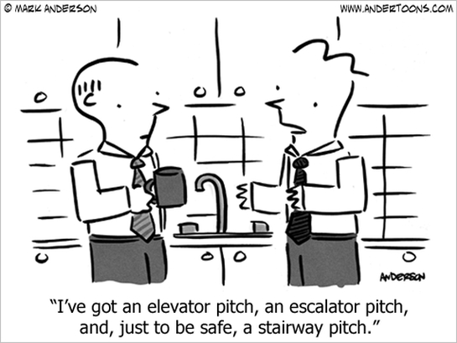
Elevator Pitch
The Study of Environmental Arctic Change (SEARCH) advances scientific knowledge of Arctic system processes to inform societal responses to Arctic change. Currently, SEARCH focuses on how diminishing sea ice, degrading permafrost, and shrinking land ice impact both Arctic and global systems. Emphasizing “knowledge to action”, SEARCH promotes original and collaborative research, synthesizes research findings, and broadly communicates the resulting knowledge to Arctic stakeholder, residents, policy-makers, and the public. As a collaborative program of Arctic researchers, funding agencies, and other stakeholders, SEARCH maintains a flexible and crosscutting structure in order to remain responsive to new challenges and opportunities in a rapidly changing Arctic, and to provide science-based answers to decision-makers’ most pressing questions.

Slide 8
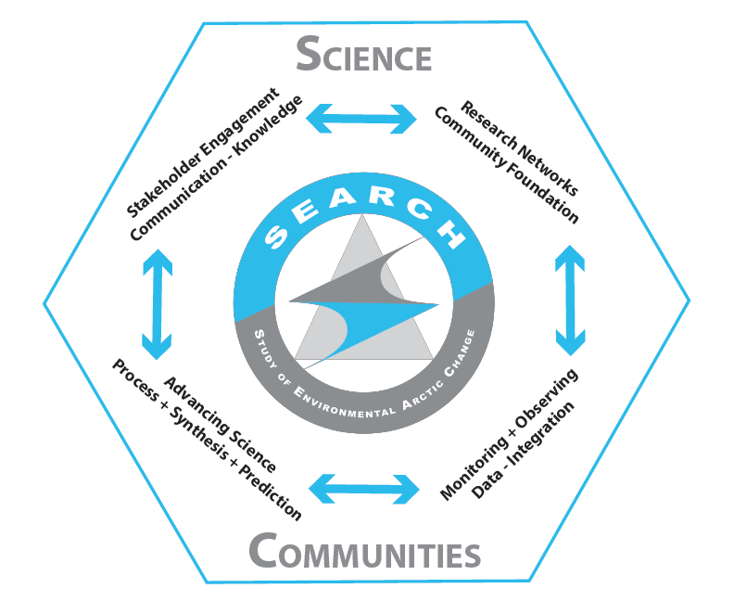
Key Audiences
Two types of communication:
Listen & Inform

Slide 9
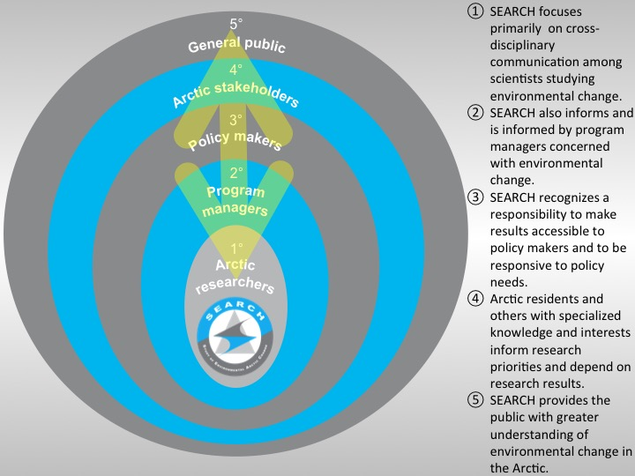

Slide 10
INFORM
PERMAFROST
S
T
A
K
E
H
O
L
D
E
R
S
POLICY
MAKERS
DECISION
MAKERS
AGENCIES
RESIDENTS
MEDIA
PUBLIC
SEA ICE
LAND ICE
S
E
A
R
C
H

Slide 11
LISTEN
PERMAFROST
S
T
A
K
E
H
O
L
D
E
R
S
POLICY
MAKERS
DECISION
MAKERS
AGENCIES
RESIDENTS
MEDIA
PUBLIC
SEA ICE
LAND ICE
S
E
A
R
C
H

Slide 12
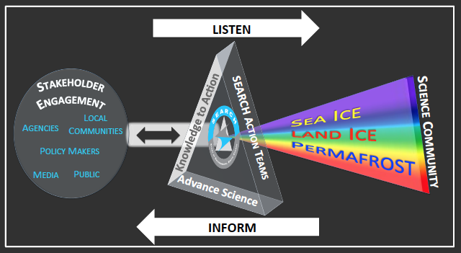
Draft Prism Model

Slide 13
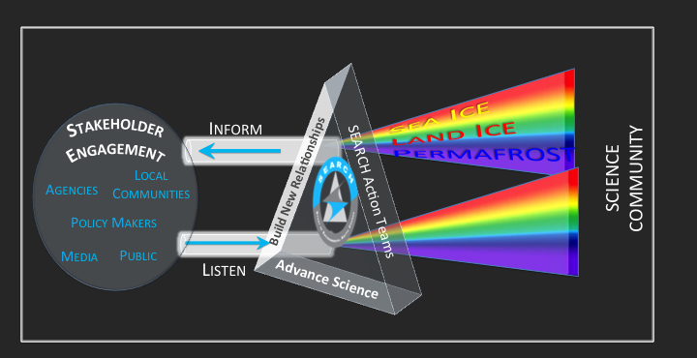
Draft Prism Model

Slide 14
Communication Matrix
Audiences
Communication products
Tools/formats
Where are we most effective?

